Slide 1


Supporting Real-Time Wireless Traffic through A High-Throughput Side Channel
Haoyang Lu and Wei Gao
University of Tennessee – Knoxville

Slide 2








Wireless Network Traffic
Real-time and Delay-sensitive Traffic
Bandwidth-demanding Traffic

Slide 3



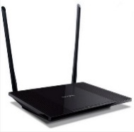

Contention for Wireless Channel
Real-time traffic
Can’t be delivered timely!
Wireless channel
Excessive latency
Bandwidth-demanding traffic
?

Slide 4
Outline
Traditional Solutions
Our Approach: Wireless Side Channel
Channel Decoding
Connection Establishment
Implementation & Evaluation
Summary

Slide 5
Network QoS Techniques
Quality of Service (QoS)-aware traffic scheduling
  Provide priority to real-time and interactive traffic to meet its latency requirement
TCP Flow control
  Control the sender’s transmission rate in order to meet the receiver’s processing rate
Lack of scalability
  What if the amount of traffic further increases?
Channel contention still exists

Slide 6
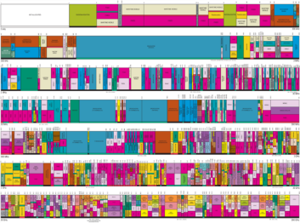

Spectrum-based Techniques
Reserved spectrum for real-time traffic
  Orthogonal Frequency-Division Multiple Access (OFDMA)
  Limitation: Performance degradation on other traffic
Extra spectrum specialized for real-time traffic
  Dedicated spectrum as a control plane in cellular network
  Limitation: scarcity of wireless spectrum
  Extra “free” spectrum?

Slide 7
Outline
Traditional Solutions
Our Approach: Wireless Side Channel
Channel Decoding
Connection Establishment
Implementation & Evaluation
Summary

Slide 8






Wireless Side Channel
Intentionally interfere the signal in the existing wireless channel* to convey extra data.
  No extra spectrum needed
  No channel contention at all.
AP
Wireless link
Alice
“Hi!”
“Hi!”
Bob
  * The existing wireless channel is named as the main channel

Slide 9
Requirements
Transparency: the main channel is not affected
  Increase Tx power for the main channel
    FCC constraint
High-throughput: sufficient for real-time applications
  Increased amount of patterned interference affects the main channel
Reliability: accurate side channel decoding
  Strong interference as high-power energy spikes
    Flashback [Mobicom’12]
    Low throughput due to the limited amount of throughput

Slide 10
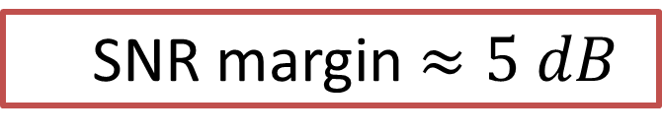


Transparency – Exploiting SNR Margin
SNR margin:
  Inaccurate SNR estimation
  Conservative rate adaptation
  For example, to support 12 Mbps in 802.11a (BER$≤0.1\%$) ,
  ${SNR}_{required}=5.8 dB$
  ${SNR}_{actual}≥10.7 dB$
$${SNR}_{actual}−{SNR}_{required}$$
By exploiting a small portion of the SNR margin, we can prevent main channel from degradation
  SNR margin $≈5 dB$

Slide 11
High-throughput – Energy Erasure
Patterned interference as energy erasure
  Data encoded as the position of erased OFDM subcarrier
  One or more erasures per symbol
High-Throughput
OFDM Symbol
Energy erasure

Slide 12
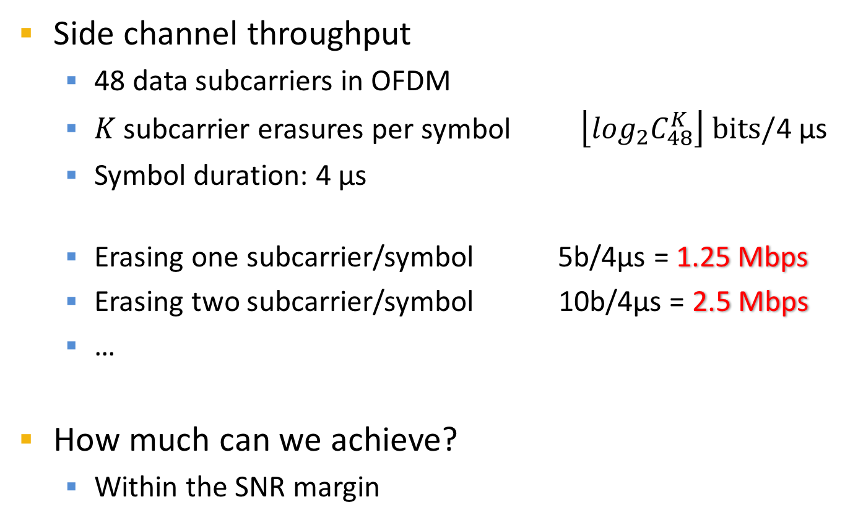
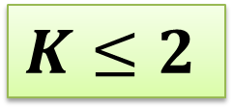
High-throughput – Energy Erasure
Side channel throughput
  48 data subcarriers in OFDM
  $K$ subcarrier erasures per symbol $\left\lfloor \log_{2}C_{48}^{K}\right\rfloor bits/\text{4 }\text{μ}\text{s}$
  Symbol duration: 4 μs
  Erasing one subcarrier/symbol 5b/4μs = 1.25 Mbps
  Erasing two subcarrier/symbol 10b/4μs = 2.5 Mbps
  …
How much can we achieve?
  Within the SNR margin
$$K≤2$$

Slide 13
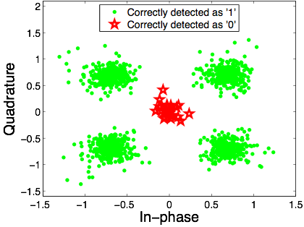
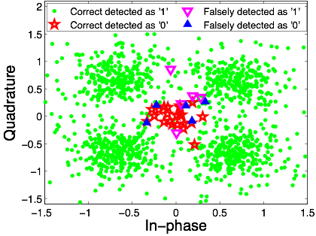
Reliability - Probabilistic Decoding
Decode side channel = Locate erased subcarrier(s)
Intuitive approach: Energy-based comparison
  Suitable for high-SNR scenarios
  Don’t take the statistics of channel noise into consideration
Our solution: Probabilistic decoding approach
20 dB
10 dB

Slide 14
Outline
Traditional Solutions
Our Approach: Wireless Side Channel
Channel Decoding
Connection Establishment
Implementation & Evaluation
Summary

Slide 15
Probabilistic Detection Algorithm
Channel response in frequency domain
Transmitted signal
Multipath fading
Main reason for misdetection
Received signal
AWGN

Slide 16
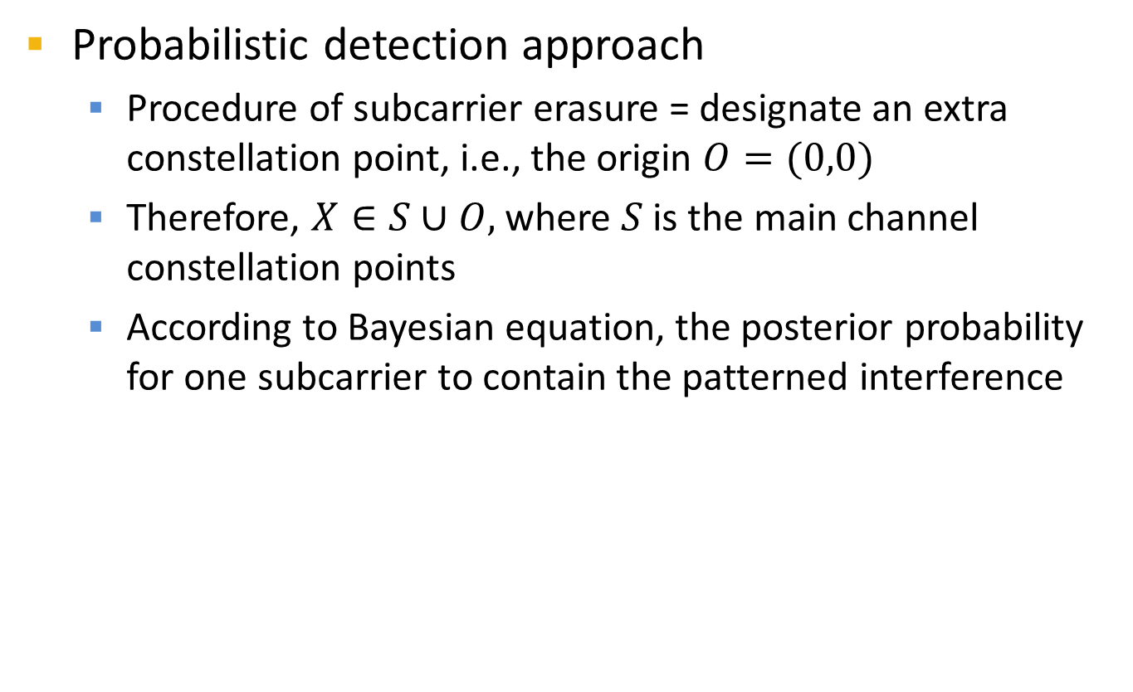

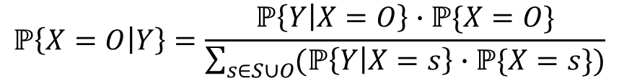
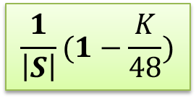

Probabilistic Detection Algorithm
Probabilistic detection approach
  Procedure of subcarrier erasure = designate an extra constellation point, i.e., the origin $O=(0,0)$
  Therefore, $X∈S∪O,$where $S$is the main channel constellation points
  According to Bayesian equation, the posterior probability for one subcarrier to contain the patterned interference
$$\frac{K}{48}$$
$$ℙ\left\{X=O | Y\right\}=\frac{ℙ\left\{Y | X=O\right\}∙ℙ\{X=O\}}{\sum_{s∈S∪O}{(ℙ\left\{Y | X=s\right\}}∙ℙ\{X=s\})}$$
Constant
$$\frac{1}{\left|S\right|}(1−\frac{K}{48})$$
$$∝\frac{ℙ\left\{Y | X=O\right\}}{\sum_{s∈S∪O}{ℙ\left\{Y | X=s\right\}}}$$
2-D AWGN continuously being estimated

Slide 17
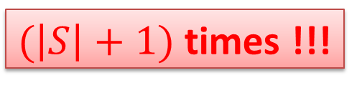
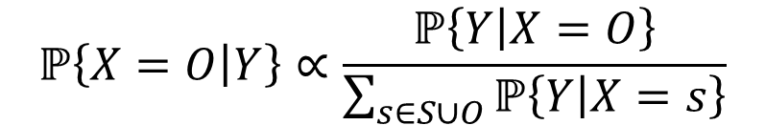

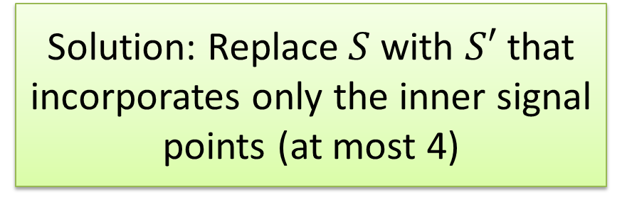
Probabilistic Detection Algorithm
$$ℙ\left\{X=O | Y\right\}∝\frac{ℙ\left\{Y | X=O\right\}}{\sum_{s∈S∪O}{ℙ\left\{Y | X=s\right\}}}$$
Limitation: Computational overhead
  $S$uses large constellation, such as 64-QAM. Require 65 times computation
$(\left|S\right|+1)$ times !!!
Solution: Replace $S$ with $S′$ that incorporates only the inner signal points (at most 4)

Slide 18
Outline
Traditional Solutions
Our Approach: Wireless Side Channel
Channel Decoding
Connection Establishment
Implementation & Evaluation
Summary

Slide 19
Challenge
Existence of side channel
  Background noise vs. patterned interference
  The existence of side channel MUST be clearly declared
Side channel addressing
  The destination of side channel MUST be declared
  Destination of side channel may be different with that of main channel

Slide 20
Connection Establishment
Attach preamble to regular WiFi frames
  The existence of preamble indicates the existence of side channel.
  Use the length of idle period between preamble and WiFi frames to indicate the destination address

Slide 21
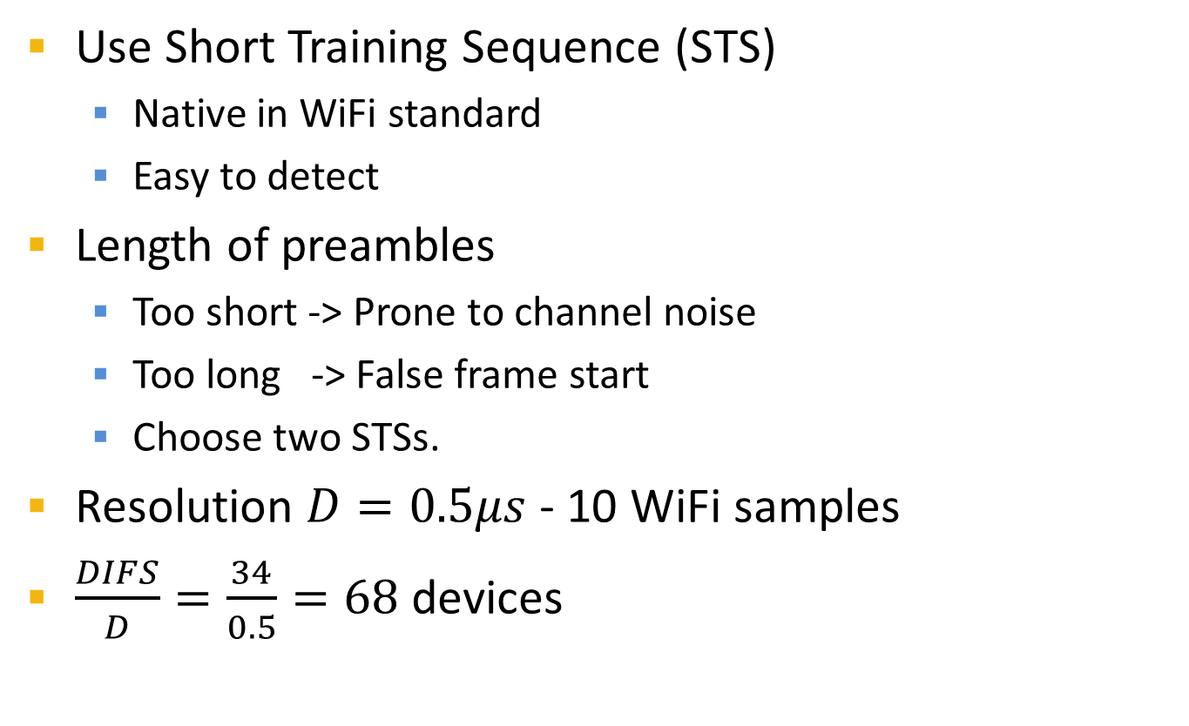
Preamble selection
Use Short Training Sequence (STS)
  Native in WiFi standard
  Easy to detect
Length of preambles
  Too short -> Prone to channel noise
  Too long -> False frame start
  Choose two STSs.
Resolution $D=0.5μs$ - 10 WiFi samples
$\frac{DIFS}{D}=\frac{34}{0.5}=68$ devices

Slide 22
Outline
Traditional Solutions
Our Approach: Wireless Side Channel
Channel Decoding
Connection Establishment
Implementation & Evaluation
Summary

Slide 23
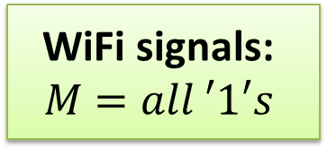

Implementation
Energy erasure = Masking (Multiplying) operation
  Implemented in frequency domain
  For example, to encode ${(11000)}_{2}={(24)}_{10}$, erase the 24th subcarrier, and the mask is $M=\underset{c_{31}}{\underbrace{1}}1…1\underset{c_{24}}{\underbrace{0}}$ $1…1$ $\underset{c_{0}}{\underbrace{1}}$
WiFi signals:
$$M=all ′1′s$$

Slide 24
Implementation over SDR
Software-Defined Radio (SDR) platform
  Hardware: USRP (N210 + UBX-40 RF frontend)
  Software: GNURadio
Two 802.11a transceivers (one Tx, one Rx)
Tune channel SNR: Adjust Tx Gain (2 - 30 dB)
5m x 5m office; NLOS; 5 GHz frequency band

Slide 25
Data Transmission Delay
Experiment setup
  Each UDP socket transmits 1kB-long frames every 100 ms
  One UDP as real-time traffic; Others as background traffic
Side channel:
Smaller delay
Less delay-jitter
Scalable
More congestion, more transmission opportunities, less delay!

Slide 26

Side Channel Detection Rate
BPSK & QPSK: nearly 100% when $SNR≥10 dB$
Detection rate improves as SNR increases.
Achieve more than 90% under actual SNRs
Erasing one subcarrier
Erasing two subcarrier

Slide 27
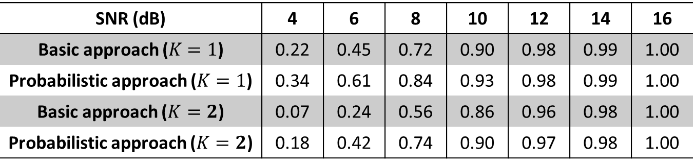
Side Channel Detection Rate
Detection rate of 9 Mbps data rate
Probabilistic approach can achieve up to 20% detection rate improvement over basic energy-based approach
SNR (dB) | 4 | 6 | 8 | 10 | 12 | 14 | 16
Basic approach ($K=1$) | 0.22 | 0.45 | 0.72 | 0.90 | 0.98 | 0.99 | 1.00
Probabilistic approach ($K=1$) | 0.34 | 0.61 | 0.84 | 0.93 | 0.98 | 0.99 | 1.00
Basic approach ($K=2$) | 0.07 | 0.24 | 0.56 | 0.86 | 0.96 | 0.98 | 1.00
Probabilistic approach ($K=2$) | 0.18 | 0.42 | 0.74 | 0.90 | 0.97 | 0.98 | 1.00

Slide 28
Side Channel Throughput
Side channel throughput (Mbps) with one subcarrier being erased in each OFDM symbol
SNR requirement with two subcarriers being erased in each OFDM symbol
  Required SNR to achieve 95% of 2.5 Mbps throughput

Slide 29
Main Channel Degradation
BER increase vs SNR
BER increase under 1% main channel BER
Less than 1% degradation in practical scenarios

Slide 30
Summary
Real-time traffic can be easily affected by concurrent bandwidth-demanding traffic in wireless networks
Our solution: wireless side channel over the existing wireless spectrum
  Exploitation of SNR margin
  Data encoded as energy erasure over OFDM subcarriers
  Accurate side channel decoding
A maximum of 2.5 Mbps with less than 1% performance degradation on the main channel

Slide 31
Thank you!
Questions?
The paper and slides are also available at:
http://web.eecs.utk.edu/~weigao/

