Slide 1
Code Offload with Least Context Migration in the Mobile Cloud
Yong Li and Wei Gao
The University of Tennessee, Knoxville
Notes:
Good morning, everyone. It is an honor for me to be here to present our paper “ Code Offload with Least Context Migration in the Mobile Cloud ”

Slide 2
Outline
Introduction
Motivation and related works
System design
Technical details
Evaluation
Notes:
This is the outline of the presentation. We would first introduce the background about mobile cloud computing in the application of mobile workload offloading. After then, we would present the motivation of our work. In system design and technical details, we will explain how do we achieve code offloading with the least context migration. We will show the effects of our system through experiment evaluation with real apps.

Slide 3
Outline
Introduction
Motivation and related works
System design
Technical details
Evaluation
Notes:
We would first introduce the background about mobile cloud computing in the application of mobile workload offloading. After then, we would present the motivation of our work. In system design and technical details, we will explain how do we achieve code offloading with the least context migration. We will show the effects of our system through experiment evaluation with real apps.

Slide 4
Cloud Computing for Mobile Devices
Contradiction between limited battery and complex mobile applications
Mobile Cloud Computing (MCC)
Offloading local computations to remote execution
Notes:
Current mobile phones are gaining increasing popularity and are doing more computationally expensively applications such as gaming, speech recognitions. These applications increase the requirements on smartphones’ capabilities in computation, communication, and storage, and seriously reduce the smartphones’ battery lifetime. Mobile Cloud Computing could be a viable solution to bridge the gap between limited capabilities of mobile devices and the increasing users’ demand of mobile multimedia applications, by offloading the computational workloads from local devices to the cloud, that is: moving part of the mobile program execution to remote cloud.

Slide 5
General Problems for Offloading
What to offload
Developers’ annotation, such as MAUI, ThinkAir
Online profiling, such as Odessa, COMET
How to offload (Our Focus)
Wrap the offloading method as RPC, like MAUI
VM synthesis, like CloneCloud, COMET
Notes:
There are generally two categories of research problems for workload offloading in MCC. The first one is what to offload. This research problem is to decide appropriate application
partitions so that users can benefit from workload offloading, since offloading itself will consume mobile resources. Some schemes rely on developers’ annotation to make offloading decision, like MAUI and ThinkAir. While others use online profiling techniques to monitor application executions to get profiling data, such as the CPU usage, energy consumption, and network latency. They make offloading decision based on these profiling data, like Odessa and COMET. The other category of offloading problem is how to offload, which is the focus of our work. One way of offloading is to wrap the offloading method as Remote Procedure Call, either in compilation phrase or runtime proxy, like MAUI. The other way is by VM synthesis, which sends the VM contexts to remote cloud and reconstruct the VM state in cloud, like CloneCloud and COMET.

Slide 6
Outline
Introduction
Motivation and related works
System design
Technical details
Evaluation
Notes:
Now we will talk how are we motivated for this work.

Slide 7
Existing Work
Restrict to a specific set of system frameworks and mobile applications
Unable to support existing mobile applications without modification, like MAUI and ThinkAir
Migrate a large amount of application contexts
Unnecessary contexts have been sent, like CloneCloud and COMET
Wireless communication is expensive!
Notes:
There are two major restrictions to the existing work. One is that they restrict the scope of the workload offloading to a specific set of system frameworks and mobile applications, like MAUI and ThinkAir. They require the programmers to annotate the applications code to do some preprocess during compilation so that the framework can handle the offloading logic for the developers. These annotations prevent the existing applications to be supported by the framework without modification. The other restriction is that the current schemes migrate a large amount of application contexts without considering the execution pattern of the application, like CloneCloud and COMET. However, the wireless communication is also expensive and takes a lot of energy. Our work is to design a system which offloads automatically by the mobile Operating System without programmers’ intervention and migrate the least but sufficient context to the cloud for offloading.

Slide 8
Motivation
Only part of memory contexts are necessary.
Notes:
Here I’d like to introduce some background about application execution. The execution of an application is consisted as a sequence of method execution in each thread. To preserve the method invocation chain, an invocation stack is maintained in each thread, and a stack frame will be associated to each invoking method. All the information relevant to the method execution, including current Program Counter (PC), method reference and registers, will be stored in the stack frame. (Show animation 1) In this example, the stack frame of method “calculate()” and “bar()” are shown in the right figure. To offload a method, we need only the information in its own stack frame. (Show animation 2) If we only want to offload method “bar()”, we will only need the information in stack frame of method “bar()”. We do not need the stack frame information of its invoker method “calculate()”. However, for COMET, their implementation will require the stack frame information of method “calculate()” is to be migrated as well even if the “calculate()” may not be able to be offloaded. (Show animation 3) Consequently, they will migrate two more array data contents to the cloud, resulting too much unnecessary data transmission.

Slide 9
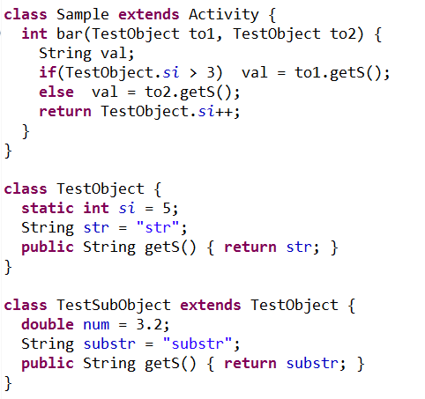
Motivation
Only part of memory contexts are necessary.
Notes:
We take a step further on reducing data transmission in offloading. By our observation, even for the argument objects of the method, only a portion of the object fields will be accessed during the execution of the offloaded method. For our example of method “bar()”, (Show animation 1) the execution of “getS()” invocation may access either the field “str” of “TestObject” or the field “substr” of TestSubObject. (Show animation 2) While the statement “TestObject.si” will access the static field “si” of “TestObject”. (Show animation 3) Thus we can see that throughout the execution of method “bar()”, it will have no chance to access the field “num” of the “TestSubObject”. As a result, it is a waste to migrate such fields which will never be accessed during the execution of the offloaded method.

Slide 10
Outline
Introduction
Motivation and related works
System design
Technical details
Evaluation
Notes:
Now we will introduce the high level idea of our system design.

Slide 11
Insights
Integrate with Android OS
Support existing application without modification
Automatic method offloading in Dalvik VM
Migrate least but sufficient memory context
Offline parsing to identify relevant memory context for a method
Utilize parsing result metadata to screen memory contexts during run-time execution
Notes:
The first insight of our system is that we build our offloading engine in the operating system level. Our offloading engine can interact with the application binaries without any modification so that we can support the existing android applications. When the method is qualified to be offloaded, our framework can intercept the method execution and offload automatically. The other insight of our system is that our system will migrate least but sufficient memory context during offloading. We achieve this effect by identifying the memory contexts that may be accessed by a specific application method, through offline parsing of the application executables. The parsing results will be stored as metadata and utilized by the run-time application execution to select the relevant memory contexts for remote execution.

Slide 12
System Design
Components:
Offline parsing - identify the relevant contexts
Run-time migration – handle offloading process
1. Parsing req
2. Send back
3. load
4. Migrate to cloud
5. Context load & execute
6. Migrate back
Notes:
There are two major components in our system. One component is for Offline Parsing and the other is for Run-time Migration. The purpose of the Offline Parsing component is to identify the relevant memory contexts that a method may operate. While the Run-time Migration component is to handle the offloading process between mobile and cloud. The offloading function is working in the following procedure:
(Show animation 1) After user installs an application from Google Play, Application Installer will send a request to cloud asking for method parsing component to work.
(Show animation 2) After offline parsing component finishes identifying memory contexts, the result will be persisted as metadata and send back to mobile.
(Show animation 3) When user launches an application, its application binary and parsed metadata will be loaded by Dalvik Virtual Machine.
(Show animation 4) When a method is qualified to offload, its invocation will be intercepted and offloaded to cloud. In this step, the parsing metadata will be utilized to find out the memory context necessary for the method to run in cloud.
(Show animation 5) The cloud will do an VM synthesis to reconstruct the execution environment upon all the memory contexts are received.
(Show animation 6) When the cloud completes the method execution, the modified memory contexts will be migrated back to mobile and mobile continues to run.

Slide 13
Outline
Introduction
Motivation and related works
System design
Technical details
Evaluation
Notes:
Now we will introduce the detail design of our system.

Slide 14
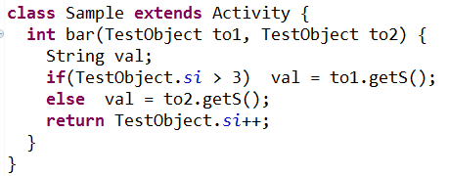
Input data sources for method
Two input data sources for a method:
Method arguments
Class static fields
this
Notes:
Prior the introduction of our details of our system components, we first need to know that there are generally two sources of inputs data available to a method: method arguments and class static fields. (Show animation 1) The method arguments are the parameters of a method, which are “to1”, “to2” for method “bar()”. Since “bar()” is an instance method, its invoking instance “this” will be automatically added as a method argument. (Show animation 2) The class static field is the field declared as static in a class definition, which is “TestObject.si” in the example.

Slide 15
Offline Parsing Components
Method Argument Parsing Component
To determine which fields in the input arguments may be accessed during method execution.
Go through all the possible execution paths
Emulate the instruction effects to find out the accessing field of an object
Class Static Field Parsing Component
To find out which class and its static fields may be operated by a method.
Parse only the static field access instructions
Notes:
Thus we designed a parsing component for each source of method inputs. Both components will do an offline parsing to identify the migration contexts needed for the method. In specific, the Method Argument Parsing Component is responsible for determining
which fields in the input arguments may be accessed during method execution. It will go through all the possible execution paths in a method. For each possible execution path, it will emulate the instruction effects to the virtual registers to determine which field of an object will be accessed. While the Class Static Field Parsing Component is responsible for finding out which class and its static fields may be operated by a method.

Slide 16
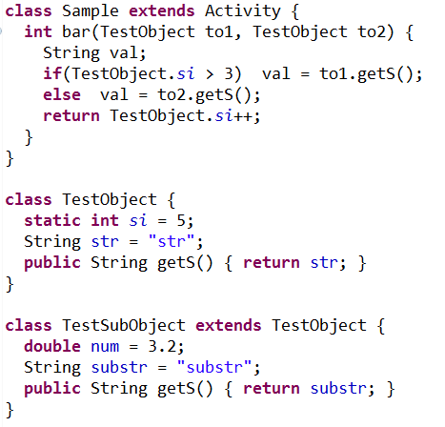
Method Argument Parsing Component
Go through all the possible execution paths
Control statements
Polymorphism
Notes:
For a method to be executed, there may be multiple possible execution paths due to Java polymorphism and the control statements, like if/else and loop. Anyone of these execution paths can happen. The actual execution path cannot be determined until run-time execution of the method. Since we are doing offline parsing, a conservative way needs to be adopted. The parsing should go through every path and combine the result for each path as the final result. (Show animation 1) For the example, the if/else statements in the method “bar()” split the execution path into two on the condition of “TestObject.si”. (Show Animation 2) After then, the polymorphism created by the “TestSubObject” makes the execution paths further split, resulting four possible paths in total. (Show animation 3) Even though the actual path may be the orange one, we cannot predict during the offline parsing. All the parsing result for these four paths need to be included in the final result.

Slide 17
Method Argument Parsing Component
Emulate the instruction effects to find out the accessing field of an object
Object Manipulation (Read):
Notes:
For each individual execution path, we will parse the instructions in this path sequentially by emulating the instruction effects to the virtual registers. In the system, we maintain a list of virtual registers keeping object references. For every instruction in the current execution path, the system will change the content of the virtual registers according to the semantic of this instruction. We will use object manipulation instruction to illustrate our idea. You can refer to paper to know more.
This instruction is to read the field of an object or put the content into the result register. For example in the method “getS()”, it has one field read instruction and register v1 refers to the object “to1”. When parsing this instruction, the system mark field “str” of “to1” as needing to be migrated and set the content of register v0 as the field “str” of “to1”.

Slide 18
Class Static Field Parsing Component
Identify relevant class static field
Parsing instructions manipulating class static field
Not considering execution paths
Notes:
The Class Static Field Parsing Component is to identify the other source of method inputs, which is the class static field. The system will go through the application binary and parse the instructions which manipulate class static fields. For this example, the system find that “TestObject.si” will access the static field “si” of “TestObject”. It will be marked this static field as needing to be migrated. This component is different from Method Argument Parsing Component in that it doesn’t take the diversity of code execution paths into consideration. This is because the instruction already contains the class and field information in the binary, which can be resolved offline.

Slide 19
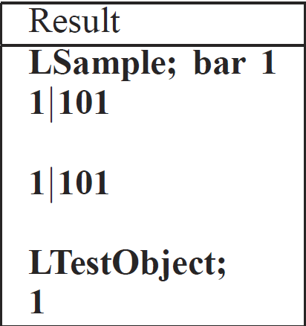
Metadata Maintenance
Java object can be organized as a tree-based structure
Record Parsing result by breadth-first traversal of the object trees
Notes:
The parsing results need to be efficiently recorded and maintained so that they can be applied for run-time migration and selectively migrating the relevant memory contexts for remote method execution. In practice, the memory contexts of a Java object can be organized as a tree-based structure, with the object itself as the root. All the instance fields and static fields of a class object can be considered as the children of the root object. Based on this tree structure, we construct the parsing result metadata by a breadth-first traversal. If a field will be accessed at run-time, “1” will be written into the metadata file, otherwise “0” is written. For this example, the first line is the key for this method, which will be used to index the metadata of this method at run-time. The numbers following the key indicate that the field “str” and “substr” of “to1” need to be migrated, while the field “num” will not be accessed at run-time. The class static field access information is constructed as the pair of class name and its field access information. In the example, the “TestObject” class and its static field “si” will be accessed.

Slide 20
Run-time Migration Component
1. Method Invocation Tracking
2. Context Migration
to the Cloud
3. Context
Reload
on the
Cloud
4. Context Migration Back to Local Device
Notes:
Then we introduce our runtime migration component. The Run-time Migration Component monitors the runtime execution of Android applications, and offloads the method execution automatically. The offloading process contains four steps. The first one is Method Invocation Tracking. It will track the entries of the method invocation. If a method is qualified to be offloaded, its execution will be intercepted and ready to be offloaded. The second step is collecting relevant memory context of the offloading method and migrating them to the remote cloud. The third step is reload the memory contexts on the cloud upon all the contexts are received. When the contexts are ready, the cloud VM will start the execution of the offloaded method. The last step is context migration back to local device when the method finishes its execution on the cloud.

Slide 21
Context Migration to the Cloud
Offline parsing result metadata
Dirty flag for every memory object by DSM
Notes:
This migration step aims to collect and migrate the least but sufficient memory contexts for the offloaded method. The system will utilize the offline parsing result to select memory contexts which are marked as needing to be migrated. Any memory contexts which are not marked will be excluded from the migrating list. In addition, since we are using distributed shared memory between mobile and cloud, any memory contexts which have already been synchronized and keeping unchanged should be avoided to be migrated. (Show animation 1).Thus, the system will only migrate the memory contexts which are marked during offline parsing and dirty. For example, the field of “str” in “to1”, “substr” of “to2” and static field “si” of class “TestObject” will be migrated to remote. While the rest will not be migrated either because of the offline mark flag or the dirty flag. (Show animation 2) After execution, since the static field “si” of class “TestObject” has been changed, we will migrate “si” back to the mobile.

Slide 22
Outline
Introduction
Motivation and related works
System design
Technical details
Evaluation
Notes:
Now we will introduce the performance evaluation result of our system.

Slide 23
Performance Evaluations
Evaluation metrics:
Method execution time
Amount of energy saved
Amount of data transmission
Comparison with existing work:
For some experiments, we compare our system with COMET on data transmission and overhead
Notes:
We evaluate our system in three metrics. The first is method execution time. It measures the average elapsed time of method executions with and without offloading over multiple experiment runs. The second metric is amount of energy saved with offloading, which measures the average amount of local energy consumption. The last metric is the amount of data transmitted during offloading. We did a comparison to the COMET system for some experiments on data transmission and the overhead of both systems.

Slide 24
Evaluation Setup
Evaluation against real Android mobile apps
Metro trip planner, Poker assistant, Sudoku game
Offloading decision
Same as COMET - History average execution time over a threshold
Experiments
30 times with different input datasets for each application
Notes:
We evaluate our system against three real Android mobile apps downloaded from Google Play – A metro trip planner, a poker game assistant and a Sudoku game. We make our offloading decision over the history average execution time for every method. If its average execution time exceeds a given threshold, the future execution of this method will be offloaded to cloud. Each experiment on a mobile application is conducted 30 times with different input datasets

Slide 25
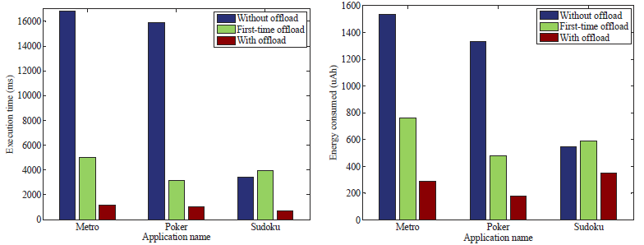
Offloading Effectiveness
5 times speed up
40% energy saved
Notes:
From our system evaluation result, we can see that we can get at least 5 times speed up in application execution. In addition, we can get 40% of energy saving in the offloaded method execution. In the Metro and poker game which are more computation intensive, we can achieve even greater offloading benefits. In particular, the case of “First-time offload” in the figure means the first time when the application methods are offloaded to the remote cloud. This is a special case since a large set of class static fields that will never be changed in later execution needs to be migrated and hence incurs additional execution time.

Slide 26
Offloading Effectiveness
Amount of data transmission during workload offloading
Reduce 40% of data transmission for the first time offloading
Reduce 70% of data transmission after first time offloading
Notes:
From the table we can see that for the first-time offloading in each application, we can save the data traffic around 40% by screening out the class static fields which will not be used in this offloaded method. While for the future offloading, we can achieve up to 70% of data transmission reduction even for the worst case of Sudoku game. The major reason for such advantage is that our scheme is able to predict which contexts will be used during method execution and hence selectively migrates them.

Slide 27
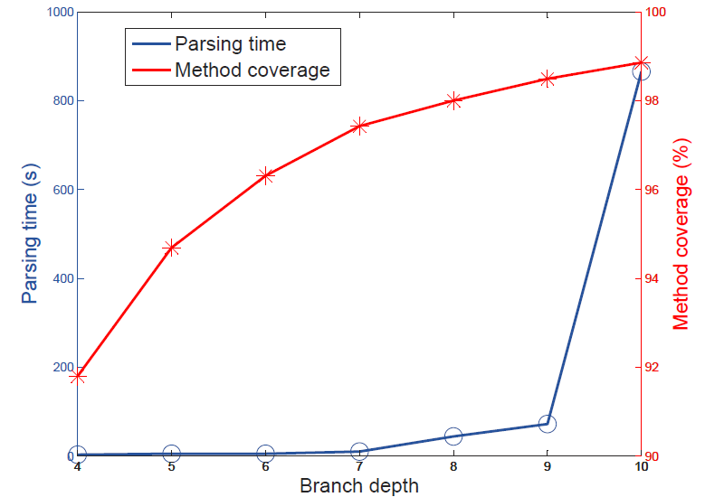
Parsing complexity
By reducing the nested branching depth, we can reduce the parse time significantly without affecting too much parsing method coverage
Notes:
As shown in the table, in general, we are able to control the offline parsing time within two minutes, which ensures prompt response to the subsequent user operations on mobile applications after installation. However, if the application involves more complicated program structure, the parsing time will increase to more than 10 minutes in Sudoku game. By reducing the nested branching depth, we can reduce the parse time significantly, while only reduce the method parsing coverage slightly.

Slide 28
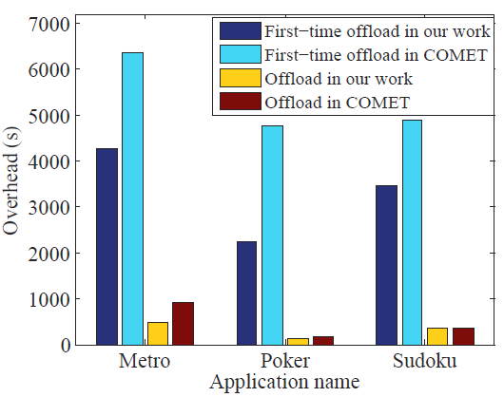
Offloading Overhead
Measured as average amount of time spent on collecting the memory contexts to be migrated
Slightly less overhead
Notes:
We measured the offloading overhead in our system as the average amount of time spent on collecting the memory contexts to be migrated. Even though we will screen the memory contexts with the parsing result, we can achieve slightly less overhead because we will transfer less data leading to less data transmission time.

Slide 29
Thank you!
Questions?
The paper and slides are also available at:
http://web.eecs.utk.edu/~weigao

