Slide 1
Forwarding Redundancy in Opportunistic Mobile Networks: Investigation and Elimination
Wei Gao¹, Qinghua Li² and Guohong Cao³
¹The University of Tennessee, Knoxville
¹University of Arkansas
³The Pennsylvania State University

Slide 2
Outline
Introduction
Motivation and focus
Investigation of forwarding redundancy
Elimination of forwarding redundancy
Performance evaluation
Conclusion

Slide 3
Opportunistic Mobile Networks
Consist of hand-held personal mobile devices
  Laptops, PDAs, Smartphones
Opportunistic and intermittent network connectivity
  Result of node mobility, device power outage, or malicious attacks
  Hard to maintain end-to-end communication links
Data transmission via opportunistic contacts
  Communication opportunity upon physical proximity

Slide 4
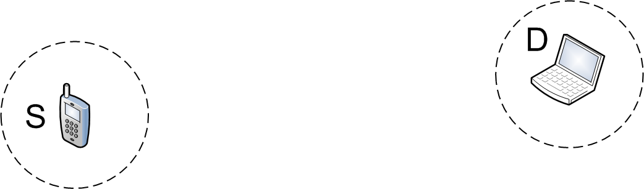
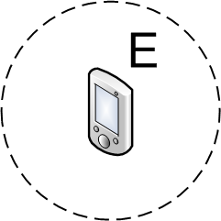
Methodology of Data Transmission
Carry-and-Forward
  Mobile nodes physically carry data as relays
  Forwarding data opportunistically upon contacts
  Major problem: appropriate relay selection
0.7
0.5
Notes:
As you can see from this example, S want to send data to D but does not have end-to-end links to D, so S has to determine whether to use A or B as relay. Suppose we know that B’s probability to contact D (0.7) is higher than that of A (0.5), than S is able to make the correct relay selection decision as B, and B will carry and forward data to the destination. In general, such relay selection may take multiple hops, as A may further select C as relay.

Slide 5
Forwarding Utility and Strategy
Forwarding utility
  A node’s capability of contacting others in the future
  The numbers 0.5 and 0.7 in the previous slide
  Evaluated based on node mobility or contact patterns
Forwarding strategies
  Built on specific routing utilities
  Determine
    Which one to be the relays
    How many relays to choose
  Tradeoff between forwarding performance and cost
    Each additional relay increases the likelihood of data delivery
Notes:
Forwarding metric: in the example in the previous slide, node A and B have different capabilities of contacting the destination D in the future.
The forwarding strategy can select both A and B as relays, or just pick up one (A or B) as relay. Each additional relay will anyway, more or less, increase the likelihood of data delivery, but also increase the cost. Therefore, the story lies on: whether a relay could provide sufficient contribution to data forwarding, so that selecting this relay is worthwhile. Different forwarding strategies have different standing points on this tradeoff.

Slide 6
Outline
Introduction
Motivation and focus
Investigation of forwarding redundancy
Elimination of forwarding redundancy
Performance evaluation
Conclusion

Slide 7
Forwarding Redundancy
The forwarding utility of each relay is evaluated separately
  Multiple relays may contact the same nodes
  Utilities do not reflect relays’ actual contribution on data forwarding
  Depend on the specific sequence of relay selection
Reduced effectiveness of resource utilization
  Redundant data replicates
  Less-efficient utilization of channel bandwidth and local storage
  Impairing cumulative data forwarding performance

Slide 8
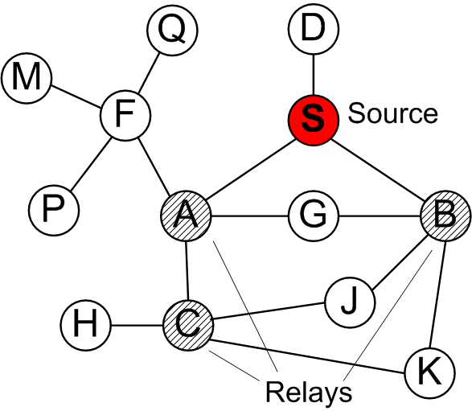
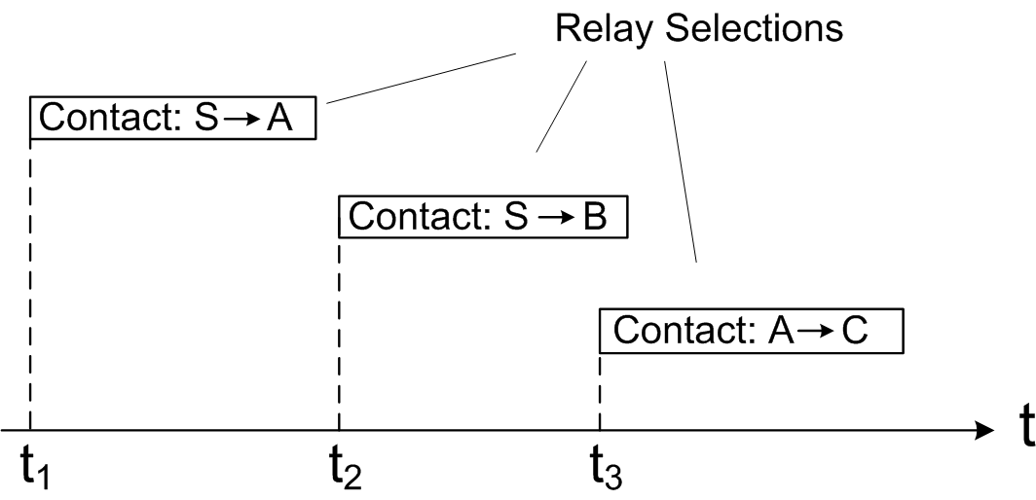
Forwarding Redundancy
An illustrative example
  B’s contribution of delivering data to G is reduced by the existence of A
  Similar case happens on J between the relays B and C
Notes:
Note that the forwarding redundancy is highly determined by the sequence of relay selection: A first, B second, then A selects C.

Slide 9
Modeling and Formulation
Network modeling
  Node contacts are described by the network contact graph (NCG) G(V,E)
    Contact process between nodes is described by
Forwarding redundancy is measured by:
  Redundancy percentage for k existing relays during time period (t₁, t₂) is
  if j is contacted by the i-th relay during (t₁,t₂)
Notes:
Thus, the size of the union of the sets N_i(t_1,t_2) is the total number of nodes which are contacted by *any* of the relays during this specific time period. The denominator, however, is simply summing up the individiaul N_i’s, but different N_i’s may overlap with each other.

Slide 10
Outline
Introduction
Motivation and focus
Investigation of forwarding redundancy
Elimination of forwarding redundancy
Performance evaluation
Conclusion

Slide 11
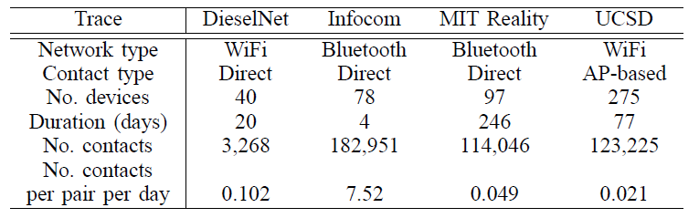
Experimental Investigations
Trace-based studies
  Experimental validation of the existence of forwarding redundancy in practice
  Traces: contacts among mobile devices with Bluetooth or WiFi interfaces moving in various scenarios

Slide 12
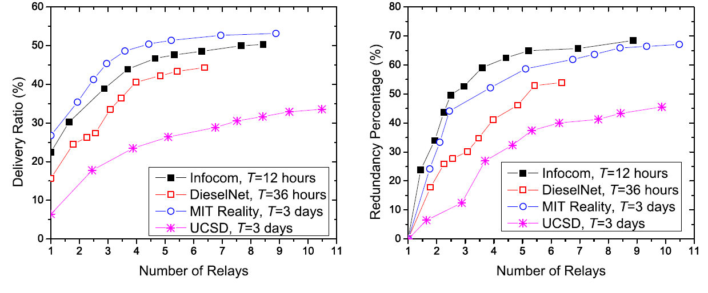
Impact of Forwarding Redundancy
Data forwarding experiments with random sources and destinations
  The increase of data delivery ratio becomes smaller when more relays are selected, due to the forwarding redundancy among relays

Slide 13
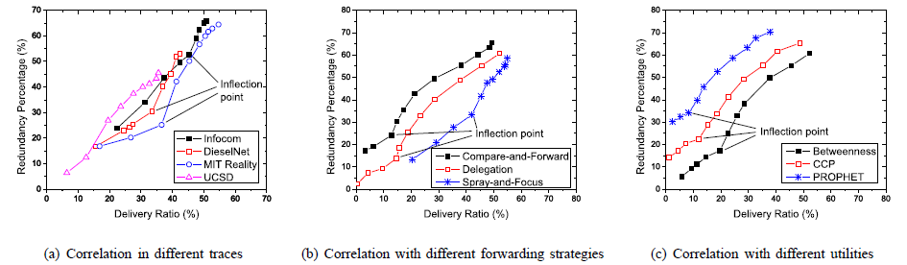
Correlation Analysis
Correlation between data delivery ratio and redundancy percentage
  Inflection points in all cases
  Small amount of redundancy helps improve performance
  Excessive redundancy is simply unnecessary

Slide 14
Outline
Introduction
Motivation and focus
Investigation of forwarding redundancy
Elimination of forwarding redundancy
Performance evaluation
Conclusion

Slide 15
Redundancy Elimination
Identify and eliminate the forwarding redundancy
  Relays’ utilities should reflect their actual contributions to data forwarding
    Dynamic during the data forwarding process
  Ensure efficient utilization of network resources
General idea: maintain the Cumulative Relay Information (CRI) for each message
  Contact capabilities of relays being selected for forwarding this message
  Compare the utility of a new relay with the current CRI

Slide 16
Global Elimination
Global CRI maintains a quantity for each node i
  The cumulative capability of the current k relays contacting node i.
  When the (k+1)-th relay is selected, the CRI is updated as
    is the capability of the (k+1)-th relay contacting node i
Forwarding redundancy caused by the (k+1)-th relay on node i
  The difference between and

Slide 17
Global Elimination
CRI Computation varies according to different utility function
Probabilistic utilities
  : the probability that the (k+1)-th relay contacts node i
  : the cumulative probability that node i is contacted by at least one of the k+1 relays
  CRI update:

Slide 18
Global Elimination
An illustrative example
  Probabilistic utilities used as numbers on edges
Notes:
By eliminating the redundancy, the relays B and C’s utilities are reduced accordingly, so as to reflect their actual contributions on data forwarding.
For example, for B, since A has been a relay when B is selected as a relay, B’s contact with G is redundant. Removal of such redundancy reduces B’s utility from 2.4 to 1.14 (using the formula in the previous slide).
Similarly, the redundancy of C on J is also removed.
For global redundancy elimination, we assume that every node in the network is aware of the complete CRI information among all the selected relays.

Slide 19
Distributed Elimination
Each relay maintains CRI in a distributed manner based on its local knowledge
Challenge: CRI maintained at different relays may be incomplete and overlap with each other
Solution: maintain CRI at a more fine-grained level
Notes:
When B is selected as the relay, A has been selected. So B gets A’s information from S. However, B does not know the existence of C, so the CRI at B and C could be incomplete and different.
When B contacts C, they exchange and merge their maintained CRI.

Slide 20
Accuracy Analysis
Main reason for incorrect redundancy elimination: CRI incompleteness
  A relay may not be aware of the existence of some other relays
  “Blind Zone”

Slide 21
Accuracy Improvement
Pre-regulation of forwarding process
  Minimize the size of Blind Zones
Posterior relay adjustment
  Detect both false-positive and false-negative errors of relay selection
  False-positive: a node with high redundancy is incorrectly selected as a relay
  False-negative: a node with high utility is incorrectly excluded from relay selection due to forwarding redundancy on other relays
Notes:
The accuracy improvement methods include stages both before and after the relay selection process.
Pre-regulation: before relay selection
Posterior adjustment: after relay selection

Slide 22
Outline
Introduction
Motivation and focus
Investigation of forwarding redundancy
Elimination of forwarding redundancy
Performance evaluation
Conclusion

Slide 23
Performance of Redundancy Elimination
MIT Reality trace
  One message is generated every hour from random data sources
  Use the local buffer more efficiently via redundancy elimination

Slide 24
Performance of Error Detection
False positive error is more dominant, especially when the number of relays is small
False positive errors are also easier to be detected

Slide 25
Conclusion
Forwarding redundancy in opportunistic mobile networks
  Generally ignored by current forwarding protocols
  Inefficient relay selection and utilization of network resources
Redundancy investigation
  Experimental validation of the existence of redundancy
Redundancy elimination
  Elimination with global knowledge
  Distributed elimination at individual relays
  Elimination accuracy analysis and improvement

Slide 26
Thank you!
Questions?
The paper and slides are also available at:
http://web.eecs.utk.edu/~weigao

