Slide 1
User-Centric Data Dissemination in Disruption Tolerant Networks
Wei Gao and Guohong Cao
Dept. of Computer Science and Engineering
Pennsylvania State University

Slide 2
Outline
Introduction
Models
Data Dissemination Approach
Theoretical Analysis
Performance Evaluation
Summary & Future Work

Slide 3
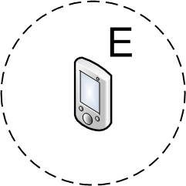
Transmitting Data in DTNs
Laptops, PDAs, Smartphones…
Intermittent and opportunistic network connectivity
Carry-and-Forward
Mobile nodes physically carry data as relays
Major problem: appropriate metrics for relay selection
0.7
0.5
Notes:
Based on this basic methodology, a lot of work has been done on developing effective relay selection methods for forwarding data to a pre-specified set of destinations in DTNs. However, in this paper, we target a different, more general but also more challenging problem: data dissemination in DTNs.

Slide 4
Our Focus
Data dissemination in DTNs
Applications: event notification, content publishing
User-centric data dissemination
Focus on satisfying user interests
Data is disseminated only to the interesters, i.e., the nodes being interested in the data
Existing network-centric schemes
All the nodes in the network are data recipients
Some nodes may not be interested in the data
Notes:
This dissemination still relies on appropriate relay selection strategy, but faces many new challenges.

Slide 5
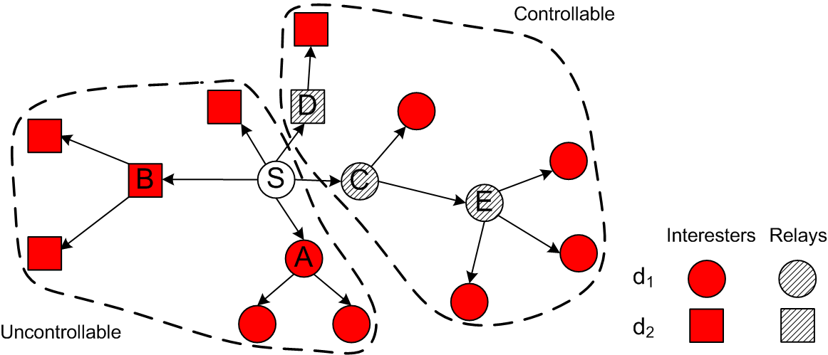
The Big Picture
Uncontrollable dissemination
A node itself determines whether to be interested in the data
Interesters act as relays
Controllable dissemination
Relays are intentionally selected among non-interester nodes according to their capabilities of forwarding data to interesters
Notes:
Since the interests of a node is generally independent from its contact capability, the effectiveness of interesters acting as relays and forwarding data to other interesters are basically random and unreliable.
Relays are selected based on the capabilities of forwarding data to the interesters, so the cost-effectiveness is controllable and reliable.
We don’t consider interesters to select relays, because in that case we are not able to maintain the cost-effectiveness ratio on those relays and control the cost-effectiveness.

Slide 6
Problem Formulation
n data items generated at source nodes S₁,S₂,…,S_{n} with time constraints T₁,T₂, …,T_{n}
Maximize the cumulative dissemination cost-
effectiveness
: the number of relays selected for data d_{i} at time t
: the estimation at time t on the number of interesters that will receive data d_{i} by time T_{i}
Local estimation at individual relays
Notes:
We focus on disseminating data to the interesters with the minimum cost, which is measured by the number of relays. We maximize the ratio when the dissemination ends, but this is done by estimating and maximizing the up-to-date ratio during the dissemination process.
Local estimation: for example, if I select a relay at 12pm, and the data expires at midnight, N_I just estimates how many interesters that this relay can deliver data to within the remaining 12 hours.

Slide 7
Challenges
Uncertainty of data recipients
Interesters are unknown a priori and it is hard to estimate at individual relays
Relay selection is more challenging
Notes:
It is basically difficult to estimate the quantities N_I at individual relays based on their limited local knowledge, and hence hard to make the decision of selecting appropriate relays.
Obviously, to maximize the cost-effectiveness, the selected relays should maximize the estimated N_I. However, it is difficult to estimate N_I only based on local knowledge.

Slide 8
Major Contributions
Centrality-based approach to relay selection which considers social contact pattern and user interests simultaneously
Theoretical insight on the dissemination cost-effectiveness
Tradeoff between dissemination cost-effectiveness and overhead maintaining network information
Notes:
Our major approach is to select relays based on the node centrality values, and we extend the existing centrality-based schemes in data forwarding, such that node centrality values incorporate both their interests and contact capabilities, and hence are able to indicate a node’s capability of forwarding data to the corresponding interesters.
Tradeoff: estimation N_I accuracy vs. overhead maintaining network information

Slide 9
Outline
Introduction
Models
Data Dissemination Approach
Theoretical Analysis
Performance Evaluation
Summary & Future Work

Slide 10
Network Model
Node contacts are described by the network contact graph G(V,E)
Contact process between nodes is described by \
Pairwise inter-contact time is assumed to be exponentially distributed

Slide 11
User Interest & Data Model
Probabilistic modeling
Keyword-based model on user interest and data
Fixed keyword space with size M

Slide 12
User Interest & Data Model
Interest profile of user i
probability vector
p_{ij}: i’s probability to be interested in the j-th keyword
Data item
n keywords and weights indicating the importance of k_{i} in describing data
Vector where
User interest probability:
Node i’s interest probability is estimated by other nodes
Notes:
Note that, this user interest probability is just used for other nodes in the network to estimate the interest of a particular node in the data, based on its interest profile.

Slide 13
Outline
Introduction
Models
Data Dissemination Approach
Theoretical Analysis
Performance Evaluation
Summary & Future Work

Slide 14
Centrality-based Approach
Relays should have good capability to forward data to interesters timely
Act as “communication hubs”
Key problem: centrality metric of relay
Notes:
For example, if I want to disseminate data to the interesters at the infocom conference site, it is a good strategy to give the data to the TPC chairs, because they are more likely to meet a lot of people, and can deliver the data to them if they are interested in the data.

Slide 15
Centrality Metric
Data-dependent metric considering social contact patterns and node interests simultaneously
Centrality of node i for data d_{k} at time
: set of nodes whose information is maintained by i
The information includes contact pattern and interest profile
Interest probability of node j in data d_{k}
Probability that node i can forward d_{k} to node j within time T_{k}-t
Notes:
In general, due to the intermittent network connectivity in DTNs, we cannot maintain the global knowledge about all the other nodes in the network. Instead, a node can only maintain part of the network information in a limited scope.

Slide 16
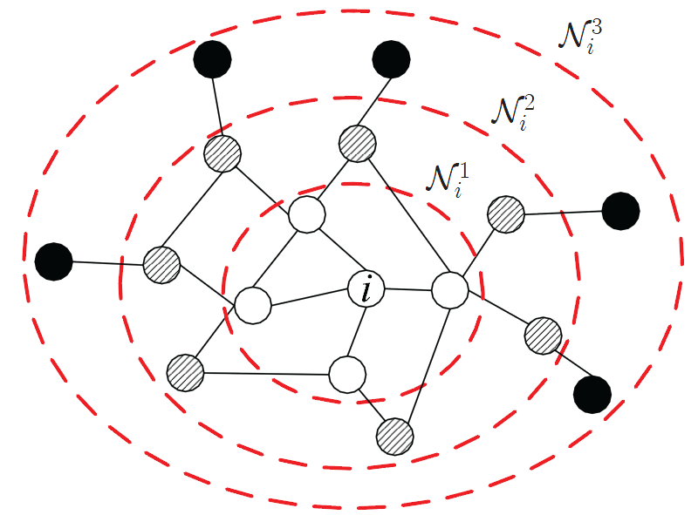
Centrality Metric
Different scopes for maintaining network information
: the r-hop neighborhood of node i on the network contact graph
Tradeoff between dissemination cost-effectiveness and maintenance overhead
Non-interester
Interesters
Notes:
Here, we see that the relay selection may not be optimal (You may miss some good relays) if you don’t have global knowledge, and this is an intrinsic limitation in DTNs due to the intermittent network connectivity.
Note that: you will NOT select bad relays….., only expect in the inevitable global optimality case.

Slide 17
Centrality Metric
When r =1,
When r >1: opportunistic path between node i and j
Path weight: the probability that data can be transmitted from i to j within time T_{k}-t
Notes:
We see that such calculation of path weight just rely on the pairwise contact rates of the edges on this path.

Slide 18
Relay Selection
At time t, a node i is only selected as relay by another relay j for data d_{k} if
j estimates that selecting i as relay increases the cost-effectiveness of disseminating d_{k}
Local estimation update:
Local estimations of relay j
Notes:
In order to select relays, each existing relay j locally estimates how many relays are selected in the network, and how many interesters can receive data via those selected relays.
After selecting i as relay, j updates its local estimations using node i ‘s centrality metric
Such local estimations may be inaccurate, but such update enables each relay to have a global view of the existing relays and their capabilities, so as to be able to (partially) control the dissemination cost-effectiveness globally.
Anyway, you cannot be able to ensure global optimality with local knowledge in a distributed environment.

Slide 19
Data Item Selection
A relay i may not have enough buffer to carry all the data items d₁,d₂,…,d_{m} simultaneously
Data items are selected to maximize the cumulative dissemination cost-effectiveness
Popular data is prioritized
Whether d_{k} is carried by i
Size of data d_{k}
Buffer size of node i
Contribution of d_{k} to the cumulative cost-effectiveness
Notes:
This contribution is just the increase of the cost-effectiveness of dissemination d_k if d_k is carried by the relay I

Slide 20
Outline
Introduction
Models
Data Dissemination Approach
Theoretical Analysis
Performance Evaluation
Summary & Future Work

Slide 21
Lower Bound of Cost-effectiveness
Dissemination cost-effectiveness of a specific data item with time constraint T
: set of interesters having received the data at time t₀
: set of selected relays at time t₀
For , the probability for the dissemination cost-effectiveness to increase
Network constants
Minimum user interest probability
Notes:
This lower bound is determined by both network contact pattern and user interests

Slide 22
Lower Bound of Cost-effectiveness
Implications
Dissemination cost-effectiveness increases with t₀
Dissemination cost-effectiveness is proportional to the relays’ contact capability and data popularity
Dissemination cost-effectiveness increases exponentially with time t
Notes:
Higher effectiveness when time elapses.
Our approach is sensitive to short time constraints, and will perform better when the time constraint increases. This comes from the assumption of exponential inter-contact time distribution.

Slide 23
Tradeoff between Cost-Effectiveness and Overhead Maintaining Network Information
When network information is maintained globally, relay selection is always optimal
r=R, where R is the diameter of network contact graph
Any selected relay increases the dissemination cost-effectiveness

Slide 24
Tradeoff between Cost-Effectiveness and Overhead Maintaining Network Information
When r<R, optimal probability of relay selection and maintenance cost increase at similar rates
For relay s, and , if
Node j is not good enough to be a relay either
Cost of maintaining r-hop network information is
Full flexibility to adjust r according to application requirements
Notes:
For a given relay s, if some node i within s’s neighborhood is not good enough as another relay, then for any node j which is (r+1)-hop away from i, which means that neither i nor s knows its information, the probability that j is a good relay candidate is very limited.
This means that if i is not selected as relay, you have very small probability to miss another good relay j.

Slide 25
Outline
Introduction
Models
Data Dissemination Approach
Theoretical Analysis
Performance Evaluation
Summary & Future Work

Slide 26
Trace-based Evaluations
Realistic DTN traces
Record contacts among Bluetooth-equipped devices

Slide 27
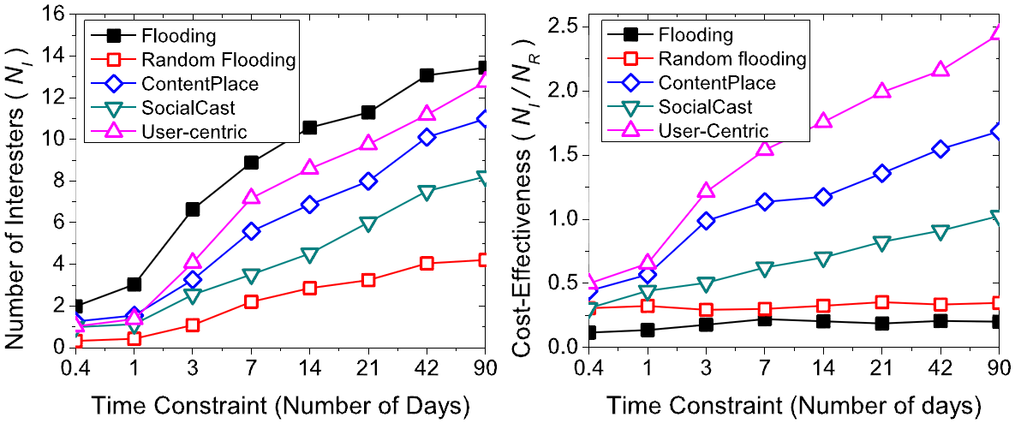
Performance Comparison
MIT Reality trace
Similar number of interesters with Flooding
Better dissemination cost-effectiveness

Slide 28
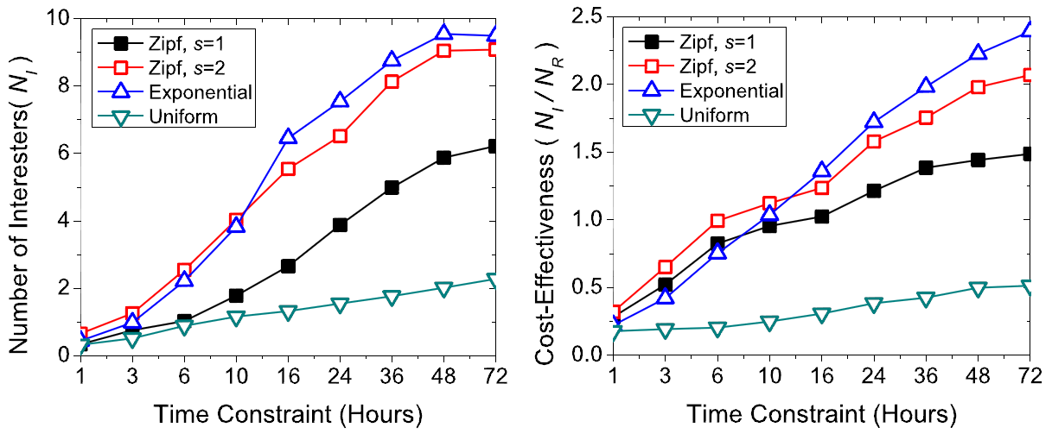
Different Distributions of User Interest
Infocom06 trace
Better performance when user interest concentrate on popular data

Slide 29
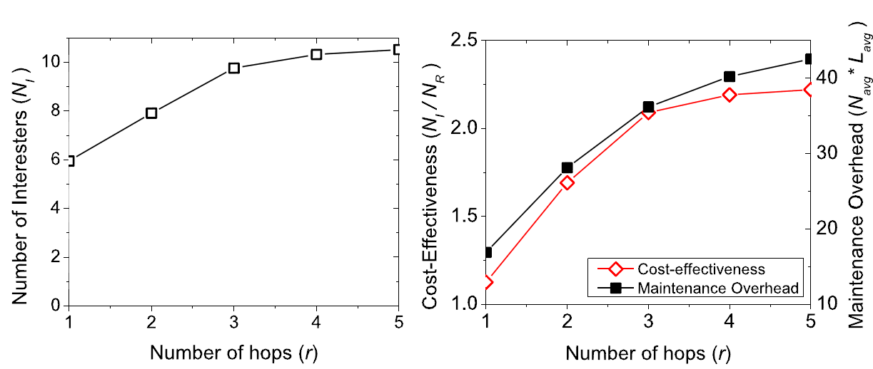
Different Ranges for Maintaining Network Information
7%
64%
Too large r does not help much

Slide 30
Summary
User-centric data dissemination in DTNs
Satisfying user interests and disseminate data only to the interesters
Centrality-based approach
Probabilistically consider social contact pattern and user interest simultaneously
Analytical results on the cost-effectiveness bounds and tradeoff
Future work
Further investigate the roles and impacts of user interests to data dissemination in DTNs

Slide 31
Thank you!
http://mcn.cse.psu.edu
The paper and slides are also available at:
http://www.cse.psu.edu/~wxg139

Slide 32
Opportunistic Path
Each hop corresponds to stochastic contact process with pairwise contact rates
X_{k}: inter-contact time between nodes N_{k} and N_{k+1}
Exponentially distributed
Y: the time needed to transmit data from A to B along the path
follows hypoexponential distribution

Slide 33
Schemes for Comparison
Random flooding
Each non-interester has a fixed probability to be relay
ContentPlace
Based on k-clique distributed community detection
Most Frequently Visited (MFV) policy to determine data utility
SocialCast
Based on “homophily” social phenomenon
Kalman filter for node co-location prediction

Slide 34
Simulation Setup
Keyword space with M=20
The k-th keyword also has the k-th popularity
User interest
Various distributions of user interest among keywords
Zipf, exponential and uniform
Data
5 data items to be disseminated
Each data item is described by 5 keywords with indexes [k, k+4]
k indicates data popularity

Slide 35
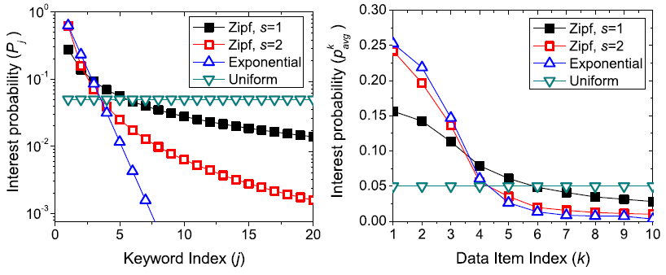
Simulation Setup

Slide 36
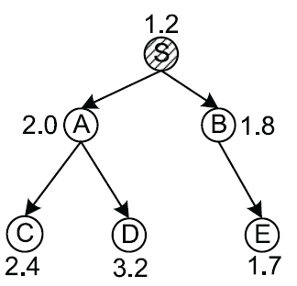
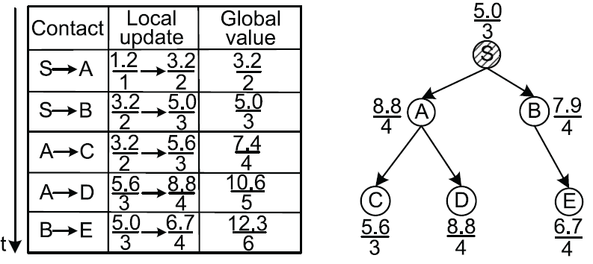
Global Optimality
Difficult with local knowledge
B is unaware of C and D
Node centrality values
Relay selection process
Local view
1.67→1.675
Global view
2.12→2.05

