Slide 1
On Exploiting Transient Contact Patterns for Data Forwarding in Delay Tolerant Networks
Wei Gao and Guohong Cao
Dept. of Computer Science and Engineering
Pennsylvania State University

Slide 2
Outline
Introduction
Trace-based Pattern Formulation
Data Forwarding Approach
Performance Evaluation
Summary & Future Work

Slide 3
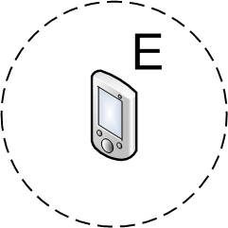
Data Forwarding in DTNs
Carry-and-Forward methods
Mobile nodes physically carry data as relays
Major problem: appropriate data forwarding metric for relay selection
Data forwarding metric measures the node’s capability of contacting others in the future
0.7
0.5
Notes:
The performance of data forwarding directly depends on the accuracy of such measurement, and improving such measurement accuracy is the major focus of this paper.
Delay Tolerant Networks consists of mobile computing devices such as laptops and smartphones. Due to the low node density and unpredictable node mobility, only opportunistic and intermittent network connectivity can be expected, and therefore data forwarding has to be done in a carry-and-forward manner.
More specifically, mobile nodes are used as relays to physically carry the data when they don’t have the wireless connection to other nodes to transmit the data. Data transmission will be done until the network connectivity is available, and relays will carry the data and move in the network during the mean time. For example, ….
It is easy to see from this example that, the key problem for this carry-and-forward is to determine an appropriate data forwarding metric for correct relay selection. That is, when an existing relay contacts another node, it determines whether to forward data to this node based on its forwarding metric.
In general, such metric should indicate the capability of a relay to forward data to the destination. However, in DTNs, due to the lack of global information at individual nodes about how to reach the destination, data forwarding metric usually measures the node’s general capability of contacting other nodes in the future.

Slide 4
Our Focus
Effective data forwarding metric for a short time constraint
Transient node contact pattern
Consider different time periods in a day
Node contact pattern may vary temporally
Relays selected based on cumulative contact patterns may not be the best choice during a short time period
Notes:
We generally notice the temporal non-stationarity of human mobility
The major focus of this paper is to develop effective data forwarding metrics, for data forwarding tasks with a short time constraint. Such data forwarding metric is based on the exploitation of transient node contact patterns.
Although various data forwarding metrics have been proposed in past, they are all based on the cumulative node contact patterns. However, when we consider data forwarding in a short time constraint, such as one day, the node contact pattern may vary temporally. In such cases, the relays selected based on the cumulative node contact capability may not be the best choice during a short time period.
Instead, relays should be selected based on their capability of contacting others during the short time period for data forwarding. Its capability during other time periods is irrelevant for data forwarding performance, and should not be considered. (Such consideration will even impair the correctness of relay selection and the performance of data forwarding).

Slide 5
Transient Contact Pattern
Transient contact distribution
Highly skewed during different time periods
Example: different people contact during different time periods in a day
Cannot be differentiated from the cumulative contact rate
Contact frequency
Notes:
We consider the transient contact pattern from two perspectives.
So let’s first look at conceptually what’s the advantage of using transient contact pattern, and how this improve the efficiency of relay selection.

Slide 6
Transient Contact Pattern
Transient connectivity
Some nodes remain connected during specific time periods to form Transient Connected Subnets (TCS)
Example: a student remains connected with his classmates during the class
Multi-hop communication within the TCS
10:00AM
11:00AM
TCS
Notes:
Currently, people only notice that there is no end-to-end connectivity in DTNs so we can only carry-and-forward, but we did not try to explore the transient connectivity: may not exist all the time, but exist for some time.
Transient contact distribution: for example, I may have most of my contacts with my labmates during the daytime, but have many contacts with my personal friends during nighttime. These two cases cannot be differentiated by using the cumulative contact rate, but I will not be a good relay choice to forward data to my personal friends during the daytime.
TCS: I may keep connected with my classmate during the class time, although this connection will be broken up after the class is over. However, during the class, I can forward data to any of my classmate via multiple hops, even if I don’t have direct contact with him.
In other words, if a node contacts any node within a TCS, it can indirectly contact all the other nodes in the same TCS.

Slide 7
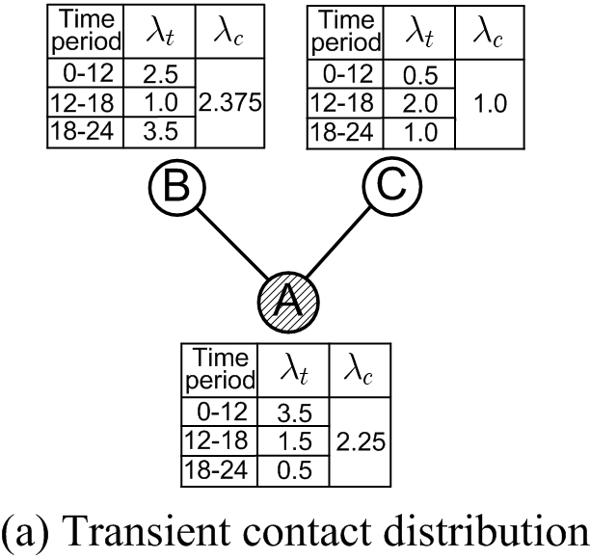
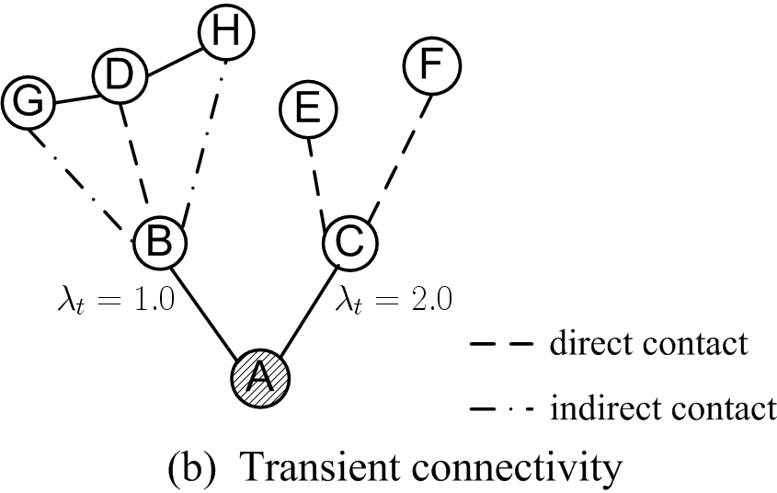
Transient Contact Pattern
Node A sends data to a destination at 12pm with a 6-hour time constraint
Valid time period: 12pm-18pm
A node forwards data to another node with higher data forwarding metric
Direct contact
Transient connected subnet
Cumulative contact rate
Transient contact rate
Notes:
In the previous example, we show how the transient contact pattern looks like, and how it differs from the cumulative node contact characteristics. Now, let me use an illustrative example to show how the consideration of transient contact pattern affect the decision of relay selection.
Consider different time periods in a day: which means that the time constraint for data forwarding is also shorter than a day.
Consider the following example: A wants to forward a data item at 12pm with a 6-hour time constraint, which means that the data forwarding will be performed between 12pm and 18pm.
Now A needs to select one relay among nodes B and C, and A will select the node as the relay if its data forwarding metric is higher than A itself. If the cumulative contact rate is used as the metric, B will be selected. However, most of B’s contacts happen during the mornings and evenings, which is irrelevant to the current data forwarding task. Instead, the transient contact rate should be considered, as a result, C is a better choice specifically for this data forwarding task.

Slide 8
Major Contributions
Formulate transient node contact patterns based on realistic DTN traces
Develop data forwarding metrics to analytically predict node contact capability with better accuracy
Notes:
So the basic problem is how to analytically formulate and represent such transient contact pattern. In our approach, such formulation is validates from realistic DTN traces.
Such accurate prediction is then directly used for improving the performance of data forwarding in DTNs.

Slide 9
Outline
Introduction
Trace-based Pattern Formulation
Data Forwarding Approach
Performance Evaluation
Summary & Future Work

Slide 10
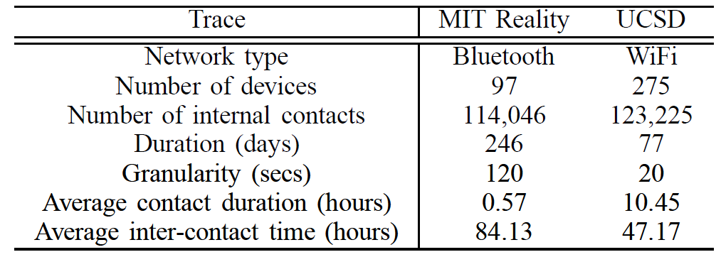
Traces
Record user contacts at university campus
Various wireless interfaces
Bluetooth: periodically detect nearby peers
WiFi: associate to the best Access Point (AP)
Notes:
The two traces differ in their scale, contact detection period, as well as the contact density and duration.
Note that the average contact duration in the MIT Reality trace is much shorter than that in the UCSD trace, and this difference will lead to significant difference in the later pattern formulation.

Slide 11
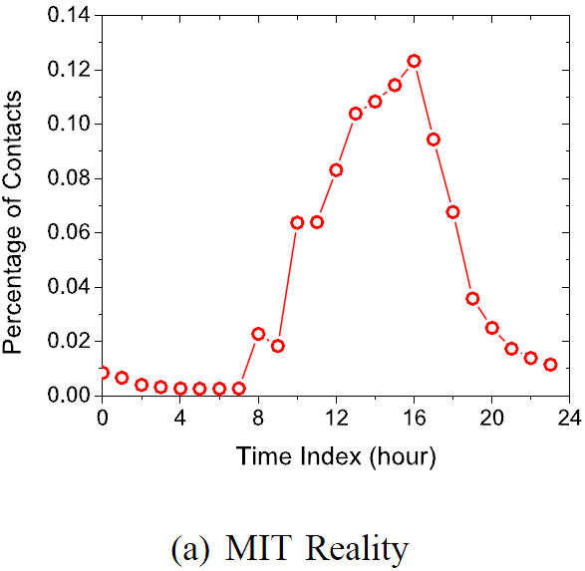
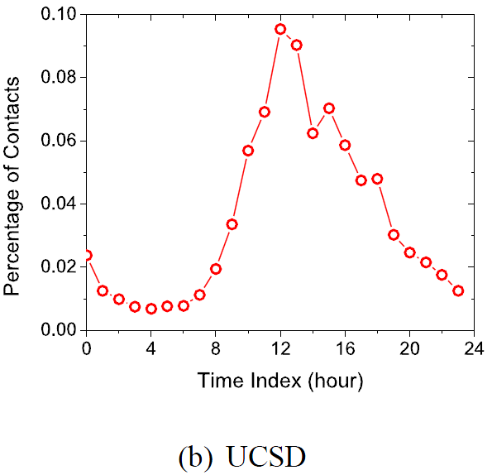
Transient Contact Distribution
Skewed distribution of node contacts
Over 50% between 12pm and 16pm
Less than 7% between 22pm and 7am
Notes:
Most node contacts happen during a short time period.
Our formulation on the transient contact distribution is mainly motivated by the skewed distribution of node contacts. In general, we observe that most node contacts happen during a short time period in a day.
12pm-16pm: working time
22pm-7am: leisure and sleeping time (midnight at UCSD: some students stay late….)

Slide 12
Transient Contact Distribution
Alternative appearances of on-period and off-period
Contact process during on-periods is stable and predictable
Contacts during off-periods are random and unpredictable
On-period
An on-period is determined by a set of contacts happened at time .
For ,
Start
End
Notes:
The transient contact distribution in a day is formulated as alternative appearances of on-periods and off-periods.
Only the contact process during the on-periods is considered as stable and predictable, and is exploited to predict the node contact capability in the future for data forwarding decision.
In this set of contacts, the inter-contact time between any two consecutive contacts is shorter than a pre-defined threshold T_on. When the next contact takes a time longer than T_on to happen, this indicates the end of an on-period.
Comparatively, any contact in an off-period, has to take a time longer than T_on for the next contact to happen.
Figure illustration:
1. So the on-period starts when there are two contact happen with an interval shorter than T_on, and it ends when the next contact did not happen within T_on.
2. In general, there will be no contact happen during off-period. If so, the contact happens in an isolated and unpredictable manner.

Slide 13
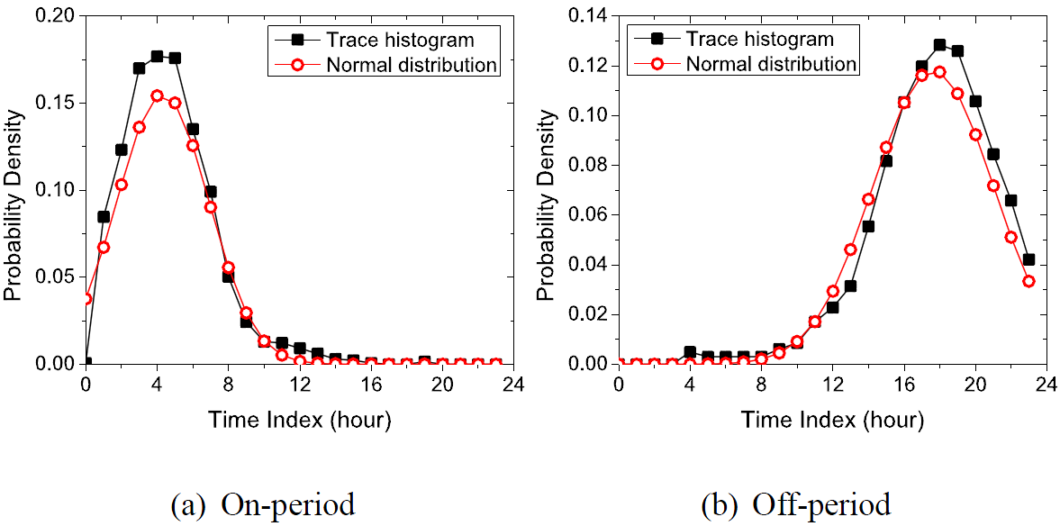
Distribution of On/Off-Period Length
Accurately approximated by normal distribution
hours for both traces
On-periods are short
Notes:
The major effort of our trace-based formulation is to investigate the distribution of on/off-period length.
We have two observations on the length distribution. This is the first, the second is in the next slide.
On-period are generally short, but most of the contacts happen during the on-periods

Slide 14
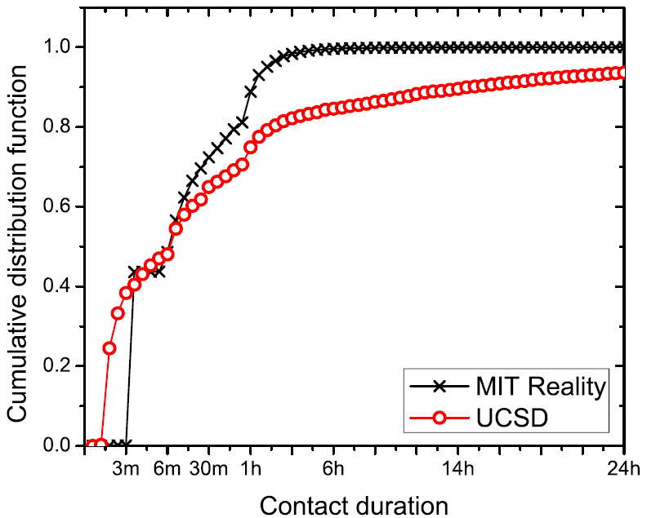
Transient Connectivity
Distribution of contact duration
Many contacts with non-negligible duration
Over 20% last longer than 1 hour
Notes:
The transient pattern of node connectivity is motivated by the distribution of contact duration.

Slide 15
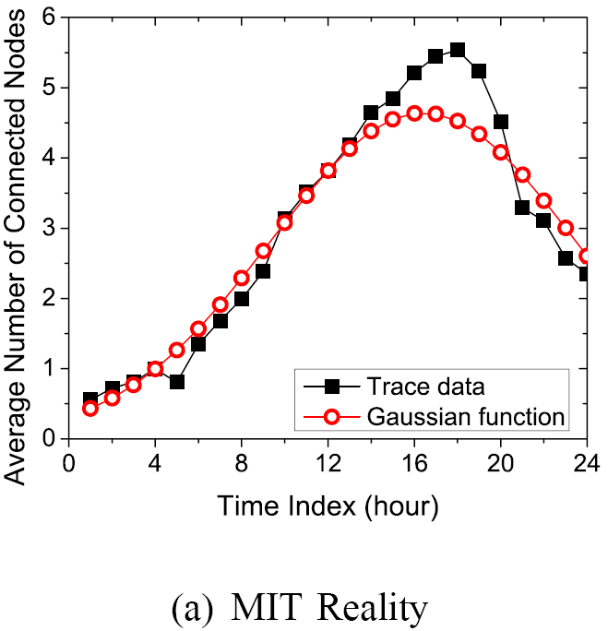
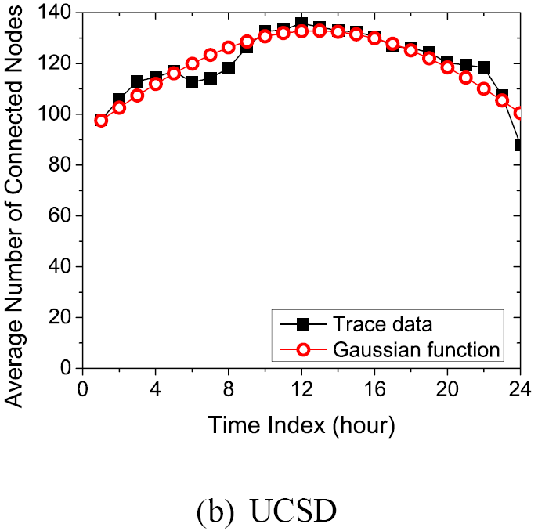
Transient Connectivity
The temporal change of TCS size of a mobile node
Formulated as Gaussian function
Notes:
Since a large portion of contacts lasts for long, nodes have enough opportunity to maintain the transient connectivity with others, and such connectivity is indicated by the size of its TCS over time.
Note that such Gaussian-based formulation takes similar form with the formulation of transient contact distribution.

Slide 16
Outline
Introduction
Trace-based Pattern Formulation
Data Forwarding Approach
Performance Evaluation
Summary & Future Work

Slide 17
Data Forwarding Metric
The capability C_{i} of node i to contact other nodes during time
t_{c}: the current time
t_{e}: the data expiration time
The expected number of nodes that node i can contact
N: the total number of nodes in the network
c_{ij}: pairwise contact probability between node i and j
Notes:
Pairwise contact probability: the probability that nodes i and j contact again in the future before time t_e.
Since such data forwarding metric is calculated in an accumulative manner, we are able to focus on estimating the pairwise contact probability. More specifically, we are going to provide more accurate estimation on such probability based on the patterns of transient contact distribution and transient connectivity.

Slide 18
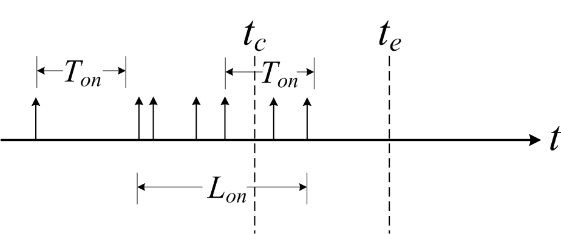
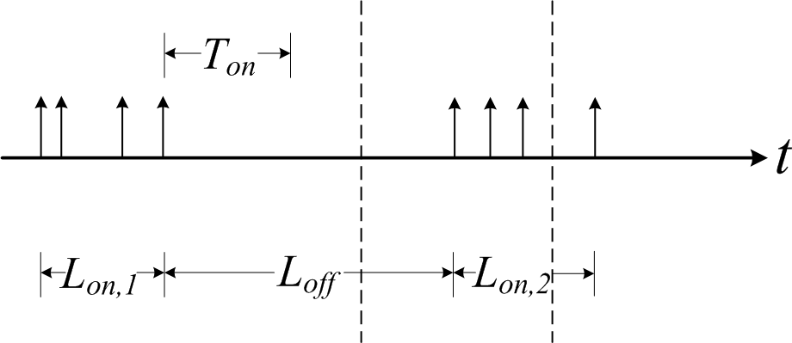
Pairwise Contact Probability
Basic idea: only based on the contact process during on-periods
Case 1: t_{c} is within an
on-going on-period
Case 2: the next on-
period starts before t_{e}
Notes:
We first estimate the pairwise contact probability based on the transient contact distribution characterized as alternative appearance of on and off periods. The basic idea is to predict the contact in the future only based on the past contact records during the on-periods, because we consider that only the contact process during on-periods are stable and predictable.
Based on such idea, we consider that the next contact can only happen in two cases.
In the first case, the current time tc is within an on-going period, so the next contact will happy soon after tc.
In the second case, although tc is within an off-period, but the next on-period will start before te.

Slide 19
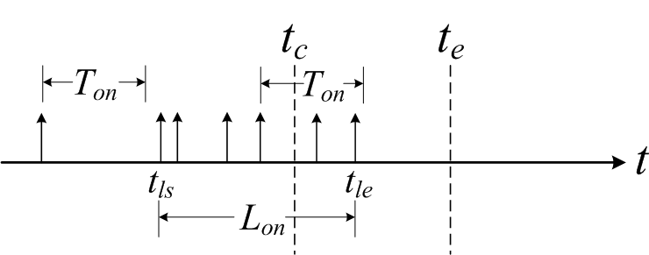
Pairwise Contact Probability
Case 1: t_{c} is within an on-going on-period
, where
T = t_{e} – t_{c}
Contact process within an on-period is modeled as Poisson
PDF of the on-period length
Notes:
Here, note that the contact process within an on-period is modeled as Poisson, due to our assumption of its stability. For each time length t_2-t_1, it has the probability p_c(t_1, t_2) to have at least one contact during the time period [t1, t2].
f_on(t) is the PDF of the length of the current on-going on-period, and the parameters are characterized from the mobility trace at real-time.

Slide 20
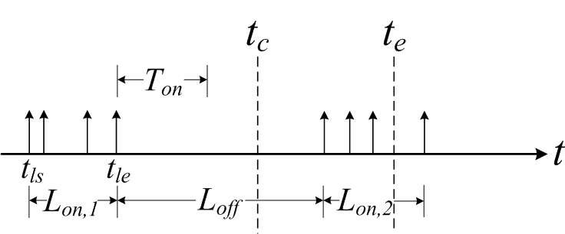
Pairwise Contact Probability
Case 2: the next on-period starts before t_{e}
, where
The last on-period ends before t_{c}
PDF of the off-period length
Notes:
The last on-period ends before t_c = t_c is within an off-period
In order to differentiate the second Case from the first Case, we also need to consider the probability for the last on-period to end before the current time, which means that the current time actually is within an off-period

Slide 21
Exploiting Transient Connectivity
A node indirectly contacts all the nodes in a TCS if it contacts any one node in the TCS
Temporal change of TCS size:
Notes:
Therefore, to incorporate the transient connectivity into the consideration of pairwise contact probability, we only need to incorporate the temporal change of TCS size when we do the integral. As stated before, since such temporal change of TCS size is also formulated as Gaussian function, this enables us to derive a uniform representation of the pairwise contact probability.

Slide 22
Outline
Introduction
Trace-based Pattern Formulation
Data Forwarding Approach
Performance Evaluation
Summary & Future Work

Slide 23
Comparisons
Data forwarding metrics
Contact Counts (CC)
Betweenness
Cumulative Contact Probability (CCP)
Data forwarding strategies
Compare-and-Forward
Delegation Forwarding
Spray-and-Wait

Slide 24
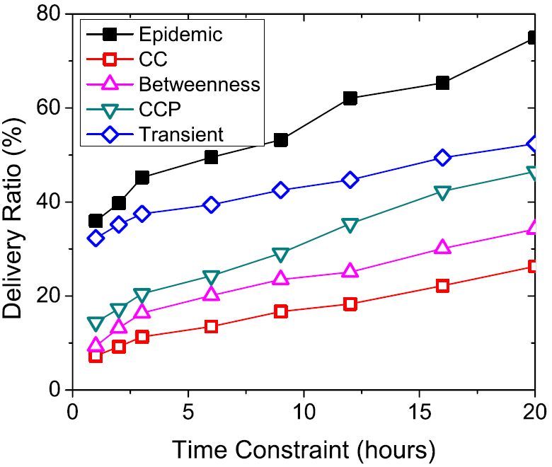
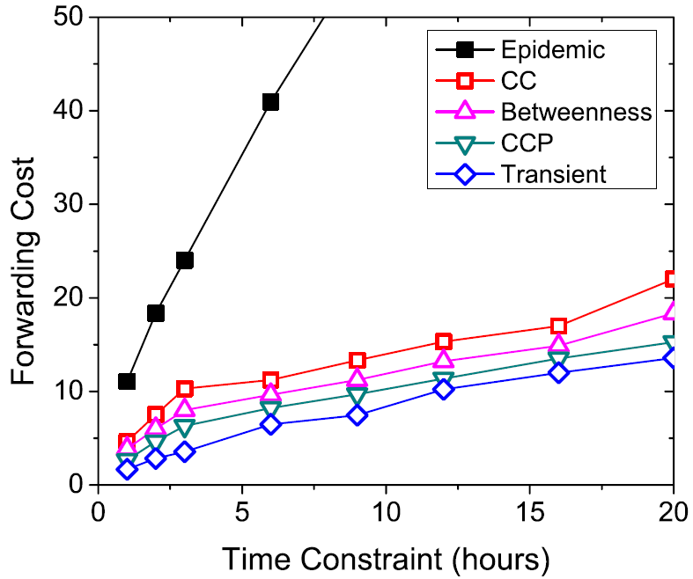
Performance Comparison
Compare-and-Forward in the UCSD trace
Better delivery ratio
Similar forwarding cost
100%
20%
Notes:
When the time constraint is shorter than 6 hours, the transient contact pattern show significant heterogeneity with the cumulative contact pattern, and our approach shows over 100% advantage in the delivery ratio compared with CCP. When the time constraint increases, the transient and cumulative node contact characteristics tend to become consistent, and therefore the advantage of our approach reduces to 20%.
Meanwhile, our approach keeps similar forwarding cost with other schemes in all the time constraints.

Slide 25
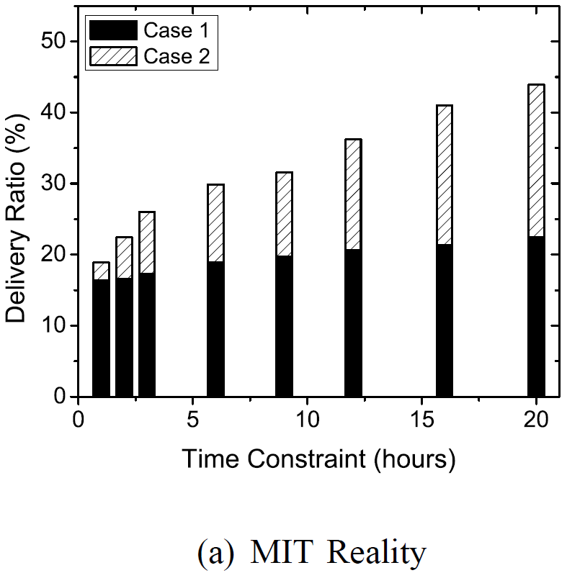
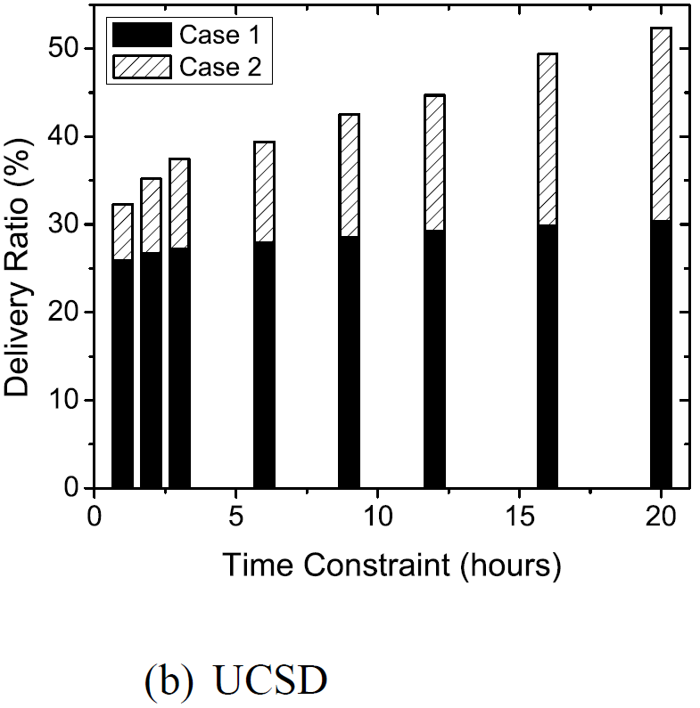
Two Cases of Contacts
30%
70%
Notes:
When the time constraint is short, most contacts happen in Case 1, i.e., the current on-period, because the accuracy of predicting on-period in the future is low in such a small time period, due to the high randomness in short time period. When the time constraint increases, such accuracy will be improved.

Slide 26
Summary
Effective data forwarding metrics for data forwarding in DTNs with a short time constraint
Improves delivery ratio with similar forwarding cost
Transient node contact patterns
Transient contact distribution
Transient connectivity
Future work
The overhead of identifying transient contact pattern
The temporal evolution of social network structure

Slide 27
Thank you!
http://mcn.cse.psu.edu
The paper and slides are also available at:
http://www.cse.psu.edu/~wxg139

Slide 28
Length Distribution of On/Off-Period
On-periods are generally short
Most contacts are covered by on-periods
We have hours for both traces
Notes:
Note that this 24 hour conclusion is not trivial (can be obvious from the daily on/off period formulation), because the characterization of on-periods and off-periods are independent from each other, the alternation among them does not necessarily follow 24-hour rule.

Slide 29
Characterizing Transient Contact Pattern
Transient contact patterns are characterized at real-time at each node
For nodes i and j, the parameters of their on/off-period are updated every time they contact
Each node detects its TCS whenever it contacts another node
A detecting beacon message is broadcasted within the TCS
Each node in the TCS replies to the original sender upon receiving the beacon.
Notes:
The parameters include the amplitude, the mean and the variance of the on-period length distribution.

Slide 30
Prediction Error
Node contact randomness
Unclassifiable contact
Off-periods longer than 24 hours
Most contacts happen during on-periods
The two cases are only found at nodes with low contact frequency
The start of a new on-period?
Random contact in an off-period?
Notes:
It is the last contact happened, but does not belong to the last on-period.
The length of some off-period may exceed 24 hours. Long off-period: two classmate may not contact during the entire weekends.

Slide 31
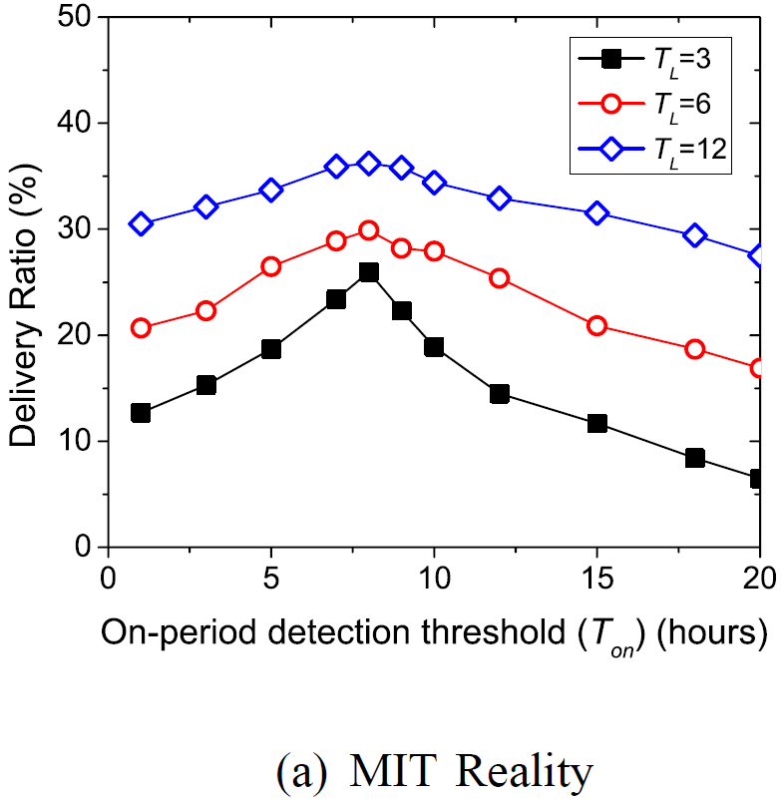
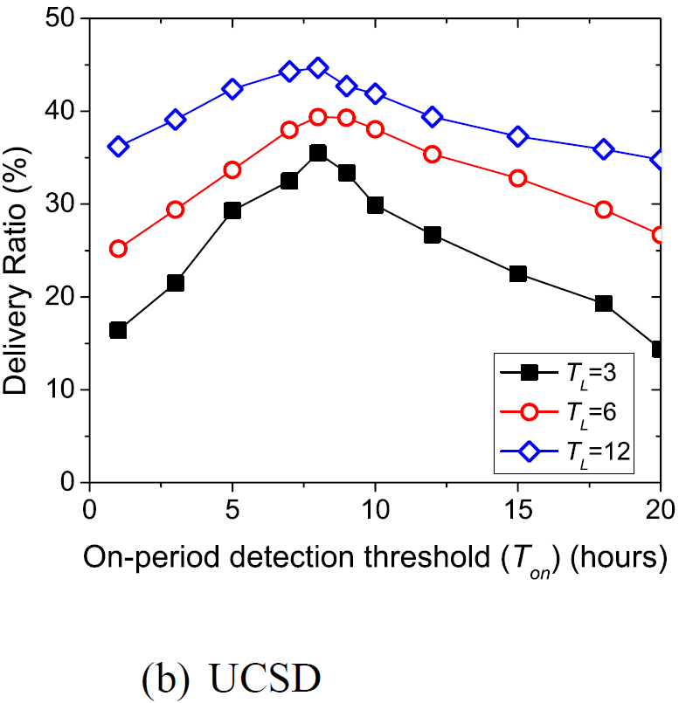
Different values of T_{on}
8
8
Notes:
T_{L} is the time constraint for data forwarding.
When the time constraint is smaller, the data forwarding performance is more sensitive to the choice of T_{on}.

Slide 32
Node Buffer Constraint
Forwarding only one data item
A node simply drops the data in cases of limited buffer
The consideration of node buffer constraint is trivial
Forwarding multiple data items
The consideration of node buffer constraint is formulated as a knapsack problem
Various data forwarding metrics can be applied
Notes:
Multiple data items: orthogonal to the major focus of this paper on developing data forwarding metrics.

Slide 33
Related Work
Node contact capability is estimated from various ways
Prediction of node mobility and co-location events
Semi-Markov chain, Kalman filter
Node contact pattern as abstraction of node mobility
Exploitation of social network concepts
Centrality, social community, homophily
Various metrics apply to the same forwarding strategy
Single-copy
Multiple-copy
Spray-and-Wait, Delegation Forwarding
Notes:
Note that: all the current data forwarding metrics are focusing on estimating the cumulative node contact capability during a long period of time.

