Slide 1
Session 8. how to enhance accountability?
HUMAN RIGHTS AND HEALTH EQUITY: IMPLICATIONS FOR ADVOCACY, ACTION AND GOVERNANCE
Abdul Rehman Pirzado MBBS,DCH.MSPH

Slide 2
Outline:
Concept and definition of accountability
Relationship between accountability and the Right to Health
Rights-holders and duty-bearers
What are the mechanisms for safeguarding accountability
Common challenges to accountability

Slide 3
Question 1:
What is accountability?

Slide 4
Defining accountability:
The essence of accountability is answerability: being accountable means having the obligation to answer questions regarding decisions and/or actions (Schedler 1999)
In democratic governance accountability implies transparency
WHO: accountability is linked to the notion of “stewardship” (Travis et al. 2002)

Slide 5
The Accountability process

Slide 6
4 dimensions of accountability in health:
financial accountability to control the misuse and abuse of public resources/authority according to:
appropriate legal procedures,
professional standards,
societal values,
ensuring affordability of medical goods and services
performance accountability availability, accessibility, acceptability and quality (AAAQ)

Slide 7
4 dimensions of accountability in health (2)
Political accountability to deliver on electoral promises
Social accountability to ensure that the duty-bearers timely and effectively respond to ongoing and emerging societal needs and concern

Slide 8
Question 2:
What is the link between accountability and the right to health?

Slide 9
Universal health coverage (UHC) and Right to Health and Equity
The goal of UHC is to ensure that all people obtain the health services they need without suffering financial hardship when paying for them.

Slide 10
Question 2:
What is the link between accountability and UHC?

Slide 11
EMR/RC60/R.2 (2013) Universal health coverage
“Ensure sustained political commitment to universal health coverage in order to ensure that all people have access to essential health services that are of sufficient quality, without the risk of financial hardship, and to achieve the health system goals”

Slide 12
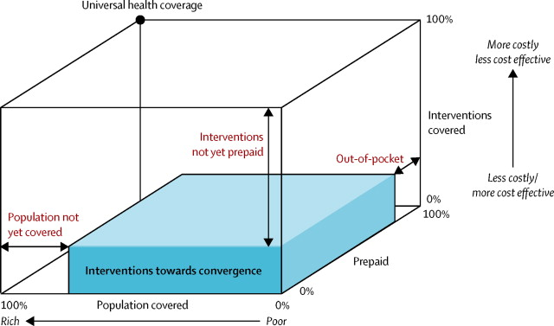
Universal health coverage model: Is this enough to ensure HR and HE

Slide 13
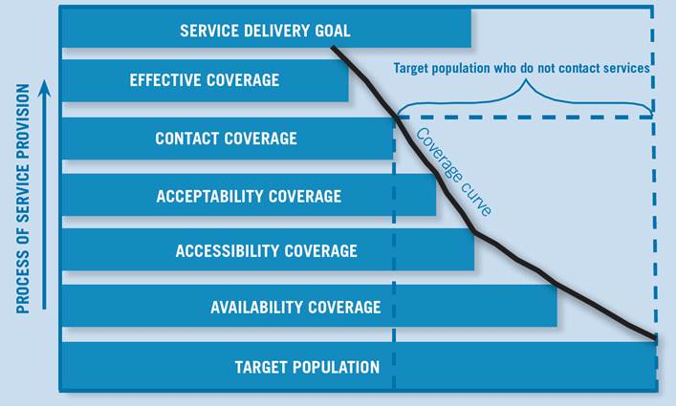
Who should we focus on?
Those with no adequate access to acceptable, affordable, quality health services and prevention programs are in focus!
Ref: Tanahashi framework for effective coverage (WHO, 2010; Tanahashi, 1978)

Slide 14
State’s commitments to UHC:
WHA58.33(2005) Sustainable health financing, universal coverage and social health insurance
WHA64.9(2011) Sustainable health financing structures and universal coverage
EMR/RC59/R.3 (2013) Health systems strengthening in countries of the Eastern Mediterranean Region: challenges, priorities and options for future action
EMR/RC60/R.2 (2013) Universal health coverage
UNGA resolution A/RES/67/81 (2012) Global health and foreign policy
Rio+20: The United Nations Conference on Sustainable Development

Slide 15
Question 3:
Who are the stakeholders?
Who is accountable to who?

Slide 16
Rights-holders and Duty-bearers:
Rights-holders
health service users/patients
women
female-headed households
children
young people
elderly
people living with disabilities and special needs
refugees
migrants
internally displaced populations
people living with HIV
health care providers
Duty-bearers
ministry of health
agencies of restraint and enforcement
funding agencies
parliament/legislators
local government officials
nongovernmental organizations
health councils and hospital boards
professional associations and syndicates
health care providers (facilities and individuals, public and private)
academic institutions
international donors

Slide 17
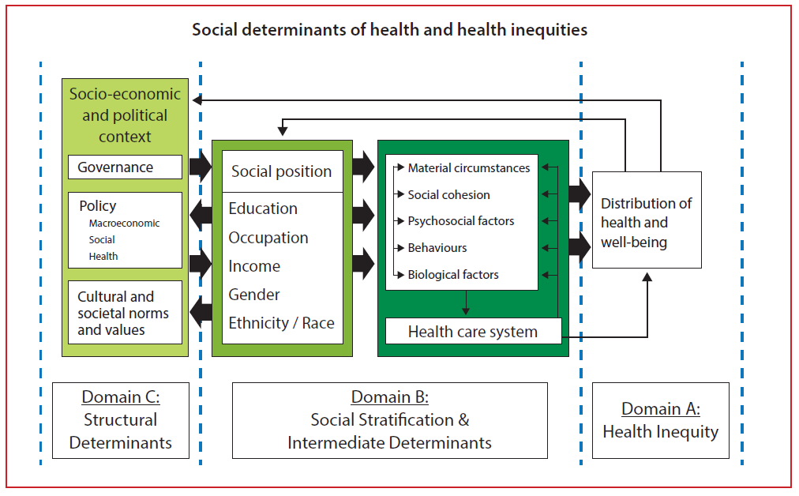

Slide 18
Governance for Health & Health Governance:
Health governance
refers to the players and stakeholders within the health sector response (e.g. Ministries of social Affaires, of environment, planning, finances, sanitation, Trade), insurance, parliamentarians, legislators, public/private health sector, councils, civil society focusing on health issues, etc.)
Governance for health
includes sectors beyond health, but those with the contribution of non-health sectors to the population’s health (e.g. Head of state, Ministry of Interior, transportation, urban planning, communication, etc.)

Slide 19
Question 4:
What are the mechanisms for safeguarding accountability?
Split to 4 groups and discuss

Slide 20
Types of accountability mechanisms:
Judicial
Quasi-judicial/oversight bodies
Political
Administrative
Social
International

Slide 21
Question 5:
What are they accountable for?

Slide 22
What are they accountable for? Regulatory Body and Supreme Health Council??
enforce the duty-bearers’ responsibility to be answerable for their decisions and actions
coordinate/monitor progressive realization of AAAQ
oversee adherence to international right to health standards and norms
promote equity, non-discrimination and ethics
ensure the focus on the most vulnerable segments of the population
ensure inclusive participation of duty-bearers and rights-holders (beneficiaries) and transparency

Slide 23
Accountability elements:
What are the commitments?
What were the identified needs?
Who are in need of what and where?
Who’s at greater need or risk, and why?
What are the gaps, disparities, barriers, bottlenecks in measures to meet the needs/reduce the risk (in relation to coverage, AAAAQ) ?
Are the principles and values fulfilled and respected?
Who are the stakeholders?
Structural elements??

Slide 24
Question 6:
What are the challenges to accountability?

Slide 25
Challenges to accountability (1):
Insufficient political commitments and “know how”
Unclear roles and mandates of different stakeholders and lack of cooperation and partnerships
Lack of public health legislations and legal frameworks

Slide 26
Challenges to accountability:
Lack/conflicting health legislation
Unstable environment/conflict
Public and private conflict of interests
Duties and responsibilities and designated authority
Increasing proportion of trade and investment

Slide 27
Role Play/ Case Study: HCV and medication
HIV and inequalities:
Low- and middle income countries:
– Unsafe injection practices and procedures
– Unscreened blood
– Unsafe injecting drug practices
– Unavailability of treatment
– Inability to afford healthcare and treatment
– Lack of health insurance or social insurance
Gender:
– Males: reluctant to express suffering, free life, increased risk of injecting drugs, unsafe sex,
– Females: reluctant to seek healthcare, cannot negotiate safe sex

Slide 28
Role Play/ Case Study: HCV and medication
Occupational exposure:
– Healthcare professionals
– Policy agents and army soldiers
Geographic location :
– Rural and remote areas were healthcare services are lacking
Traditions:
– Unsafe female genital cutting
– Unsafe male circumcision
– Unsafe tattooing, piercing, scarification
– Informal healthcare providers (barber shops, etc.)
– Stigma towards disease status and risk behaviors

Slide 29
Role Play/ Case Study: HCV and medication
Country A is experiencing high prevalence of HCV
A pharmaceutical company is offering two medical treatment
High effective medication but high cost
Less effective medication and low cost
Main stakeholders are negotiating
Roles:
Ministry of Health Officials
Pharmaceutical company
NGO
Patient groups
Private sector physicians
Community members
Media

Slide 30
Group work/ Provincial action plan
Step 1:
Healthchallenges, roles of other sectors to address these challenges- how to assess progress
Step 2:
Relevant policies; needed interventions
Step 3:
Developing framework; identifying stakeholders; finalizing indicators; setting targets

Slide 31
THANK YOU FOR YOUR ATTENTION!

