Slide 1
Abdul Rehman Pirzado
MnCAH Officer

Slide 2
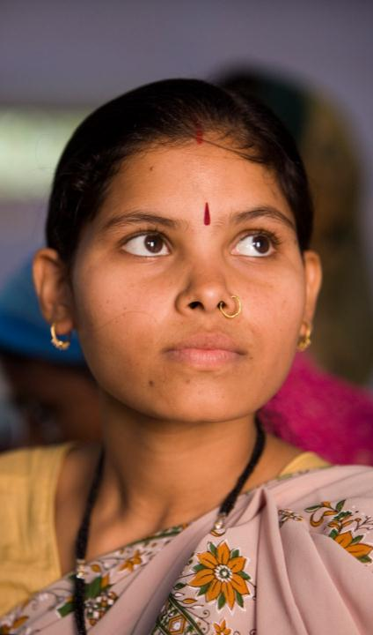
At a glance
• 16 million adolescent girls between 15 and 19 become mothers every year
• Adolescent pregnancies are most common among poor and less educated girls and those living in rural areas
• Despite progress, adolescent pregnancy continues to increase in some regions of the developing world
OMS

Slide 3
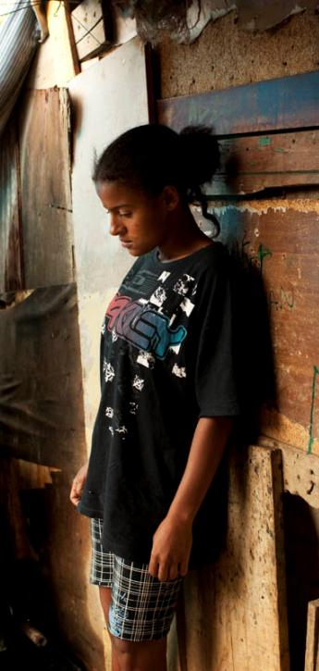
Consequences
Adolescent pregnancy and childbirth is associated with greater health risks for the mother: Complications of pregnancy and childbirth are the leading cause of death in adolescent girls aged 15-19 years in developing countries.
Adolescent pregnancy is harmful to the health of infants: Babies of adolescent mothers are more likely to die, to have low birth weight, and to have long time ill effects.
Adolescent pregnancy reinforces the vicious cycle of poverty and ill health: Adolescent mothers in many places leave or are made to leave school, and are less likely than their peers to develop vocational skills.
OMS

Slide 4
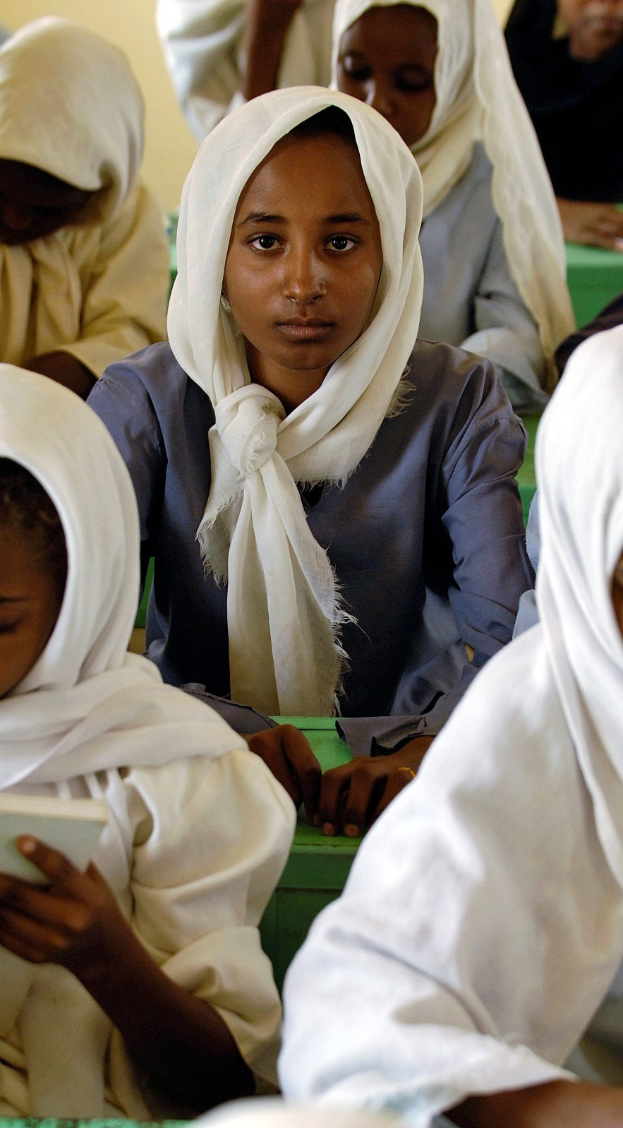
WHO Guidelines on preventing early pregnancy and poor reproductive outcomes in adolescents in developing countries
Based on
• Thorough review of the evidence
• Practical experience of policy makers, programme managers, and front-line workers from countries around the world
Developed in a systematic and transparent manner
In partnership with
• Guttmacher Institute
• International Center for Research on Women
• FHI360
• Population Council
• Centro Rosarino de Estudios Perinatales (Argentina)
Supported financially by
• United Nations Population Fund
• United States Agency for International Development
• International Planned Parenthood Federation
UN

Slide 5
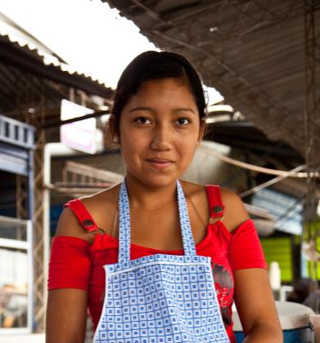
Levels of Early Pregnancy Determinants
Early pregnancy and poor reproductive outcomes among adolescents are determined by a web of micro- and macro-level factors:
• Individuals make choices to engage in specific behaviours
• Family and community norms, traditions, and economic circumstances influence these choices
• Policy and regulatory frameworks facilitate or hinder choices
Actions are needed at each of these levels by different sectors.
Adolescents too have key roles to play.
ONU
JOEY O’LOUGHLIN

Slide 6
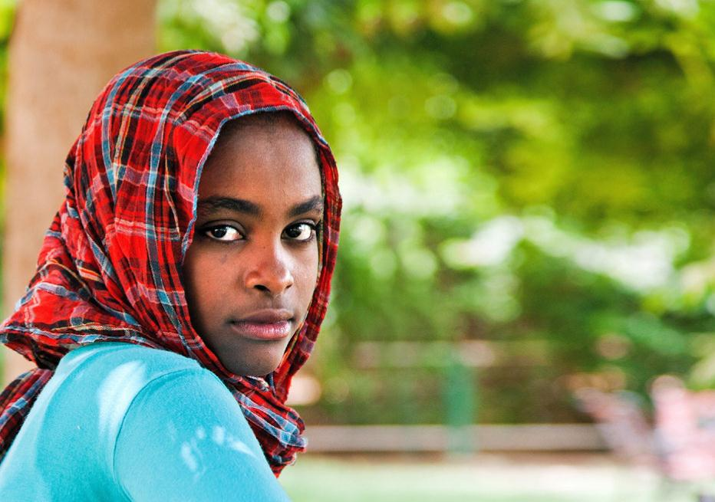
Reduce marriage before age 18
Outcome 1
Policy-Level Actions
• Prohibit early marriage
Individual, Family & Community-Level Actions
• Inform and empower girls
• Keep girls in school
• Influence cultural norms that support early marriage
UNFPA

Slide 7
Reduce marriage before age 18
Outcome 1
EVIDENCE
• 21 ungraded reports or studies, and the expert panel’s recommendations
• Evidence from Afghanistan, Bangladesh, Egypt, Ethiopia, India, Kenya, Nepal, Senegal & Yemen
• Interventions included communicating targeting adolescents, community members, and other political decisions
UNFPA

Slide 8
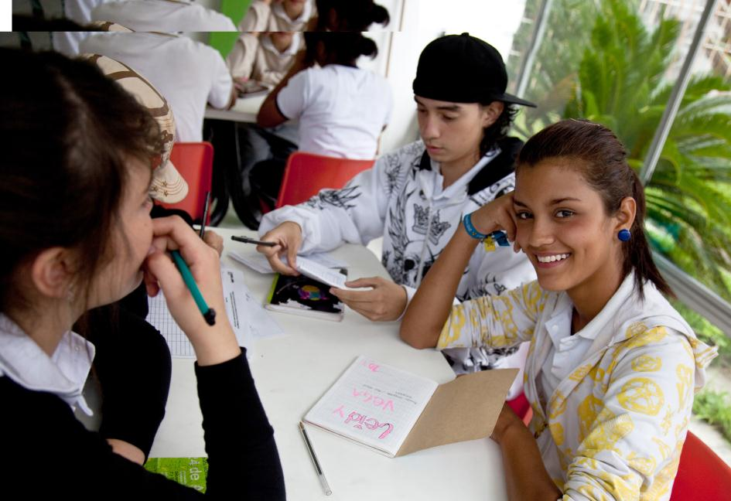
Create understanding and support to reduce pregnancy before the age of 20 years
Outcome 2
Policy-Level Actions
• Support pregnancy prevention programmes among adolescents
Individual, Family & Community-Level Actions
• Educate girls and boys about sexuality
• Build community support for preventing early pregnancy
JOEY O’LOUGHLIN

Slide 9
Create understanding and support to reduce pregnancy before the age of 20 years
Outcome 2
EVIDENCE
• 2 graded systematic reviews, 3 ungraded studies, and the expert panel's recommendations
• Evidence from Mexico, Nigeria, and poor socioeconomic segments of developed countries
• Interventions included sexuality education, cash transfer schemes, early childhood education & youth development and life skills building
JOEY O’LOUGHLIN

Slide 10
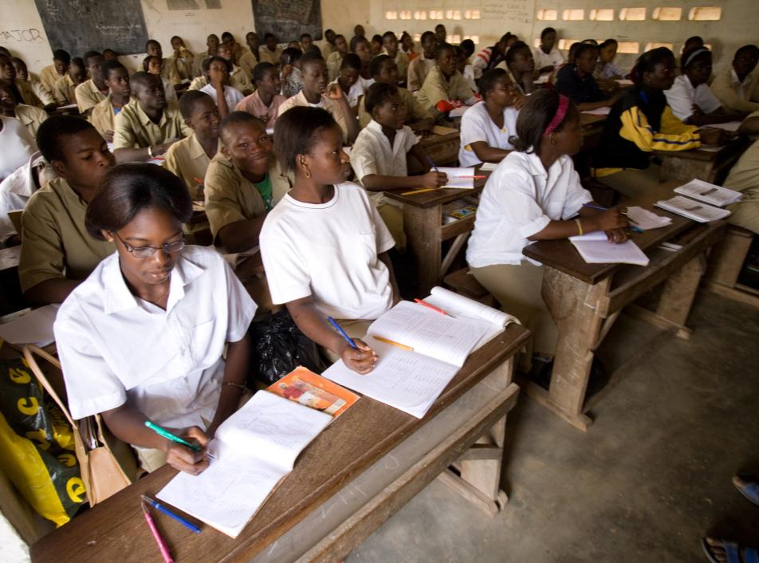
Increase use of contraception
Outcome 3
Policy-Level Actions
• Legislate access to contraceptive information and services
• Reduce the cost of contraceptives to adolescents (conditional recommendation)
Individual, Family & Community-Level Actions
• Educate adolescents about contraceptive use
• Build community support for contraceptive provision to adolescents
• Enable adolescents to obtain contraceptive services
WHO

Slide 11
Increase use of contraception
Outcome 3
EVIDENCE
• 7 graded studies or systematic reviews, 26 ungraded studies, and the expert panel’s recommendations
• Evidence from Bahamas, Belize, Brazil, Cameroon, Chile, China, India, Kenya, Madagascar, Mali, Mexico, Nepal, Nicaragua, Rwanda, Sierra Leone, South Africa, United Republic of Tanzania & Thailand
• Interventions included health system improvements, and community and stakeholder engagement.
WHO

Slide 12
Outcome 4
Reduce coerced sex
Policy-Level Actions
• Prohibit coerced sex
Individual, Family & Community-Level Actions
• Empower girls to resist coerced sex
• Influence social norms that condone coerced sex
• Engage men and boys to critically assess gender norms
UN

Slide 13
Outcome 4
Reduce coerced sex
EVIDENCE
• 2 graded studies, 6 ungraded studies or reports & expert panel’s recommendations
• Evidence from Botswana, India, Kenya, South Africa, Tanzania, & Zimbabwe
• Interventions included communication directed at girls, boys and men & the community members to influence knowledge, understanding & attitudes on coerced sex
UN

Slide 14
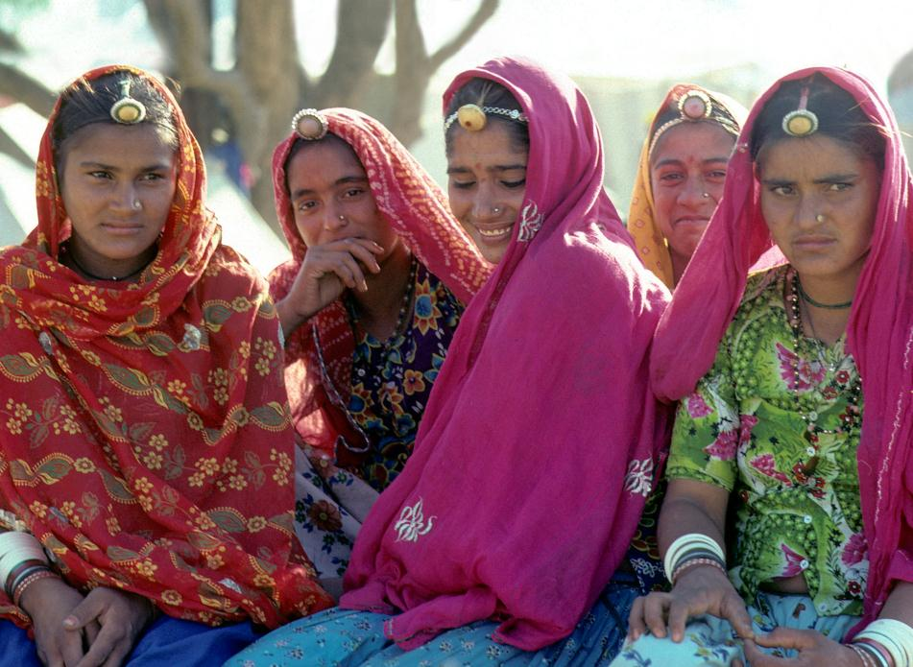
Outcome 5
Reduce unsafe abortion
Policy-Level Actions
• Enable access to safe abortion and post-abortion services for adolescents
INDIVIDUAL, FAMILY, & COMMUNITY-LEVEL ACTIONS
• Inform adolescents about dangers of unsafe abortion
• Inform adolescents about where they can obtain safe abortion services, where legal
• Increase community awareness of the dangers of unsafe abortion
UN
Health system-Level Actions
• Identify and remove barriers to safe abortion services

Slide 15
Outcome 5
Reduce unsafe abortion
EVIDENCE
• No available studies
• Expert panel relied on its experience and judgment to inform the recommendations
UN

Slide 16
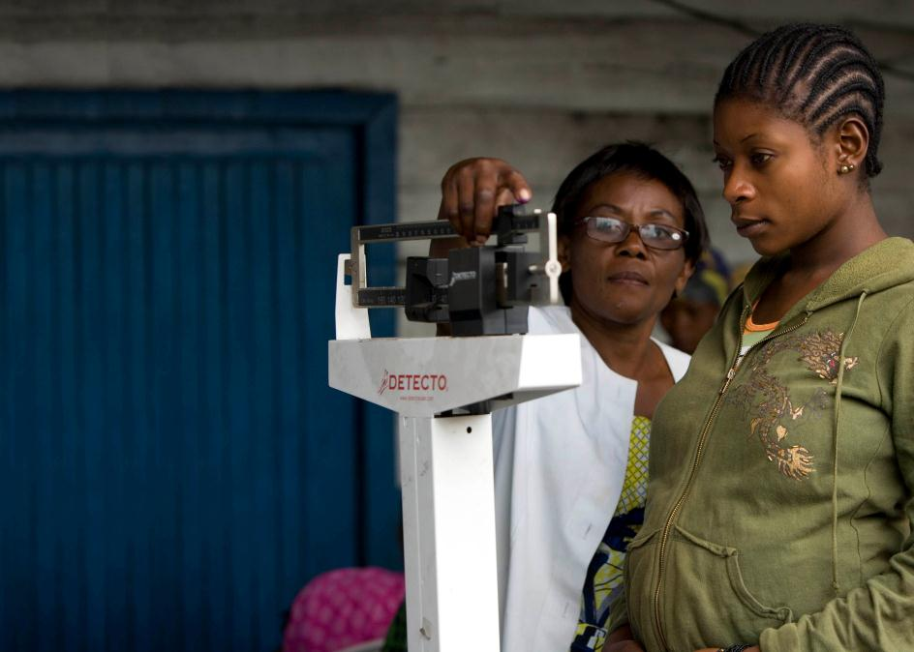
Outcome 6
Increase use of skilled antenatal, childbirth, and postpartum care
POLICY-LEVEL ACTIONS
• Expand access to skilled antenatal, childbirth, and postnatal care
• Expand access to Basic and Comprehensive Emergency Obstetric Care
Individual, Family, & Community-Level Actions
• Inform adolescents and community members about the importance of skilled antenatal and childbirth care
Health system-Level Actions
• Ensure that adolescents, families, and communities are well prepared for birth and birth-related emergencies
• Be sensitive and responsive to the needs of young mothers and mothers-to-be
WHO

Slide 17
Outcome 6
Increase use of skilled antenatal, childbirth, and postpartum care
EVIDENCE
• 1 graded study, 1 ungraded study, existing WHO guidelines & expert panel’s recommendations
• Studies from Chile and India
• Interventions included home visits to adolescent mothers and a cash transfer scheme contingent upon health facility births
WHO

Slide 18
“Educated and empowered women and girls can make informed decisions about their own health.”
— DR. MARGARET CHAN, DIRECTOR-GENERAL, WHO
“When girls are educated, healthy and can avoid child marriage, unintended pregnancy and HIV, they can contribute fully to their societies’ battles against poverty.”
— DR. BABATUNDE OSOTIMEHIN, EXECUTIVE DIRECTOR, UNFPA

