Slide 1
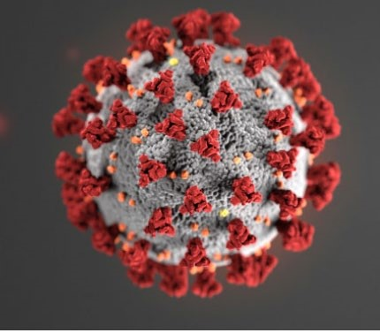
Introduction to COVID-19 Waste Management
Dr. Abdul Rehman Pirzado

Slide 2
Goal:
Increase health and safety awareness for responders and workers with potential exposure to COVID-19.

Slide 3
Learning objectives:
After attending the webinar participants will be able to:
Explain basic facts about COVID-19.
Assess the risk of workplace exposure to COVID-19.
Define key steps in worker protection and infection control.
Identify methods to prevent and respond to COVID-19 exposure in the workplace.

Slide 4
What is SARS-CoV-2?
SARS-CoV-2 is the virus that causes coronavirus disease 2019 (COVID-19)
SARS = severe acute respiratory distress syndrome
Spreads easily person-to-person
Little if any immunity in humans

Slide 5
Transmission
COVID-19 is spread from person to person mainly through coughing, sneezing, and possibly talking and breathing.
Droplet - respiratory secretions from coughing or sneezing landing on mucosal surfaces (nose, mouth, and eyes)
Aerosol - a solid particle or liquid droplet suspended in air
Contact -Touching something with SARS-2 virus on it and then touching mouth, nose or eyes
Other possible routes: Through fecal matter

Slide 6




This webinar by itself is not sufficient training for personnel who have potential for occupational exposure to the SARS-CoV-2 virus.
Information on COVID-19 is rapidly changing, sometimes daily. Refer to reliable sources such as the WHO and NMoHR&C

Slide 7

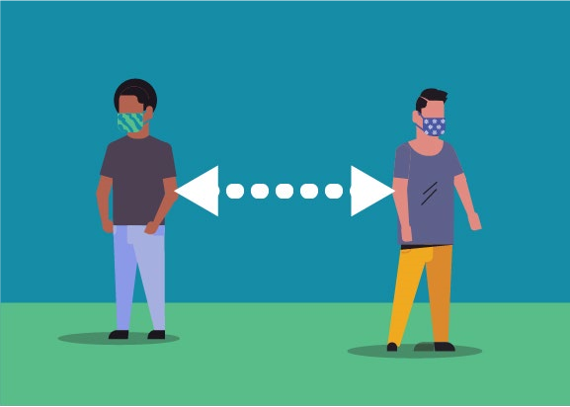
What can individuals do?
Be informed and prepared.
Maintain social distancing (3 feet).
Wash your hands frequently.
Use alcohol-based hand sanitizer.
Avoid touching your eyes, nose, and mouth.
Stay home when you are sick.
Cough or sneeze into a tissue or your elbow.
Clean and disinfect frequently touched objects and surfaces

Slide 8

Five steps to proper handwashing
Wet your hands with clean, running water (warm or cold), turn off the tap, and apply soap.
Lather your hands by rubbing them together with the soap. Lather the backs of your hands, between your fingers, and under your nails.
Scrub your hands for at least 20 seconds. Need a timer? Hum the “Happy Birthday” song from beginning to end twice.
Rinse your hands well under clean, running water.
Dry your hands using a clean towel or air dry them

Slide 9

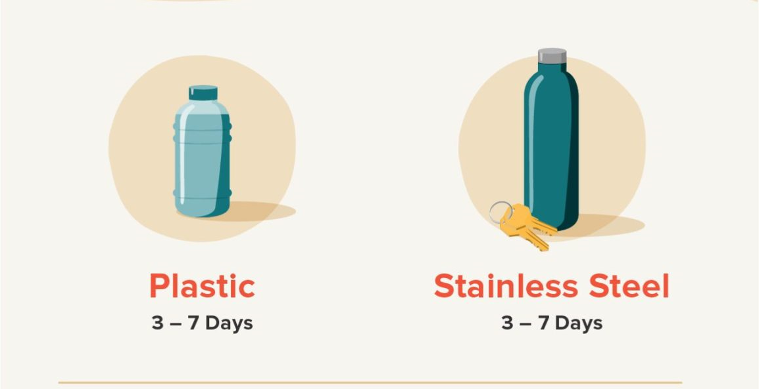


How long does SARS-CoV-2 survive outside of the body?
It is not clear yet how long the coronavirus can live on surfaces, but it seems to behave like other coronaviruses.
Virus may persist on surfaces for a few hours or up to several days, depending on conditions and the type of surface.

Slide 10
Cleaning and Disinfection
Existing recommended cleaning and disinfection procedures for health-care facilities should be followed consistently and correctly.
It is likely that it can be killed with a simple disinfectant.
The efficacy of all disinfectants is affected, to different degrees, by organic material. Thus, it is essential to clean surfaces with a detergent and water before applying a disinfectant.

Slide 11
Cleaning and Disinfection (cont…)
Many disinfectants are active against enveloped viruses, such as the COVID-19 virus, including commonly-used hospital disinfectants. Currently, WHO recommends using:
  70% ethyl alcohol (trade name Erthnol) to disinfect small surface areas and equipment between uses, such as reusable dedicated equipment (for example, thermometers);
  Sodium hypochlorite (commonly known as Bleach powder) at 0.1% (1000 ppm) for disinfecting surfaces and 0.5% (5000 ppm) for disinfection of blood or bodily fluids spills in health-care facilities.
  Hydrogen Peroxide >=0.5%

Slide 12
Waste Segregation
Type of waste | Color coding - symbol | Type of container
0. Household refuse | Black | Plastic bag
1. Sharps | Yellow and | Sharps container
2a. Waste entailing a risk of contamination 2b. Anatomical waste | Yellow and | Plastic bag or container
2c. Infectious waste | Yellow marked “highly infectious” and | Plastic bag or container which can be autoclaved
3. Chemical and pharmaceutical waste | Brown, marked with a suitable symbol | Plastic bag, container

Slide 13
Waste Segregation (cont….)
Type of waste | Color coding - symbol | Type of container
1. Sharps | Yellow and | Sharps container

Slide 14
Waste Segregation (cont….)
Type of waste | Color coding - symbol | Type of container
2a. Waste entailing a risk of contamination 2b. Anatomical waste | Yellow and | Plastic bag or container
2c. Infectious waste | Yellow marked “highly infectious” and | Plastic bag or container which can be autoclaved

Slide 15
Waste Segregation (cont…)
Type of waste | Color coding - symbol | Type of container
3. Chemical and pharmaceutical waste | Brown, marked with a suitable symbol | Plastic bag, container

Slide 16
Waste Segregation (cont…)
Type of waste | Color coding - symbol | Type of container
0. Household refuse | Black | Plastic bag
1. Sharps | Yellow and | Sharps container
2a. Waste entailing a risk of contamination 2b. Anatomical waste | Yellow and | Plastic bag or container
2c. Infectious waste | Yellow marked “highly infectious” and | Plastic bag or container which can be autoclaved
3. Chemical and pharmaceutical waste | Brown, marked with a suitable symbol | Plastic bag, container

Slide 17
Distribution of Waste at Health Facility
Hazardous Waste
Non Hazardous Waste
15
%
85
%
Infectious waste
Pathological waste
Paper and cardboard
Sharps
Packaging
Pharmaceutical waste
Food waste
Genotoxic waste
Chemical waste
Aerosols (spray)
Radioactive waste
Source: Compiled by Authors based on UNEP-IETC, 2012

Slide 18
Personal Protective Equipment (PPE) for Cleaning
Hand hygiene action should always be applied, including after PPE removal
Type of cleaning task | Required personal protective equipment for cleaning staff
Routine cleaning (standard precautions) | Mask (unless spills or contamination risk—see below)
Terminal cleaning (standard precautions) | Mask and Reusable rubber gloves
Blood and body fluid spills and high contamination risk areas (e.g., cleaning bed of an incontinent patient, labor and delivery wards) | Gown and/or plastic apron Reusable rubber gloves Face shield or face mask and goggles (if splash risk or large spill)
Droplet precautions (routine and terminal cleaning) | Gown and/or plastic apron Reusable rubber gloves Face shield or face mask and goggles
Contact precautions (routine and terminal cleaning) | Gown and/or plastic apron Reusable rubber gloves
Cleaning staff PPE for COVID-19

Slide 19
Both WHO and UN Environment program have endorsed steam based disinfection because of the persistent organic pollutants produced by incineration. Incineration is also more expensive and has more carbon footprint than steam based technologies. Trapping energy from waste burning is the most polluting and expensive form if energy generation.

Slide 24
Waste Management in COVID 19 Context
Follow the national regulations / WHO WASH guidance on infectious waste treatment
Treat coronavirus waste as any infectious waste
Segregate waste at source
Dispose in an infectious waste in foot operated bin, with a suitably color coded liner.
Proper handling collection, transport and storage
Use PPE (mask, face shield, heavy duty gloves, long sleeve gown, boots) hand hygiene

Slide 25
Waste Management in COVID 19 Context (cont…)
Use safe and environmentally sound treatment methods
Centralized treatment facility using autoclave, microwaves
Hybrid stream systems, microwaves, ecofriendly treatment methods
On-site Chemicals disinfection low resource settings bleach, pressure cooker a highest setting (30 m), encapsulation and sanitary burial
Cut masks and other PPE: reports that they are being illicitly resold
Follow routine disinfection and cleaning protocols for waste bins.

Slide 26
Key practices for IPC and WASH in HCFs
Hand Hygiene (handwashing with soap and running water or alcohol- based hand rub AHRB/ sanitizer) and safe cough and sneeze etiquette in all settings
Ensure availability at all time of properly labelled water points for different usages (safe water for drinking; water for handwashing stations; water for cleaning and disinfection of surfaces) in adequate quantity and sanitation services regularly serviced and disinfected

Slide 27
Key practices for IPC and WASH in HCFs
Environmental cleanliness (cleaning floors, surfaces and any touch points and linen)
PPE and WASH equipment disinfection (aprons, boots, googles, waste containers, water containers)
Infectious and hazardous waste management

Slide 28
Thanks You

