Slide 1
Infant and Young Child Feeding (IYCF)
Abdul Rehman Pirzado
MBBS,DCH,MSPH

Slide 2
Infant and Young Child Feeding (IYCF)
Global strategy developed by WHO and UNICEF to revitalize world attention on the impact that feeding practices have on infants and young children
Malnutrition has been responsible, directly or indirectly, for over 50% of the 10.9 million deaths annually among children under5 years of age
Over two-thirds of these deaths occur in the first year of life

Slide 3
Global situation
7.6 million children U5 years die /year
2.6 million (35%) ---- malnutrition---1/3rd (10%) of these deaths are due to micronutrient deficiencies
170 million (27% of all children globally )--- stunted (low Ht/age),100 million of total in Asia
100 million --- under weight (Low wt/age)---19% of child death
60 million ---wasted (low wt/ht)
20 million/yr ---LBW (<2.5 kg)
Save the Children-2012

Slide 4
Malnutrition in Pakistan (NNS 2011)
In Pakistan, the nutritional status of children under 5 years of age is extremely poor.
Child Malnutrition rates in Pakistan is significantly high.
Types of Malnutrition
Stunting --- 43.7%
Under weight --- 31.5%
Wasting --- 15.1%
Micronutrient deficiency
Anemia --- 61.9%
Vitamin A deficiency --- 54%
Vitamin D deficiency --- 40%
Zinc deficiency --- 39.2%

Slide 5
Appropriate diet during pregnancy & lactation
During Pregnancy
Women does not need more food during pregnancy
3 meals each day plus one extra small meal or snack in between meals
During Lactation
Three meals each day plus two extra small meals or snacks in between meals to sustain energy and better take care of child
Peas, lentils , beans, oil, green vegetables or fruit and meat
Never stay thirsty; use of juice, soups etc. should be increased

Slide 6
The Baby-Friendly Way
TEN STEPS TO SUCCESSFUL BREASTFEEDING
Every facility providing maternity services and care for newborn infants should:
1. Have a written breastfeeding policy that is routinely communicated to all health care staff.
2. Train all health care staff in skills necessary to implement this policy.
3. Inform all pregnant women about the benefits and management of breastfeeding.
4. Help mothers initiate breastfeeding within an half hour of birth.
5. Show mothers how to breastfeed, and how to maintain lactation even if they should be separated from their infants.

Slide 7
The Baby-Friendly Way
TEN STEPS TO SUCCESSFUL BREASTFEEDING
Every facility providing maternity services and care for newborn infants should:
6. Give newborn infants no food or drink other than breast milk unless medically indicated.
7. Practise rooming in – allow mothers and infants to remain together – 24 hours a day.
8. Encourage breastfeeding on demand.
9. Give no artificial teats or pacifiers (also called dummies or soothers) to breastfeeding infants.
10. Foster the establishment of breastfeeding support groups and refer mothers to them on discharge from the hospital or clinic.

Slide 8
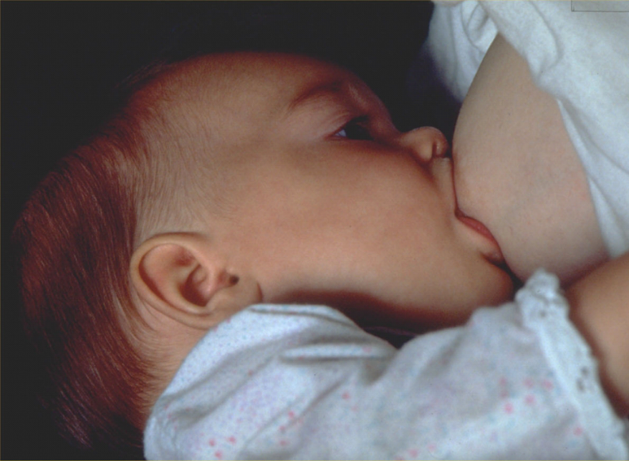
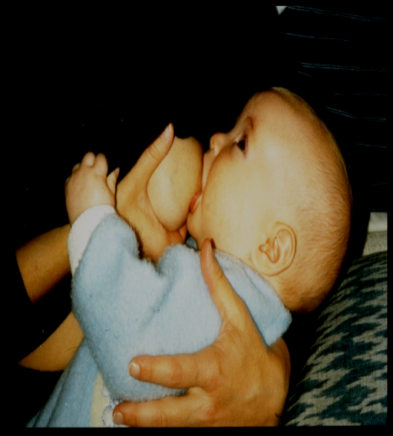
Good position & Attachment
Baby head & body in line
Baby held close to mothers body
Baby whole body supported
Baby approaches breast nose to nipple.
More areola visible above baby’s mouth than below
Baby’s mouth wide open
Lower lip turned outwards
Chin close to breast

Slide 9
Nutrition: Food Groups
Staple Food: Wheat Rice Corn Millets | Protein: Meat Fish Egg Bean | Minerals and Vitamins: Fruits Green leafs Vegetables | Calories: Oils Fat Honey

Slide 10
Recommended Complementary Feeding Practices
Age | Frequency | Amount of food | Texture/ thickness | Varity
6-8 months | 2 – 3 times | 2-3 TSF upto ½ cup(250ml) | Thick porridge | Breastfeed + Staple foods
9-11 months | 4 times food & snacks | ¾ to 1 cup(250ml) | Meshed food | Breastfeed + Staple foods
12-23 months | 5 times food & snacks | 1 - 2cup(250ml) | Family food sliced | Breastfeed Staple foods
If baby is not breastfed | Add 1 to 2 extra servings |  |  | Add 1-2 cups of milk daily
Be patient and actively encourage baby to eat
Feed you baby in a clean cup with spoon Never use bottle for feeding Wash your hands before feeding with soap and water before preparing food, eating and feeding your child

Slide 11
Ten Key Messages
Breastfeeding for two years or longer helps a child to develop and grow strong and healthy
Starting other foods in addition to breast milk at 6 completed months helps a child to grow well
Foods that are thick enough to stay in the spoon give more energy to the child
Animal-source foods are especially good for children, to help them grow strong and lively
Peas, beans, lentils, nuts and seeds are also good for children
Dark-green leaves and yellow-colored fruits and vegetables help a child to have healthy eyes and fewer infections

Slide 12
Ten Key Messages
A growing child 6 – 8 months needs 2 – 3 meals a day
A growing child 9 – 24 months needs three to four meals a day Plus additional 1 – 2 snacks if the child is hungry: Give a variety of foods
A growing child needs increasing amounts of food
A young child needs to learn to eat: encourage and give help … with lots of patience
Encourage children to drink and eat during illness and provide extra food after illness to help them recover quickly

Slide 13
Three step counseling
Help you to counsel with mothers for infant & young child feeding
Step 1 ---- Assess ; Ask , Listen & observe--- Assess age appropriate feeding practices & health of child & mother
Step 2 ---- Analyze ; identify difficulties & prioritize the difficulties if more then than 1 difficulty, praise mother
Step 3 ---- Act ; discuss , suggest small amount of relevant information, give option regarding feeding difficulty & help mother to select one option .
Additional Support --- Refer to health facility, IYCF support group in community, Health worker
Thank the mother ,Set next meeting

Slide 14
Thanks

