Slide 1

Thought Experiments in Science
John D. Norton
Department of history and Philosophy of Science
University of Pittsburgh
Pittsburgh Summer Program 6
Center for Philosophy of Science, University of Pittsburgh
July 11-15, 2022
This lecture: ???

Slide 2

http://www.pitt.edu/
~jdnorton/lectures/
CPS_summer_2022
/CPS_summer_2022.html

Slide 3
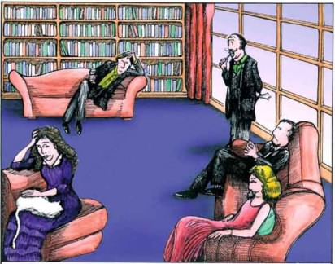
Please Think About this Problem
The epistemological problem of thought experiments in science:
How can merely experimenting in thought provide new knowledge of the natural world?
Replacement for the superconducting supercollider.
www.thought-experiment-jokes.com

Slide 4
Three Thought Experiments
1. Maxwell’s Demon
2. The Rotating Disk
3. The Dome

Slide 5
1. Maxwell’s Demon

Slide 6



Thermodynamics versus the molecular kinetic theory.
Heat ALWAYS passes from hot to cold only.
Unconfined gases ALWAYS expand.

Slide 7

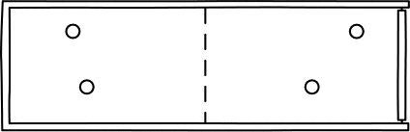
Thermodynamics versus the molecular kinetic theory.
A molecular gas can spontaneously recompress.
The microscopic physics of molecular gases is not directed in time.

Slide 8
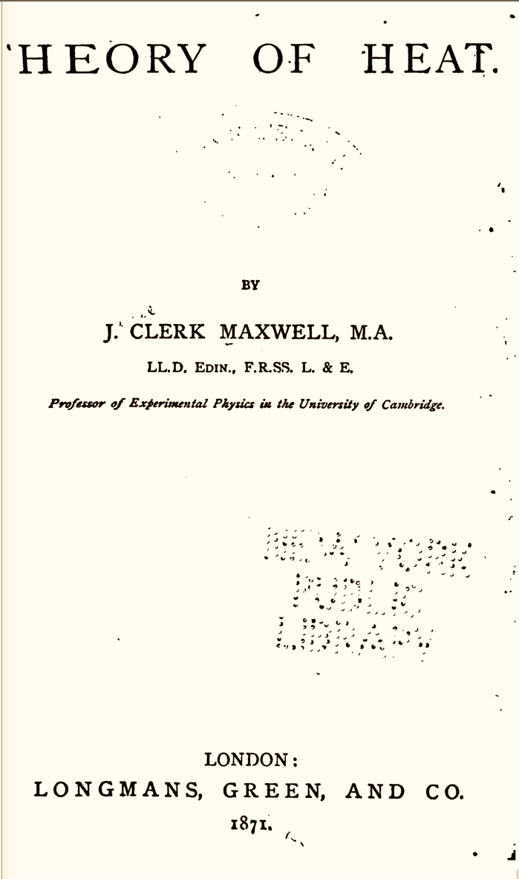
Theory of Heat,
1871, first ed.
Also
Letter to Tait, 1867;
Rayleigh 1871

Slide 9
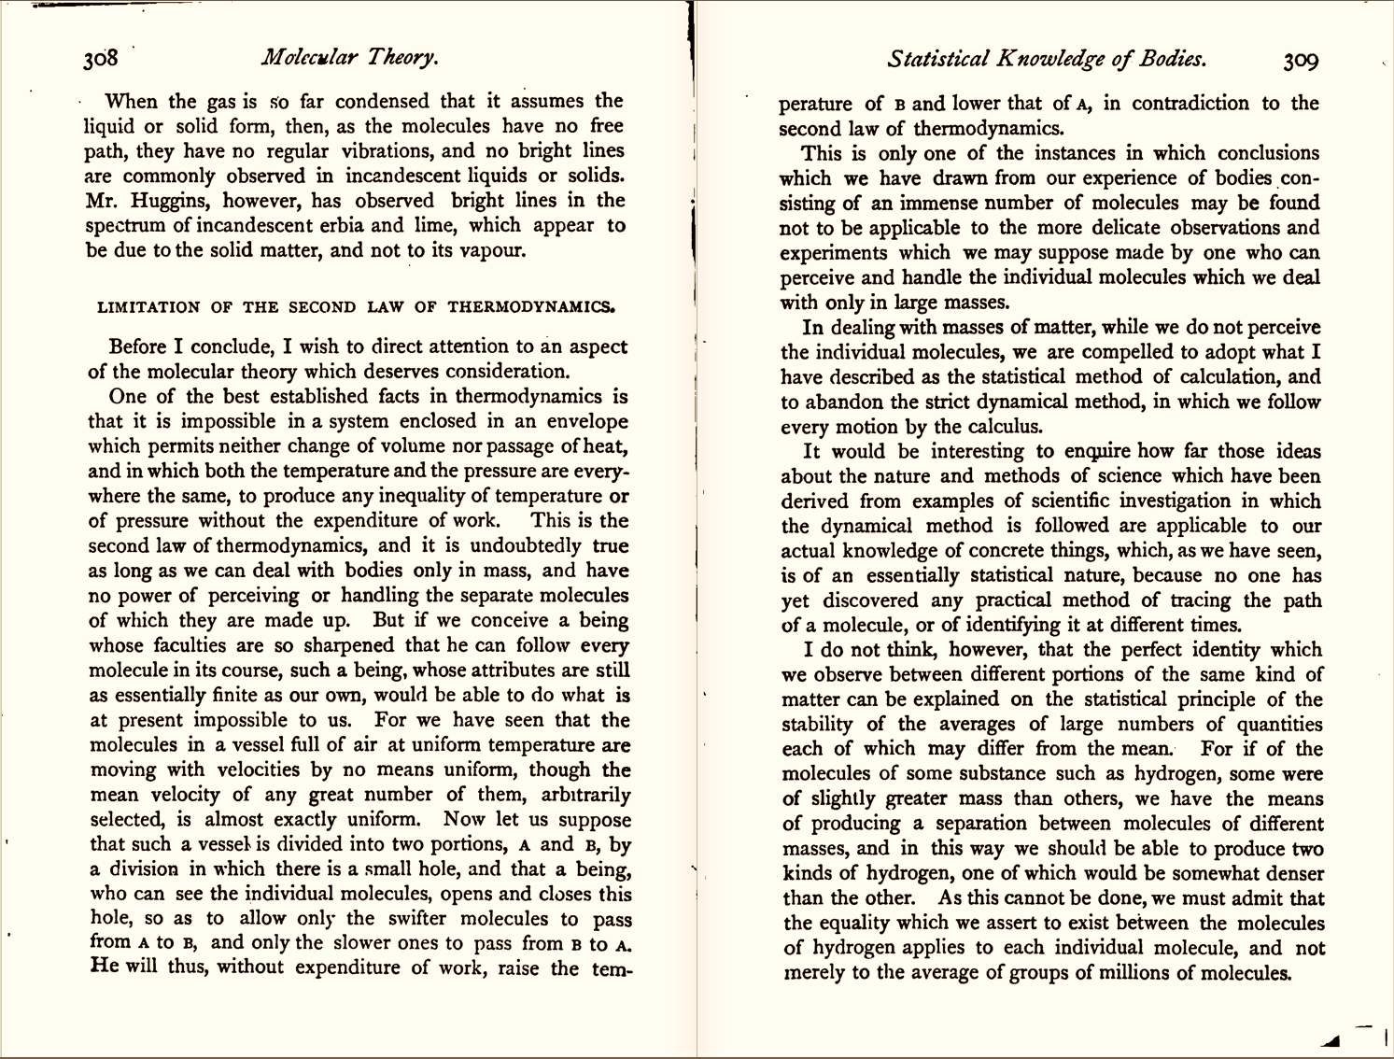
Theory of Heat
Better scan from 1872, 2nd ed.

Slide 10
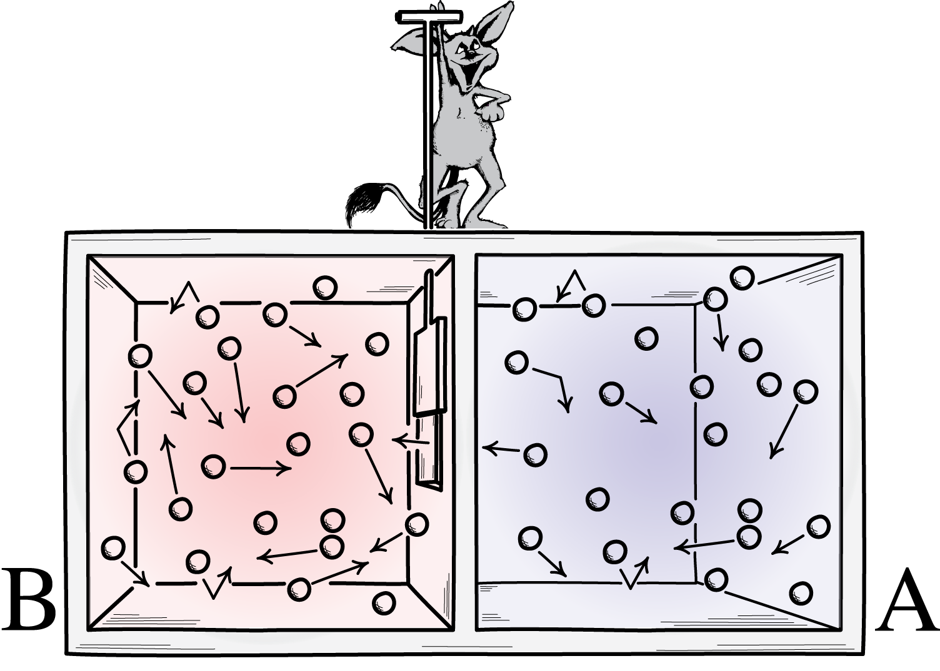
Maxwell’s Proposal
“He will thus, without expenditure of work,
raise the temperature of B
and lower that of A,
in contradiction to the second law of thermodynamics.”
air initially at
uniform temperature

Slide 11
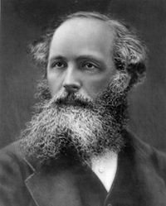
Maxwell’s Moral: The Demon Wins
“This is only one of the instances in which conclusions which we have drawn from our experience of bodies consisting of an immense number of molecules may be found not to be applicable to the more delicate observations and experiments which we may suppose made by one who can perceive and handle the individual molecules which we deal with only in large masses.
In dealing with masses of matter, while we do not perceive the individual molecules, we are compelled to adopt what I have described as the statistical method of calculation, and to abandon the strict dynamical method, in which we follow every motion by the calculus.”
Theory of Heat.
The demon illustrates that Second Law would fail if we could manipulate individual molecules.
No compulsion to exorcise the demon to protect the Second Law.
…. Nanotechnology has not yet overturned the Second Law.

Slide 12
2. The Rotating Disk

Slide 13
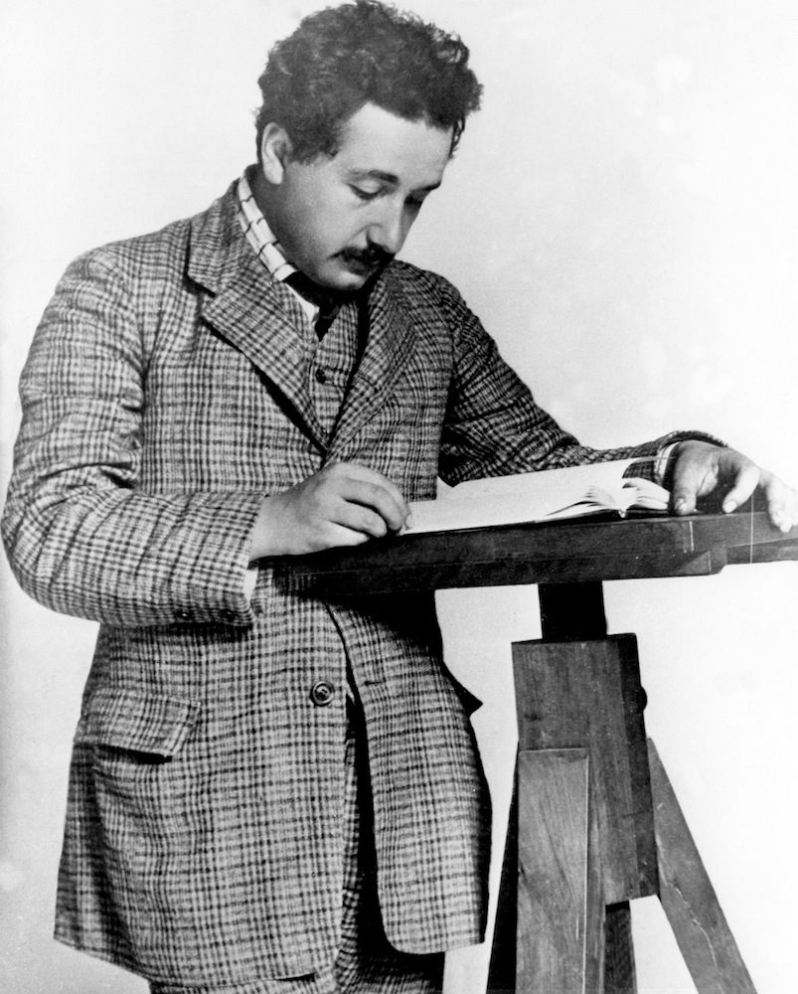
Einstein’s Discovery of Relativity Theory
1905
Apply the principle of relativity to inertial motion.
Special relativity
1907, 1908, 1909, 1910, 1911, 1912, 1913, 1914, 1915.
Extend the principle of relativity to accelerated motion.
???
rotation
Rectilinear acceleration
Gravity slows clocks, slows and bends light.

Slide 14
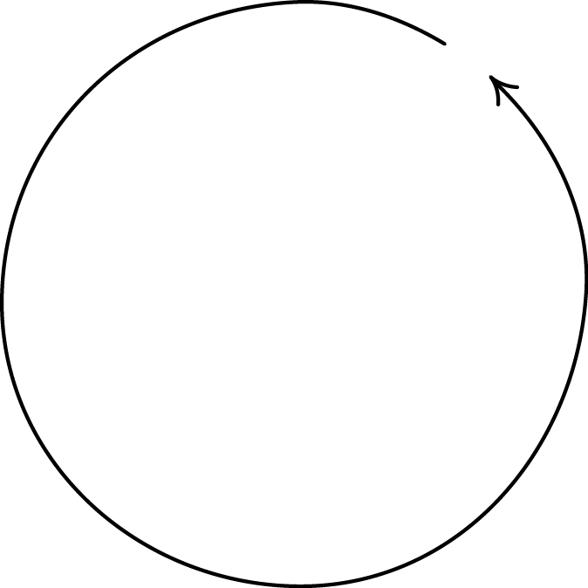
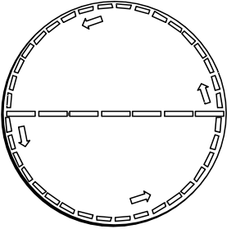
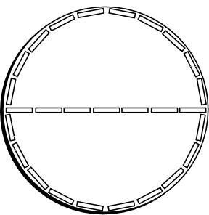
Rotating Disk 1912
= π x diameter
circumference
> π x diameter
circumference
measured by laying out moving, contracted rods end to end.
Length of radial rods unaffected by motion.
measured by laying out rods end to end.
Geometry found on a rotating disk is non-Euclidean.

Slide 15
3. The Dome
An Indeterminstic Newtonian System

Slide 16
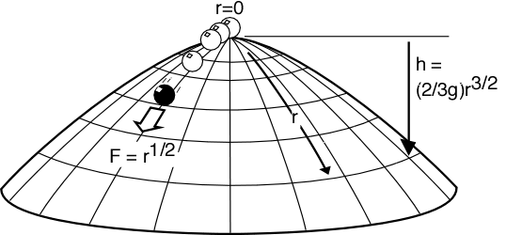
The Arrangement
A unit mass sits at the apex of a dome over which it can slide frictionless. The dome is symmetrical about the origin r=0 of radial coordinates inscribed on its surface. Its shape is given by the (negative) height function h(r) = (2/3g)r^{3/2}.
The mass experiences an outward directed force field
F = (d/dr) potential energy = (d/dr) gh = r^{1/2}.
The motion of the mass is governed by Newton’s “F=ma”:
d²r/dt² = r^{1/2}.

Slide 17
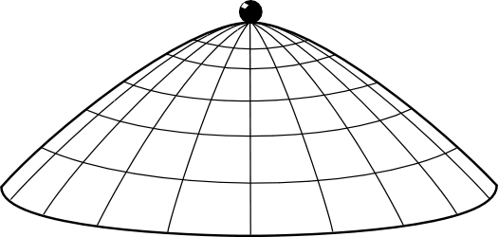
Possible motions: None
r(t) = 0
solves Newton’s equation of motion since
d²r/dt² = d²(0)/dt² = 0 = r^{1/2}.

Slide 18

Possible motions: Spontaneous Acceleration
The mass remains at rest until some arbitrary time T, whereupon it accelerates in some arbitrary direction.
r(t) = 0, for t≤T and
r(t) = (1/144)(t–T)⁴, for t≥T
solves Newton’s equation of motion
d²r/dt² = r^{1/2}.
For t≤T, d²r/dt² = d²(0)/dt² = 0 = r^{1/2}.
For t≥T
d²r/dt² = (d² /dt²) (1/144)(t–T)⁴
= 4 x 3 x (1/144) (t–T)²
= (1/12) (t–T)²
= [(1/144)(t–T)⁴]^{1/2} = r ^{1/2}

Slide 19
The computation again
For t≤T, d²r/dt² = d²(0)/dt² = 0 = r^{1/2}.
For t≥T
d²r/dt² = (d² /dt²) (1/144)(t–T)⁴
= 4 x 3 x (1/144) (t–T)²
= (1/12) (t–T)²
= [(1/144)(t–T)⁴]^{1/2} = r ^{1/2}

Slide 20
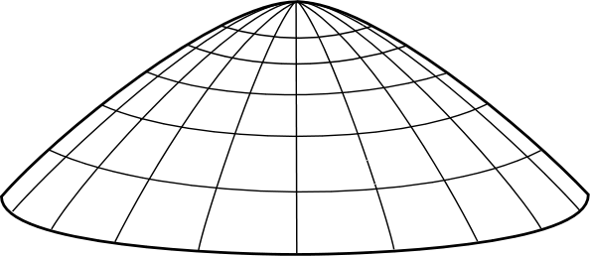
The Dome without Calculus
Imagine the mass projected from the edge.
Close…

Slide 21

The Dome without Calculus
Imagine the mass projected from the edge.
Closer…

Slide 22
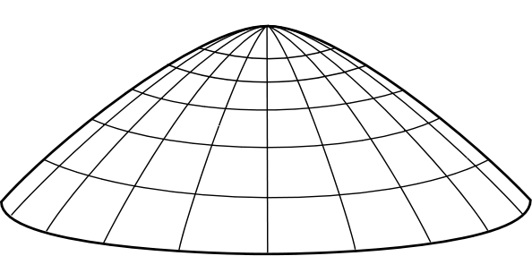
The Dome without Calculus
Imagine the mass projected from the edge.
BINGO!
Now consider the time reversal of this process.
Spontaneous motion!
BUT there is a loophole. Spontaneous motion fails for a hemispherical dome. How can the thought experiment fail in that case?

Slide 23
How do these thought experiments inform us?

Slide 24
Epistemologies of Thought Experiments
Platonism, Intuitionism
Brown
Laws of nature reside in a Platonic world. We perceive the laws directly in the right sort of thought experiment.
Experimentalism
Sorensen
Thought experiments gain epistemic power through their mimicry of real experiments.
Constructivism
Kuhn, Gendler
Thought experiments reveal lacunae in our conceptual systems and show us how to reconfigure them.
Visualization and Simulation
Arthur
The mind has the power to simulate the world through visualization.
Mental Models
Nersessian, Palmieri
Thought experiments are the manipulation of mental models discussed in recent cognitive science.
Arguments
Norton
Thought experiments are merely disguised, picturesque argumentation.

Slide 25
The Argument View

Slide 26
Two Versions
Thought experiments are arguments that
posit hypotheticals or counterfactuals (“thought”);
(ii) invoke irrelevant particulars (“experiment”).
Context of Justification
Context of Discovery
The reconstruction thesis:
All thought experiments can be reconstructed as arguments based on tacit or explicit assumptions. Belief in the outcome is justified only in so far as the reconstructed argument is cogent.
The execution thesis:
The actual carrying out of a thought experiment is the execution of an argument, even if in disguised form.
Notes:
On the execution thesis:
People are often reluctant to make the step from the reconstruction thesis to the execution thesis.
The analogy is to a seer whose predictions agree with what everyone could reasonably predict from reading the newspaper.

Slide 27
An Illustration

Slide 28
Einstein’s Rotating Disk Thought Experiment
Reconstructed
(D1) In Euclidean geometry, the measured circumference of a disk is π times its diameter. (Premise)
(D2) The geometry of a non-rotating disk is Euclidean. (Premise)
(D3) The motion of a radial element on a rotating disk is perpendicular to its length, so that (according to special relativity) the length is unaltered. (Premise)
(D4) The motion of a circumferential element on a rotating disk is along its length, so that (according to special relativity) the length is contracted. (Premise)
(D5) Therefore the measured circumference of a rotating disk is more than π times the measured diameter. (From D2, D3, D4)
(D6) Therefore the geometry of a rotating disk is not Euclidean. (From D1, D5)

Slide 29
For the reconstruction thesis
1. No magic epistemology
2. No counterexamples

Slide 30
1.

Slide 31
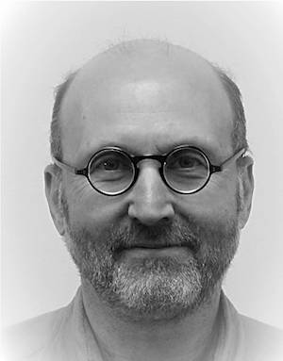
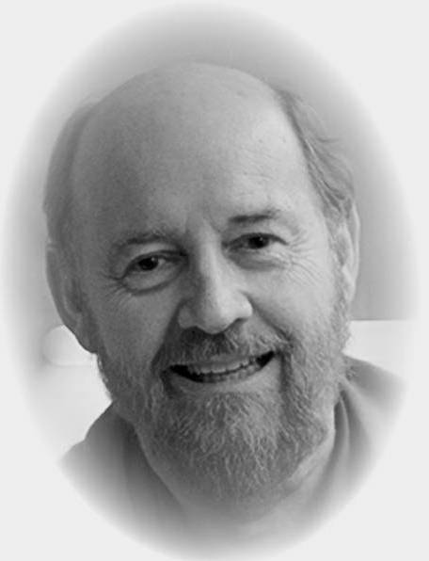
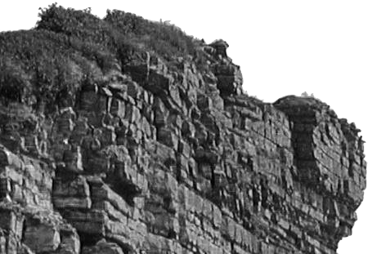
Results of a good thought experiment come from somewhere…
Ordinary
or
Extraordinary
A thought experiment is short narrative that reports no novel empirical facts.
Result comes from reconfiguring what we already know.
Result comes from
Epistemic magic
No viable position in between.

Slide 32
Results of a good thought experiment come from somewhere…
Ordinary
or
Extraordinary
Result comes from reconfiguring what we already know.
Result comes from
Epistemic magic

Slide 33
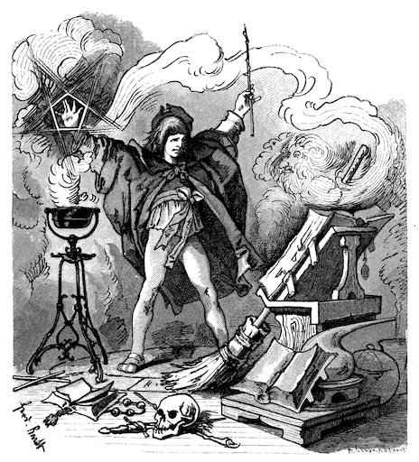
Results of a good thought experiment come from somewhere…
Ordinary
or
Extraordinary
or
Extraordinary
Result comes from reconfiguring what we already know.
Result comes from
Epistemic magic
Result comes from
Epistemic magic
Why choose magic when the prosaic suffices?

Slide 34

How ordinary reconfiguring works.
Reconfigure by means that…
… preserve truth.
deductive argument
What we already know.
…or preserve its likelihood.
inductive argument
Notes:
No epistemic miracles --> grounds for accepting the argument view.
Reliability thesis --> reason to reject all other views

Slide 35
2.

Slide 36
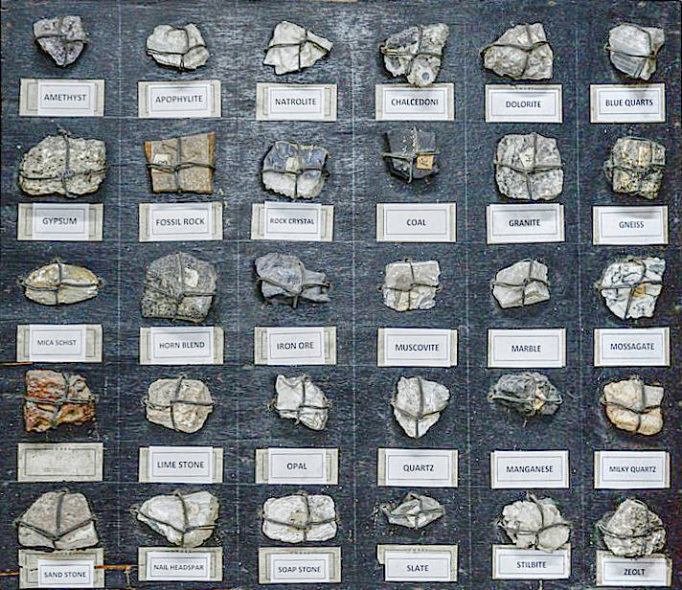
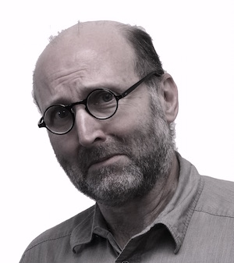
No counterexamples in 30 years of efforts to find them.
The open challenge:
find a counterexample.
Why it is hard to do:
Thought experiments are refined instruments communicated fully in a short narrative.
Logic, ordinary modes of reasoning, are expansive and elastic.
Umm…, I’m not worried.

Slide 37
For the execution thesis
1. Reading the narrative
2. Suspicious powers

Slide 38
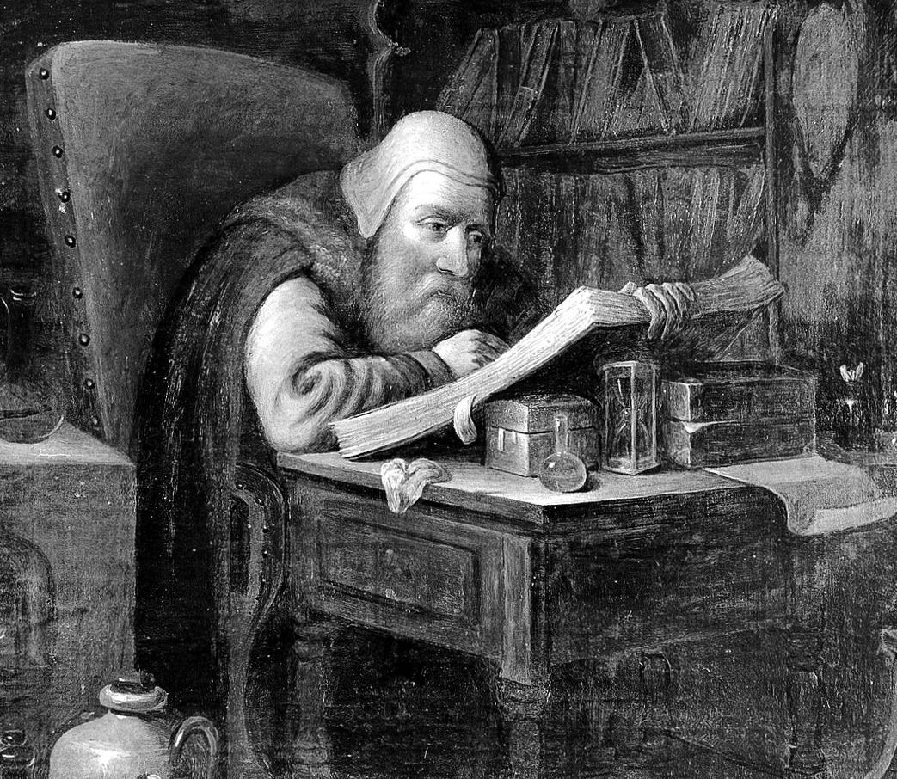
1. The narrative
The narrative of a typical thought experiments in science lays out an argument, step by step, to the conclusion sought.
We read the narrative critically, proceeding from step to step, ensuring that we agree with each step.
The actual carrying out of a thought experiment is the execution of an argument, even if in disguised form.
The execution thesis

Slide 39
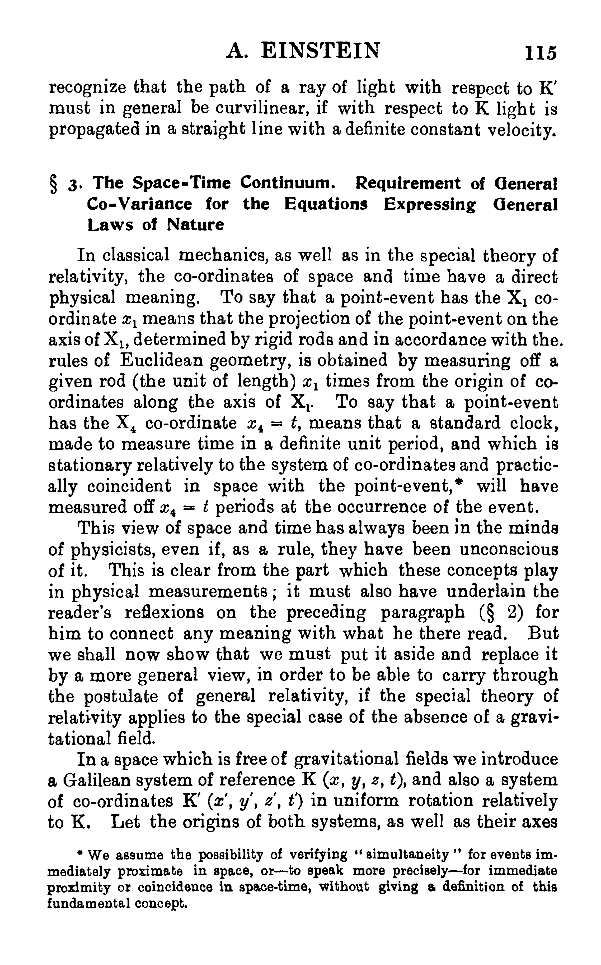
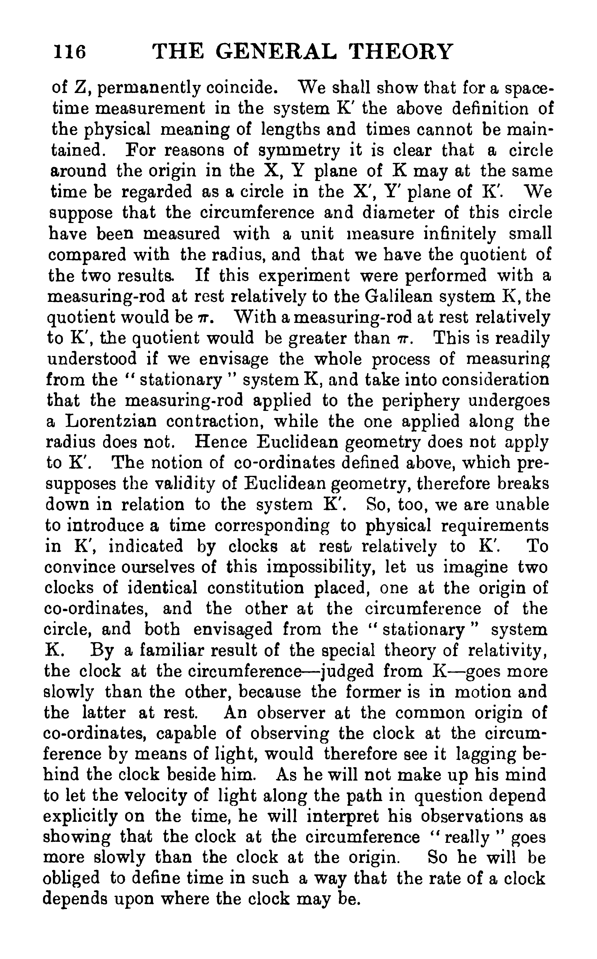

Slide 40
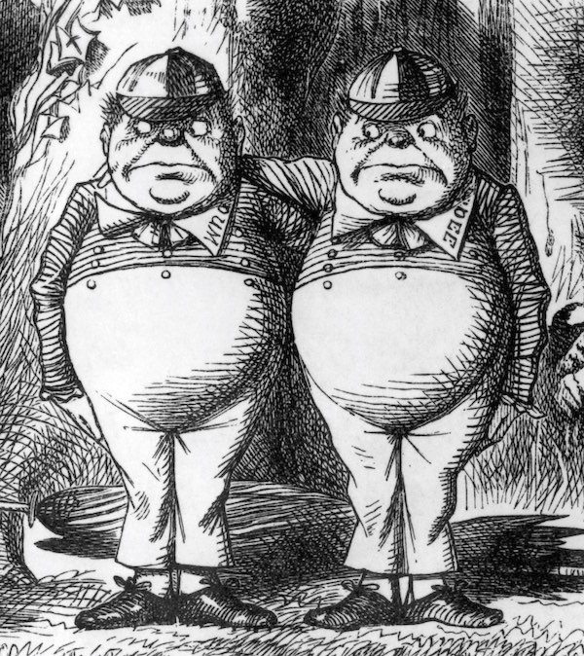
2. Suspicious powers
Epistemic reach of a thought experiment.
=
Epistemic reach of a picturesque argument.
How can this happen if the execution of a thought experiment implements some other power of or process in the mind?

Slide 41
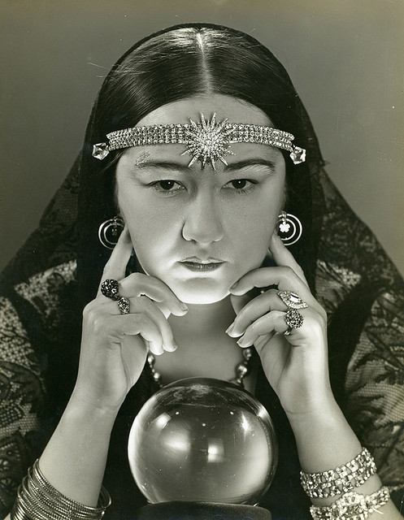

You have always wanted to be a sailor. You hate broccoli.
I have always
wanted to be a sailor.
I hate broccoli.
My
Year
Book

Slide 42
The Reliablity Challenge

Slide 43
Thought experiments can err.
thought experimenting is to be a reliable instrument,
we must be able to distinguish the epistemically successful from the unsuccessful thought experiment.
IF
THEN
The challenge:
Thought experiment anti thought experiment pairs.
The argument view
can distinguish good from bad:
A good thought experiment is a good argument.
A bad thought experiment is a bad argument.
How do other accounts distinguish?

Slide 44
Thought Experiment –
Anti Thought Experiment
Pairs

Slide 45
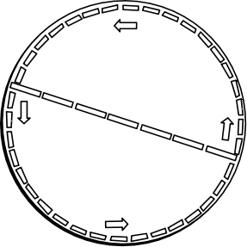
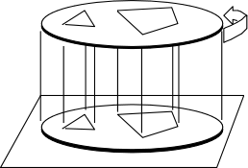
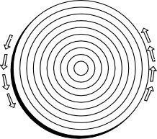
Einstein’s rotating disk (three versions)
C < π D
Moving rings contracted
circumferentially
but not radially
Petzold
(to Einstein, July 26,
1919)
C = π D
Figures at an instant
traced onto non-rotating
tracing paper.
Varicak 1911
(after a method by Ehrenfest)
C > π D
Tangential rods
contracted
Radial rods uncontracted
Einstein 1912

Slide 46
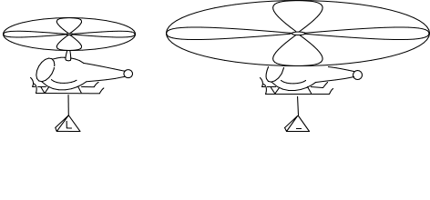
The Helicopter: the Thought Experiment
What is the lift generated by an infinite, non-rotating rotor?
Double rotor size.
Halve rotor speed.
Rotor lift stays the same (at L).
Power consumed is halved.
In the limit of infinitely many doublings,
an infinite, non-rotating rotor generates lift L and consumes no power.
“That must be how angels work. Wide wing spans.”
--Jeremy Butterfield
Notes:
Why is this thought experiment spurious? Analogy. A rope can hold 100 lb. Halve cross sectional area of rope and double tensile strength--it can still hold 100 lb. In the limit of infinitely many halvings, we have a rope of zero cross section carrying 100 lb. But a rope of zero cross section is no rope at all!

Slide 47
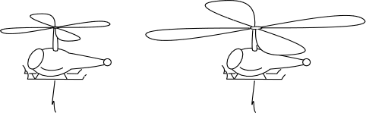
The Helicopter: the Anti-Thought Experiment
What is the lift generated by an infinite, non-rotating rotor?
A finite, non-rotating rotor generates no lift.
Double rotor size.
Rotor still generates no lift.
In the limit of infinitely many doublings,
an infinite, non-rotating rotor generates no lift.

Slide 48
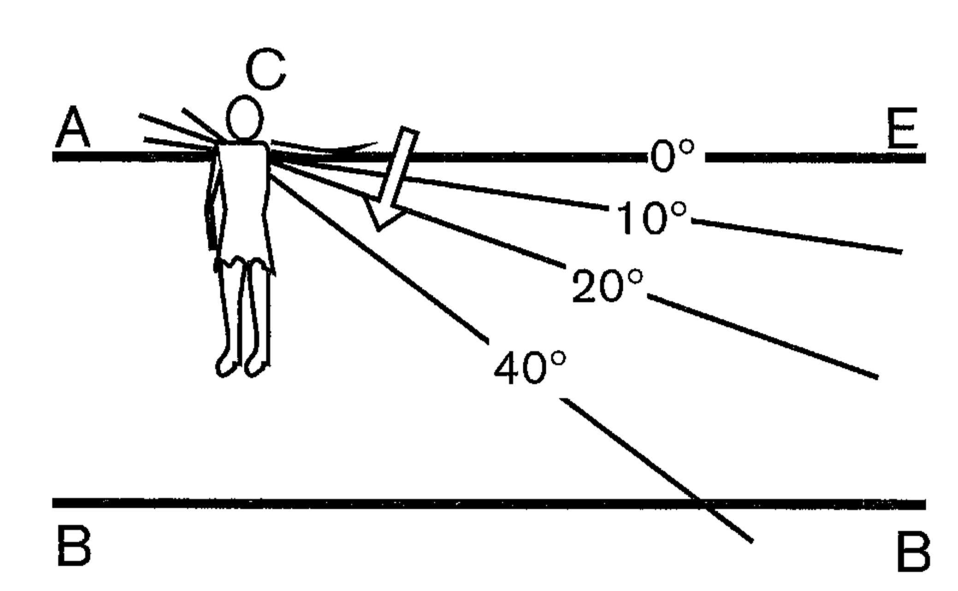
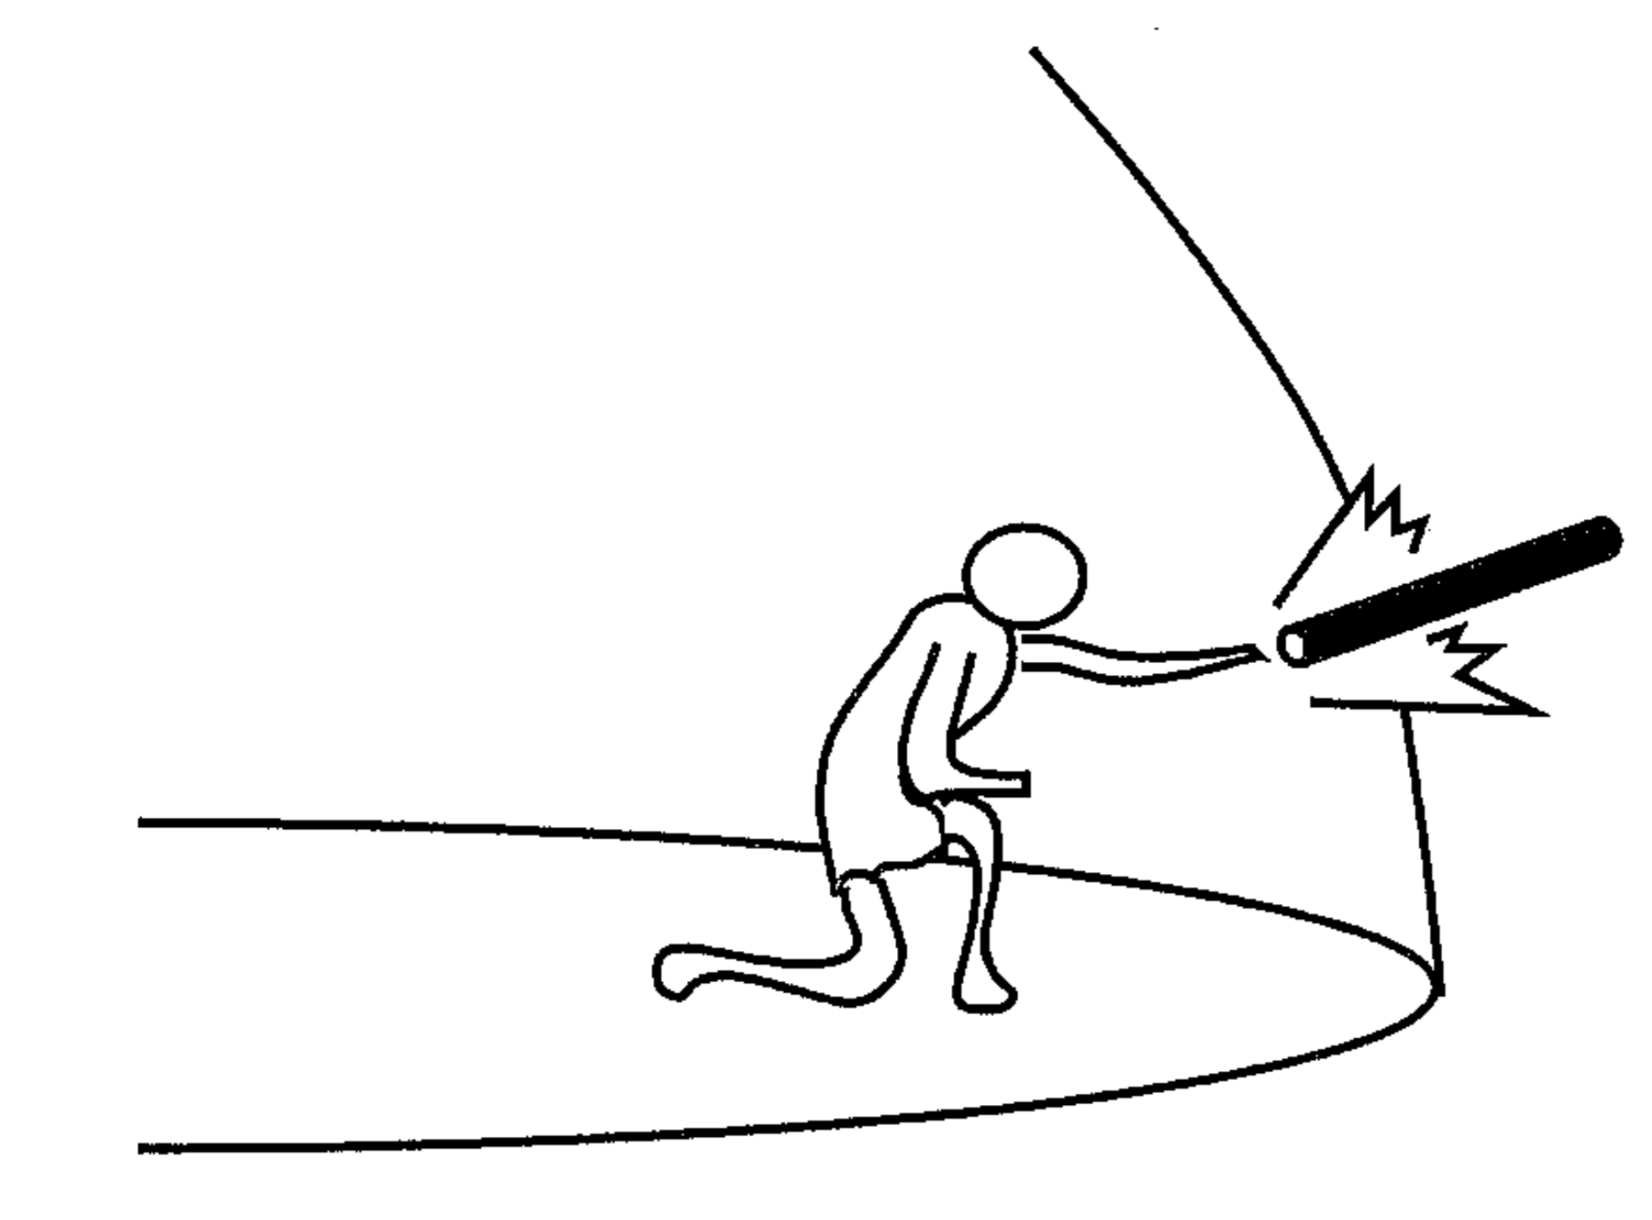
Thought experiment
Space is finite.
Anti Thought experiment
Space is infinite.
Aristotle, On the Heavens,
Bk 1, Ch. 5, 272ª8-21
Archytas, reported by Simplicius
“… could I not stretch my hand or stick outside...”
In an infinite, rotating universe, when does the infinite radius ACE first contact BB?

Slide 49




Car in the garage
Thought experiment. A car approaches a garage at 86%c.
The car is contracted 50%. Car fits.
Anti thought experiment. The garage approaches the car at 86%c.
The garage is contracted 50%. Car does not fit.
They are the same case, viewed in two different frames of reference.

Slide 50
Variation: Rod in a slot
More: Newton’s bucket vs Mach’s bucket.

Slide 51
Three step to the argument view
1.
Thought experiment
anti-thought experiment pairs
Thought experiments can err.
2.
Thought experiments can be used reliably.
They are governed by a generalized logic
3.
Evolution of the study of logic.
The logics of thought experiments are the standard deductive and inductive logics.

Slide 52
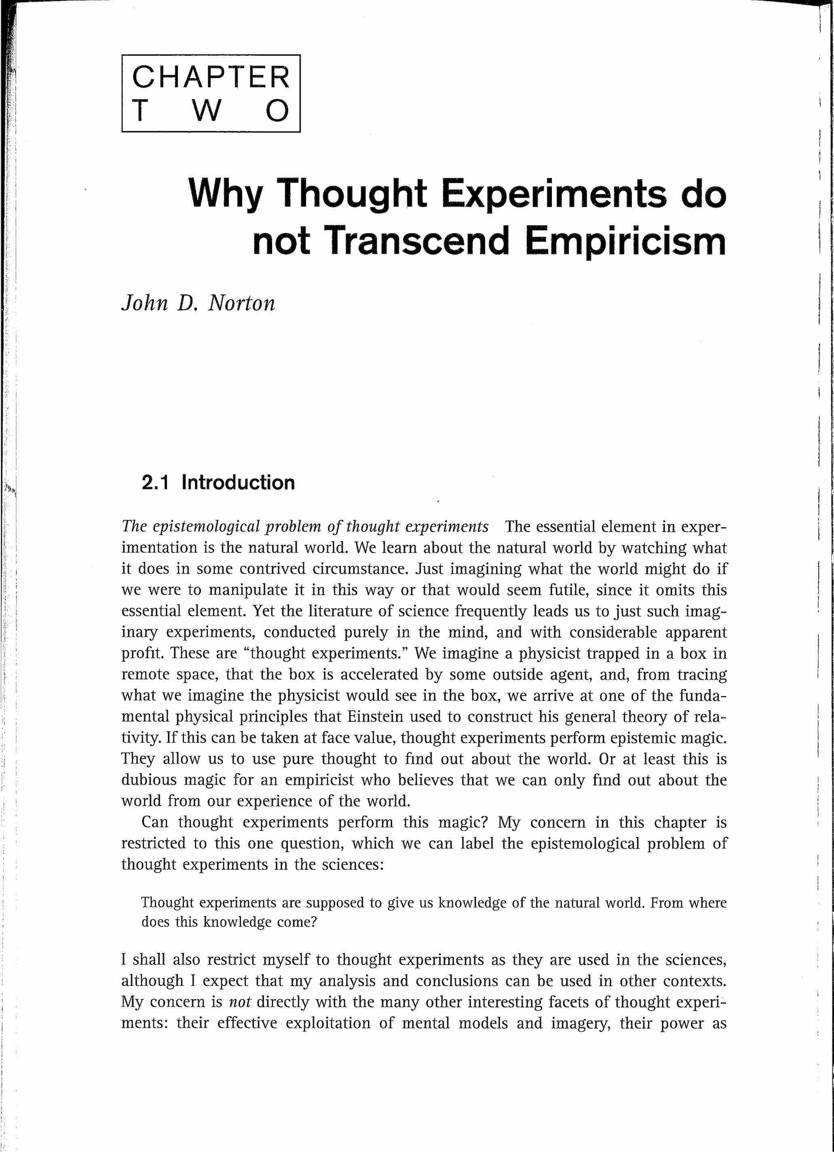
For more on Steps 2. and 3.:

Slide 53
Conclusion

Slide 54
How do other epistemologies explain the reliability of thought experimentation?
Platonism By analogy to vision.
The disanalogy with Platonic vision is that we have no independent way to check if we misperceive Platonically.
Experimentalism By analogy to ordinary experiment?
Does replicating a bad thought experiment reveal its failure?
Constructivism Reconfiguration arrived at by "constructive participation.”
How do we know when we participate erroneously?
Visualization and simulation
How do we distinguish reliable visualizations from fantasies of the imagination?
Mental Models Mental models do supply a generalized logic that can designate flawed manipulations as erroneous.

Slide 55

THE END

