Slide 1
Thought Experiments in Science John D. Norton Department of history and Philosophy of Science University of Pittsburgh
Pittsburgh Summer Program 1 Center for Philosophy of Science University of Pittsburgh
Wednesday, July 12th, 2017

Slide 2
http://www.pitt.edu/~jdnorton/lectures/CPS_summer_2017/CPS_summer_2017.html

Slide 3
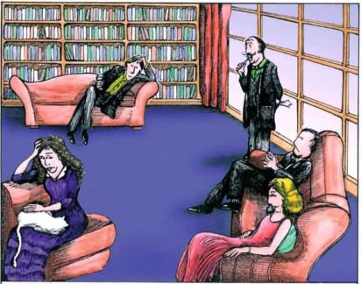
Please Think About this Problem
The epistemological problem of thought experiments in science:
How can merely experimenting in thought provide new knowledge of the natural world?
Replacement for the superconducting supercollider.
www.thought-experiment-jokes.com

Slide 4
Three Thought Experiments 1. Maxwell’s Demon 2. The Rotating Disk 3. The Dome

Slide 5
1. Maxwell’s Demon

Slide 6
Thermodynamics versus the molecular kinetic theory.
Heat ALWAYS passes from hot to cold only.
Unconfined gases ALWAYS expand.

Slide 7
Thermodynamics versus the molecular kinetic theory.
A molecular gas can spontaneously recompress.
The microscopic physics of molecular gases is not directed in time.

Slide 8
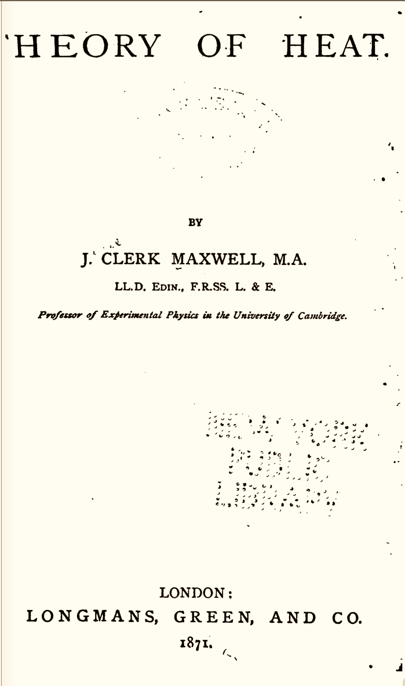
Theory of Heat, 1871, first ed.
Also
Letter to Tait, 1867;
Rayleigh 1871

Slide 9
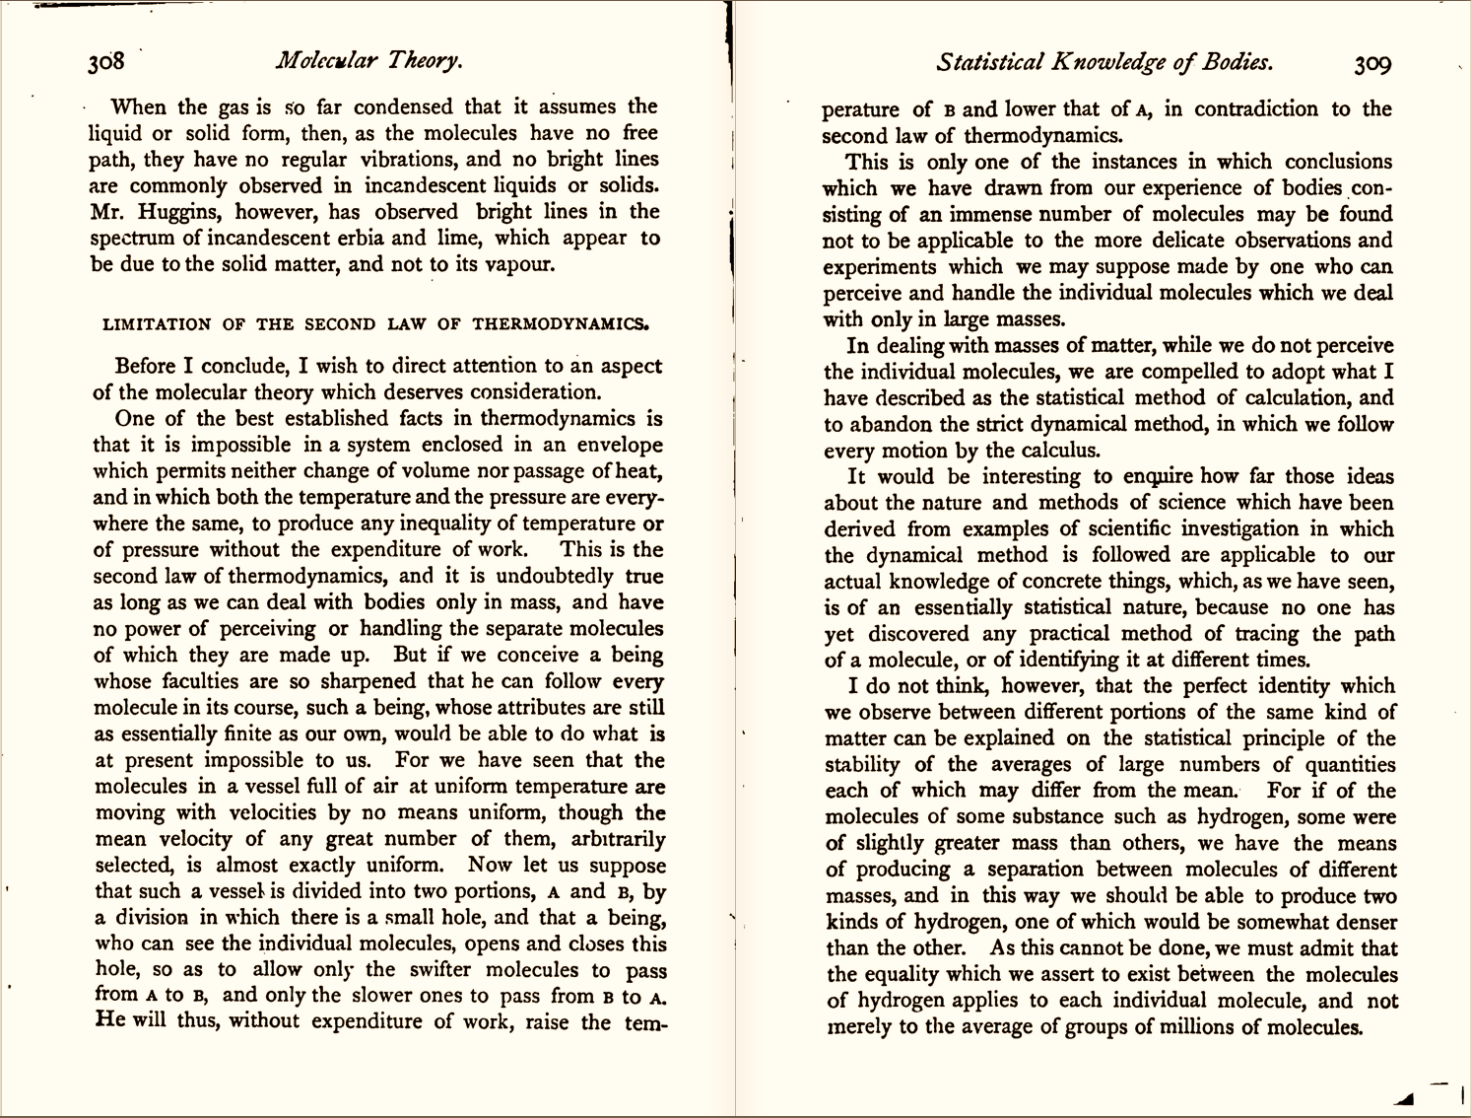
Theory of Heat
Better scan from 1872, 2nd ed.

Slide 10
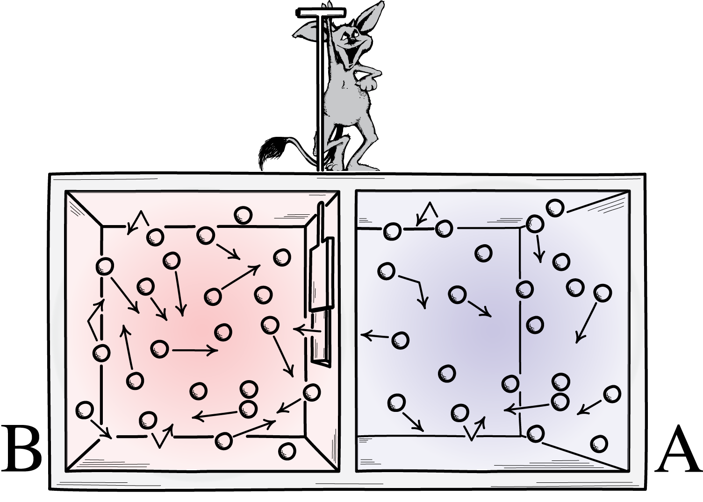
Maxwell’s Proposal
“He will thus, without expenditure of work,
raise the temperature of B
and lower that of A,
in contradiction to the second law of thermodynamics.”
air initially at
uniform temperature

Slide 11
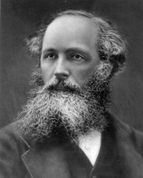
Maxwell’s Moral: The Demon Wins
“This is only one of the instances in which conclusions which we have drawn from our experience of bodies consisting of an immense number of molecules may be found not to be applicable to the more delicate observations and experiments which we may suppose made by one who can perceive and handle the individual molecules which we deal with only in large masses.
In dealing with masses of matter, while we do not perceive the individual molecules, we are compelled to adopt what I have described as the statistical method of calculation, and to abandon the strict dynamical method, in which we follow every motion by the calculus.”
Theory of Heat.
The demon illustrates that Second Law would fail if we could manipulate individual molecules.
No compulsion to exorcise the demon to protect the Second Law.
…. Nanotechnology has not yet overturned the Second Law.

Slide 12
2. The Rotating Disk

Slide 13
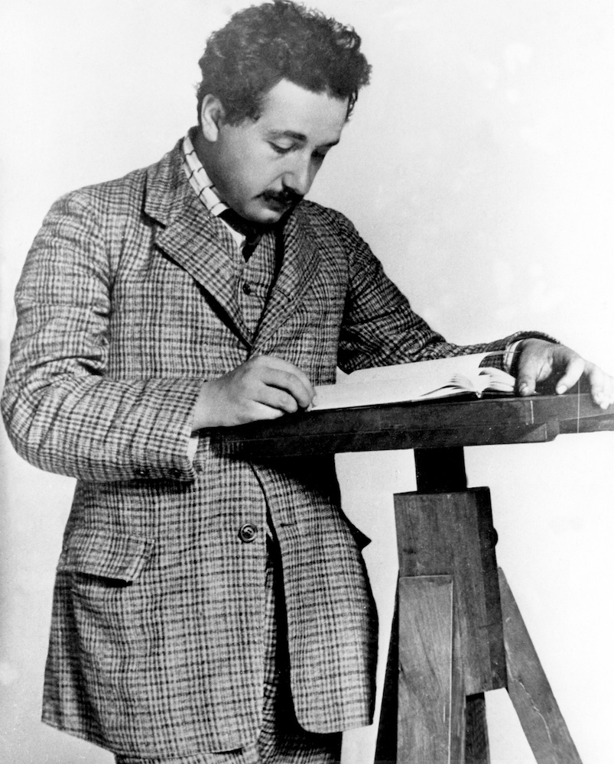
Einstein’s Discovery of Relativity Theory
1905
Apply the principle of relativity to inertial motion.
Special relativity
1907, 1908, 1909, 1910, 1911, 1912, 1913, 1914, 1915.
Extend the principle of relativity to accelerated motion.
???
rotation
Rectilinear acceleration
Gravity slows clocks, slows and bends light.

Slide 14
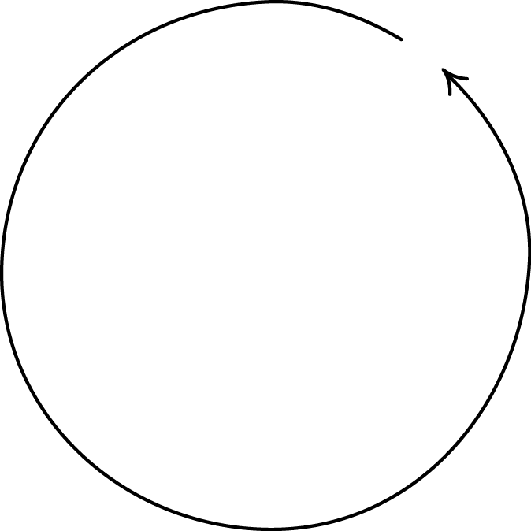
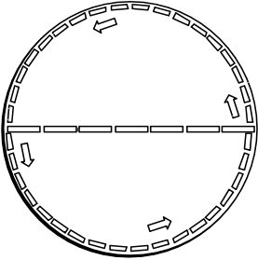
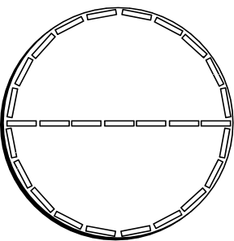
Rotating Disk 1912
= π x diameter
circumference
> π x diameter
circumference
measured by laying out moving, contracted rods end to end.
Length of radial rods unaffected by motion.
measured by laying out rods end to end.
Geometry found on a rotating disk is non-Euclidean.

Slide 15
3. The Dome An Indeterminstic Newtonian System

Slide 16
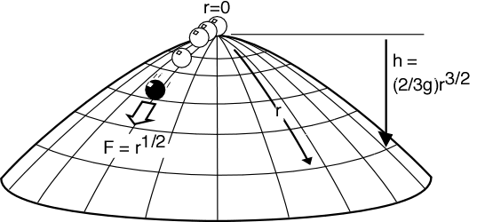
The Arrangement
A unit mass sits at the apex of a dome over which it can slide frictionless. The dome is symmetrical about the origin r=0 of radial coordinates inscribed on its surface. Its shape is given by the (negative) height function h(r) = (2/3g)r^{3/2}.
The mass experiences an outward directed force field
F = (d/dr) potential energy = (d/dr) gh = r^{1/2}.
The motion of the mass is governed by Newton’s “F=ma”:
d²r/dt² = r^{1/2}.

Slide 17
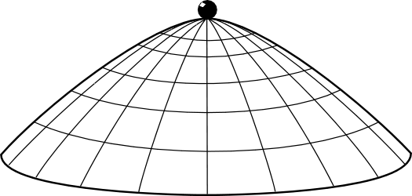
Possible motions: None
r(t) = 0
solves Newton’s equation of motion since
d²r/dt² = d²(0)/dt² = 0 = r^{1/2}.

Slide 18
Possible motions: Spontaneous Acceleration
The mass remains at rest until some arbitrary time T, whereupon it accelerates in some arbitrary direction.
r(t) = 0, for t≤T and
r(t) = (1/144)(t–T)⁴, for t≥T
solves Newton’s equation of motion
d²r/dt² = r^{1/2}.
For t≤T, d²r/dt² = d²(0)/dt² = 0 = r^{1/2}.
For t≥T
d²r/dt² = (d² /dt²) (1/144)(t–T)⁴
= 4 x 3 x (1/144) (t–T)²
= (1/12) (t–T)²
= [(1/144)(t–T)⁴]^{1/2} = r ^{1/2}

Slide 19
The computation again
For t≤T, d²r/dt² = d²(0)/dt² = 0 = r^{1/2}.
For t≥T
d²r/dt² = (d² /dt²) (1/144)(t–T)⁴
= 4 x 3 x (1/144) (t–T)²
= (1/12) (t–T)²
= [(1/144)(t–T)⁴]^{1/2} = r ^{1/2}

Slide 20
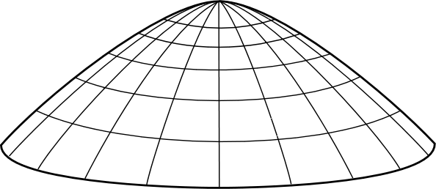
The Dome without Calculus
Imagine the mass projected from the edge.
Close…

Slide 21
The Dome without Calculus
Imagine the mass projected from the edge.
Closer…

Slide 22
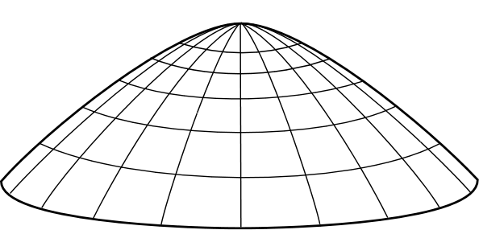
The Dome without Calculus
Imagine the mass projected from the edge.
BINGO!
Now consider the time reversal of this process.
Spontaneous motion!
BUT there is a loophole. Spontaneous motion fails for a hemispherical dome. How can the thought experiment fail in that case?

Slide 23
How do these thought experiments inform us?

Slide 24
Epistemologies of Thought Experiments
Platonism, Intuitionism
Brown
Laws of nature reside in a Platonic world. We perceive the laws directly in the right sort of thought experiment.
Experimentalism
Sorensen
Thought experiments gain epistemic power through their mimicry of real experiments.
Constructivism
Kuhn, Gendler
Thought experiments reveal lacunae in our conceptual systems and show us how to reconfigure them.
Visualization and Simulation
Arthur
The mind has the power to simulate the world through visualization.
Mental Models
Nersessian, Palmieri
Thought experiments are the manipulation of mental models discussed in recent cognitive science.
Arguments
Norton
Thought experiments are merely disguised, picturesque argumentation.

Slide 25
The Argument View

Slide 26
The Argument View: Principal Claims
Thought experiments
are arguments that happen also to (i) posit hypotheticals or counterfactuals (“thought”); (ii) invoke irrelevant particulars (“experiment”).
Since…
…no epistemic mysteries.
Reliability thesis (more shortly).
Context of Justification
All thought experiments can be reconstructed as arguments based on tacit or explicit assumptions. Belief in the outcome is justified only in so far as the reconstructed argument is cogent. (“The reconstruction thesis”)
…no counterexamples known to me (but many claimants).
Context of Discovery
The actual carrying out of a thought experiment is the execution of an argument, even if in disguised form. (“The execution thesis”)
…the epistemic reach of a thought experiment coincides with the reach of an argument.
Notes:
On the execution thesis:
People are often reluctant to make the step from the reconstruction thesis to the execution thesis.
The analogy is to a seer whose predictions agree with what everyone could reasonably predict from reading the newspaper.

Slide 27
Einstein’s Rotating Disk Thought Experiment Reconstructed
(D1) In Euclidean geometry, the measured circumference of a disk is π times its diameter. (Premise)
(D2) The geometry of a non-rotating disk is Euclidean. (Premise)
(D3) The motion of a radial element on a rotating disk is perpendicular to its length, so that (according to special relativity) the length is unaltered. (Premise)
(D4) The motion of a circumferential element on a rotating disk is along its length, so that (according to special relativity) the length is contracted. (Premise)
(D5) Therefore the measured circumference of a rotating disk is more than π times the measured diameter. (From D2, D3, D4)
(D6) Therefore the geometry of a rotating disk is not Euclidean. (From D1, D5)

Slide 28
The Case for the Argument View
Accept the argument view since:
No epistemic miracles.
Thought experiments take
what we already know tacitly
and make it explicit by means that…
…preserve truth;
deductive argument
…or preserve its probability.
inductive argument
Reject any other view since:
Reliability Thesis
If thought experiments can be used reliably, epistemically, then they must be arguments that justify their outcomes by an identifiable logic , construed very broadly, or reconstructible as them.
Notes:
No epistemic miracles --> grounds for accepting the argument view.
Reliability thesis --> reason to reject all other views

Slide 29
Thought Experiment – Anti Thought Experiment Pairs and the case for the reliability thesis.

Slide 30
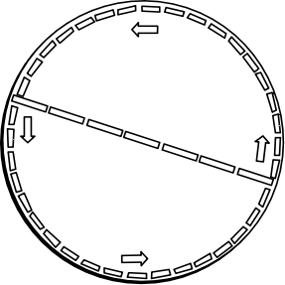
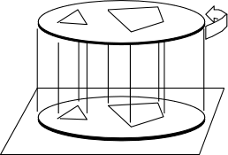
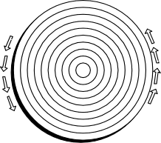
Thought Experiment Anti-Thought Experiment Pairs (three)
C < π D
Moving rings contracted
circumferentially
but not radially
Petzold
(to Einstein, July 26,
1919)
C = π D
Figures at an instant
traced onto non-rotating
tracing paper.
Varicak 1911
(after a method by Ehrenfest)
C > π D
Tangential rods
contracted
Radial rods uncontracted
Einstein 1912

Slide 31
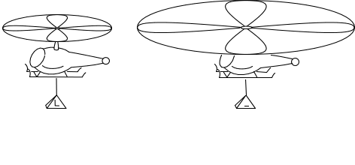
The Helicopter: the Thought Experiment
What is the lift generated by an infinite, non-rotating rotor?
Double rotor size. Halve rotor speed.
Rotor lift stays the same (at L). Power consumed is halved.
In the limit of infinitely many doublings,
an infinite, non-rotating rotor generates lift L and consumes no power.
“That must be how angels work. Wide wing spans.”
--Jeremy Butterfield
Notes:
Why is this thought experiment spurious? Analogy. A rope can hold 100 lb. Halve cross sectional area of rope and double tensile strength--it can still hold 100 lb. In the limit of infinitely many halvings, we have a rope of zero cross section carrying 100 lb. But a rope of zero cross section is no rope at all!

Slide 32
The Helicopter: the Anti-Thought Experiment
What is the lift generated by an infinite, non-rotating rotor?
A finite, non-rotating rotor generates no lift.
Double rotor size.
Rotor still generates no lift.
In the limit of infinitely many doublings,
an infinite, non-rotating rotor generates no lift.

Slide 33
Three Step Argument for the Reliability Thesis
1.
Thought experiment anti-thought experiment pairs
Thought experiments can err.
2.
Thought experiments can be used reliably.
They are governed by a generalized logic
3.
Evolution of the study of logic.
The logics of thought experiments are the standard deductive and inductive logics.

Slide 34
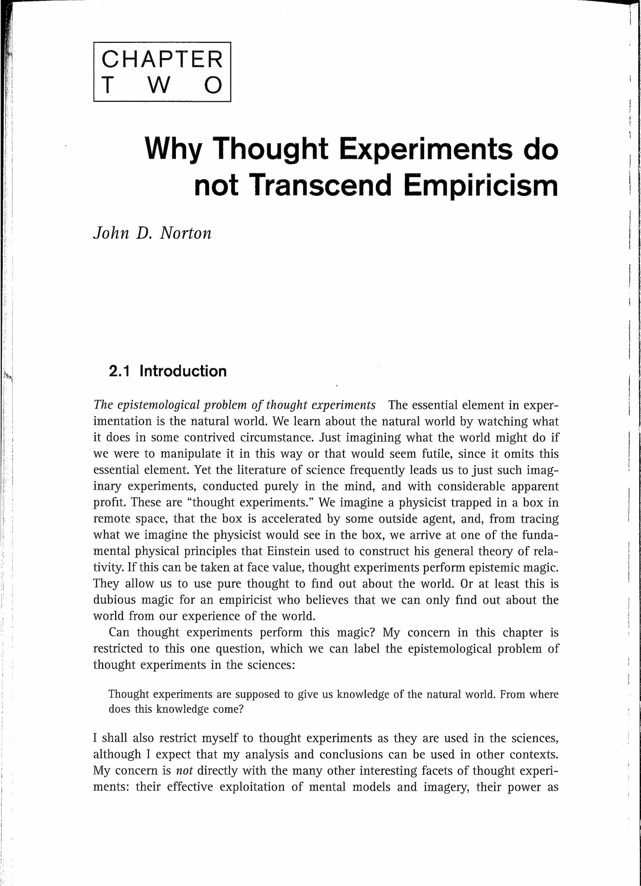
For more on Steps 2. and 3.:

Slide 35
Conclusion: How do Other Epistemologies Recover Reliability?

Slide 36
How do other epistemologies explain the reliability of thought experimentation?
Platonism By analogy to vision. The disanalogy with Platonic vision is that we have no independent way to check if we misperceive Platonically.
Experimentalism By analogy to ordinary experiment? Does replicating a bad thought experiment reveal its failure?
Constructivism Reconfiguration arrived at by "constructive participation.” How do we know when we participate erroneously?
Visualization and simulation
How do we distinguish reliable visualizations from fantasies of the imagination?
Mental Models Mental models do supply a generalized logic that can designate flawed manipulations as erroneous.

Slide 37
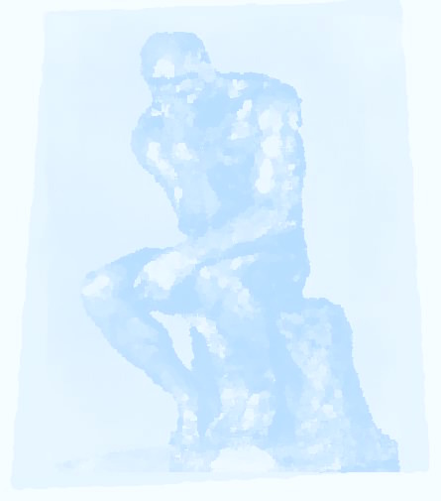
THE END

