Slide 1
Multilingual QeD jajlo'
be'nI''a'wI', Datu' alexandria
Notes:
Qo'noS jajlo' QeD Multilingual. be'nI''a'wI', Datu' alexandria SoQ pong ron laporte Original teywI' lupoQ DeSDu' http://www.pitt.edu/~super7/56011-57001/56121.ppt
SoQ mughmeH yong latlh 50 + Hol, nuqneH download
microsoft much mughwI' (HoS lang chel-neH) naQ much qaStaHvIS puS 60 Hol mugh 'ej chaq downloaded DeSDu':
https://microsofttranslator.uservoice.com/knowledgebase/articles/1159792-presentation-translator-how-do-i-use-this-to-tra
vaj not mugh much incorporated bIngDaq ghItlh leghlu' qaStaHvIS ghItlhvam 'ach chaH chaq mugh SoH pong latlh mughwI' Apps je
App google mughwI':
https://play.google.com/store/apps/details?id=com.google.android.apps.translate&hl=en

Slide 2
ba serageldin Qul Methods be'nI''a'wI', Datu'
> 1,000,000 emails
paq Qul Methods 14,000
ghojmoH 60,000,000 HaDwI'
qo' largest Qul Methods be'nI''a'wI', Datu'
qo' largest scientific powerpoint be'nI''a'wI', Datu'
qo' largest ghojmoHwI' global Qul 'ej methods
Multilingual QeD developers
Notes:
ba serageldin Qul Methods be'nI''a'wI', Datu'
> 1,000,000 emails
paq Qul Methods 14,000
ghojmoH 60,000,000 HaDwI'
qo' largest Qul Methods be'nI''a'wI', Datu'
qo' largest scientific powerpoint be'nI''a'wI', Datu'
qo' largest ghojmoHwI' global Qul 'ej methods
Multilingual QeD developers

Slide 3
3 vatlhvI' Publications vo'
developing countries
80 vatlhvI' roghvaH qo'
publication
roghvaH
Scientific Equity nIS
Notes:
3 vatlhvI' Publications vo'
developing countries
80 vatlhvI' roghvaH qo'
Scientific Equity nIS

Slide 4
qay'
6500 Hol HochDaq
1 Hol QeD (English Hol)
Notes:
qay'
6500 Hol HochDaq
1 Hol QeD (English Hol)
"Hol barriers"

Slide 5
buStaHmo' potlh puS Sov. albert einstein
ВООБРАЖЕНИЕ ВАЖНЕЕ ЗНАНИЙ (russian)
الخيال أكثر أهمية من المعرفة(arabic)
想象力比知识更重要 (chinese)
l'imagination est-potlh que De la connaissance (french)
button 103 Hol mugh
Notes:
buStaHmo' potlh puS Sov. albert einstein
button 103 Hol mugh
chay' mughmeH bIr mIw wIje'laHbe'chugh vaj button website chenmoH http://www.pitt.edu/~super1/how%20to%20create%20multilingual%20translation%20button.htm

Slide 6
"vi title civil rights 'AY' SIQwI' federal boQ financial SuD reasonable mIw vay' ghun, chavmoH je activities pong eligible nuv je poQ 1964 tera' proficiency vuS"
Notes:
vuS tera' Proficiency (lep)
"vi title civil rights 'AY' SIQwI' federal boQ financial SuD reasonable mIw vay' ghun, chavmoH je activities pong eligible nuv je poQ 1964 tera' proficiency vuS"

Slide 7
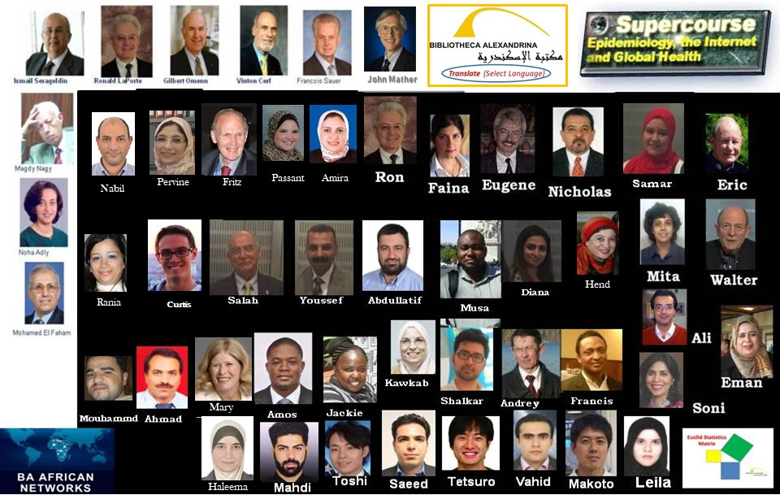
team Bibliotheca alexandrina
Notes:
team Bibliotheca alexandrina
laH neH SoHvaD qaStaHvIS nungbogh team global. tor po' maSIr, barat, iran, nIpon, kenya, kazakhstan, mexico, nigeria, u.s. 'ej latlh law' Sep vay' qaS ghu'vam. poH 'ej effort vay' DuHbe' qaS donated SuvwI' qu nuvpu'.
"'oH reH law' DuHbe' until Qu' 'oH" (mandela)
"not vIHar puS qo' pagh choH ghojwI'pu'lI' nuvpu'. qar'a', ghaH 'Iv reH Hoch "(mead)
jInmol supercourse- www.pitt.edu/~super1
Supercourse QeD- ssc.bibalex.org
central asian QonoS porgh Damo' ghaH Global- cajgh.pitt.edu
Qul Methods be'nI''a'wI', Datu' alexandria- http://ssc.bibalex.org/helpdesk/introduction.jsf
bibliotheca alexandrina (ba) lalDan Networks- http://afn.bibalex.org/generalportal.aspx
euclid Statistical Matrix- http://www.pitt.edu/~super1/researchmethods/statisticsmatrix.htm
serageldin-euclid be'nI''a'wI', Datu'- http://www.pitt.edu/~super1/researchmethods/serageldineuclidlibrary.htm
baifa resourse SoH chavmoH- https://bibalex.org/baifa/en/page/resourcesharingservice#ba serageldin be'nI''a'wI', Datu'
mugh google- https://translate.google.com/
mughwI' microsoft- https://www.microsoft.com/en-us/translator/
multilingual Supercourse- www.pitt.edu/ ~super1/multilingualsupercourse.html

