Slide 1
HIGHLIGHTS OF NOTABLE DISASTERS OF 2012
PART 7: 2012 TORNADOS
(In Chronological Order)
Walter Hays, Global Alliance for Disaster Reduction, University of North Carolina, USA
Notes:
More lectures at Disasters Supercourse - http://www.pitt.edu/~super1/collections/collection52.htm

Slide 2
THE TREND OF 2010, AND 2011 CONTINUED IN 2012
BOTH SPRING WEATHER AND WINTER WEATHER CREATED FAVORABLE CONDITIONS FOR DEVASTATING TORNADOS

Slide 3
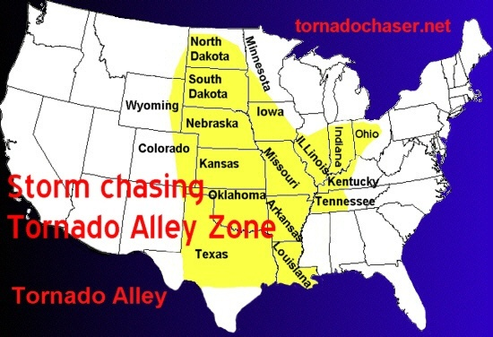
MAP OF THE USA’s “TORNADO ALLEY”

Slide 4
WHAT IS A DEVASTATING TORNADO LIKE?
Based on experiences in the USA

Slide 5
SUDDENLY - - -
With little of no warning, you hear a loud noise
You turn to walk back to the house and it’s gone.
You are alive, but homeless.

Slide 6
SUDDENLY - - -
You’re in the middle of an eerie state of confusion.
You’ve lost everything.
So have your neighbors.

Slide 7
AND ALMOST AS SUDDENLY - - -
People you’ve never met before are giving you food, water, clothing, and medicine, and helping you find the strength to start over again.

Slide 8
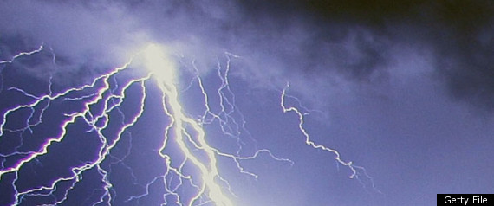
FAVORABLE CONDITIONS FOR CREATION OF TORNADOS
Strengthening winds
Daytime heating
Low-level moisture return along and ahead of cool front

Slide 9
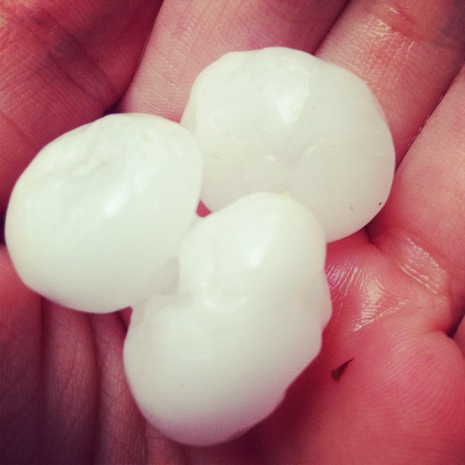
HAIL

Slide 10
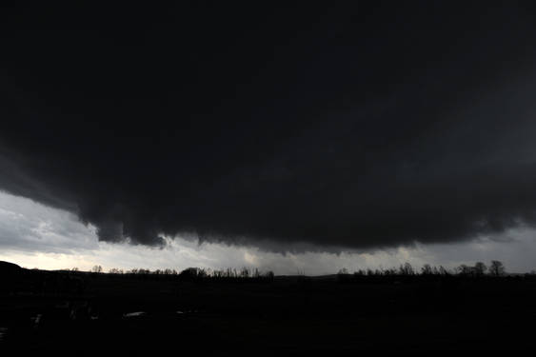
AN EF-4 TORNADO IN INDIANA: MARCH 2

Slide 11
ES-4 TORNADOES HAVE WIND SPEEDS OF AT LEAST 277 KPH (166 MPH)

Slide 12
EARLY SEASON TORNADOES RIP THROUGH 6 STATES
Homes, trailer parks, shopping malls, churches, hospitals, and resorts were damaged and destroyed by high winds as tornadoes touched down in Kansas, Missouri, Illinois, and 3 other Midwestern states.

Slide 13
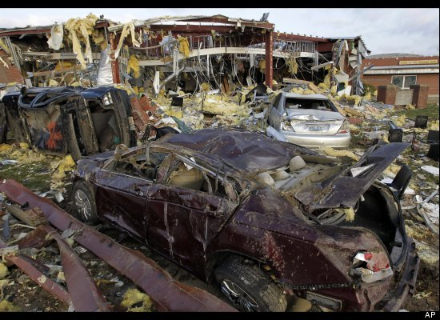
HENRYVILLE, INDIANA: DAMAGE AT JR – HIGH SCHOOL

Slide 14
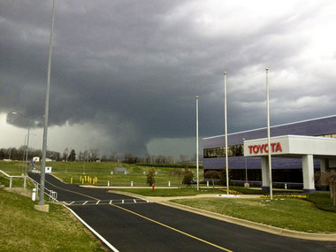
STORM APPROACHING ATHENS,GEORGIA AREA

Slide 15
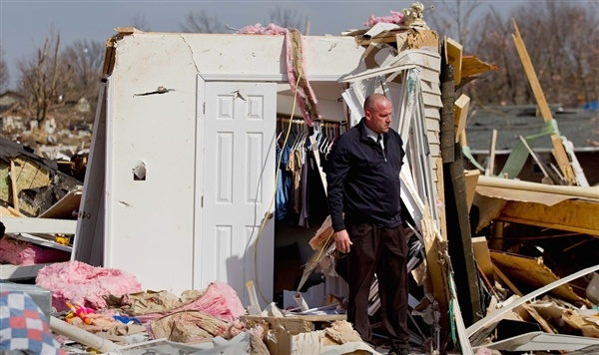
DAMAGE: HARRISBURG, IL: FEB. 29, 2012

Slide 16
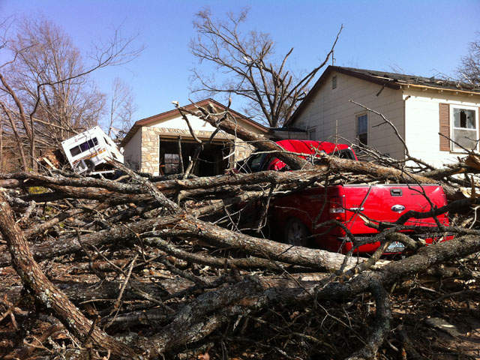
WIND DAMAGE: BRANSON, MISSOURI

Slide 17
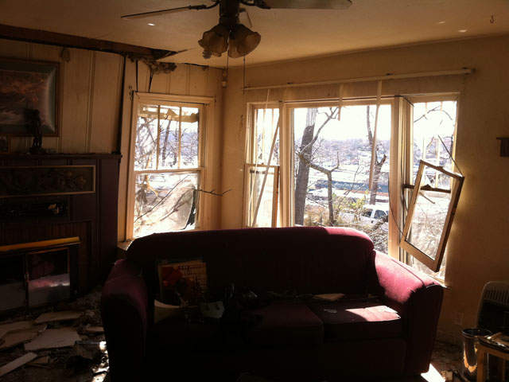
WIND DAMAGE: BRANSON, MISSOURI

Slide 18
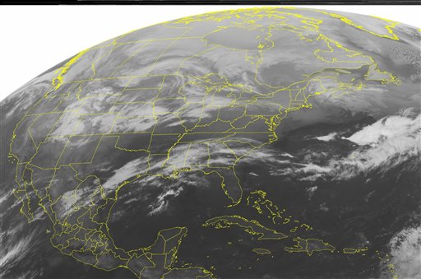
MARCH 2 STORMS STRETCHED FROM THE GULF COAST TO GREAT LAKES

Slide 19
THE TWISTERS TOUCHED NEARLY ALL AREAS OF LIFE FROM THE GULF COAST TO THE GREAT LAKES TO THE EAST COAST
Over 10 million people at risk

Slide 20
SOCIETAL IMPACTS
Homes, schools, fire stations, trailer parks, shopping malls, churches, hospitals, prisons, senior centers, resorts and complete towns were damaged and destroyed by high winds and hail.

Slide 21
DEATH TOLL (about 38) COULD HAVE BEEN HIGHER BECAUSE OVER 10 MILLION PEOPLE WERE AT RISK

Slide 22
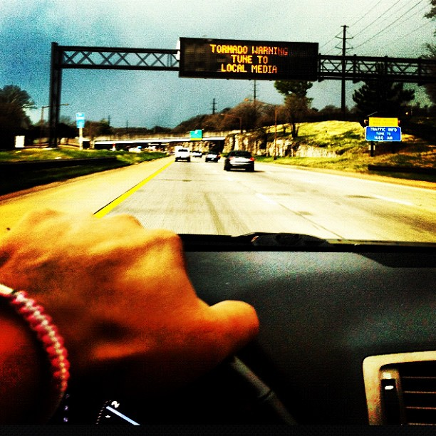
WARNING MESSAGES ON INTERSTATE HIGHWAYS

Slide 23
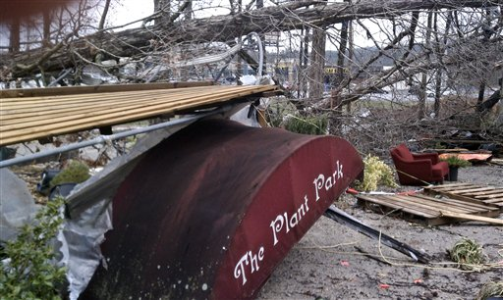
WIND DAMAGE- TONEY, ALABAMA; MARCH 2

Slide 24
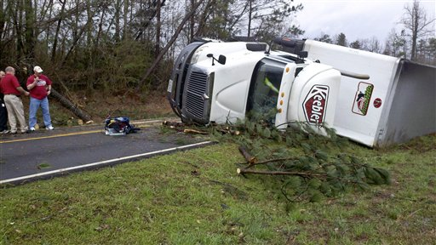
WIND DAMAGE- HARVEST, ALABAMA; MARCH 2

Slide 25
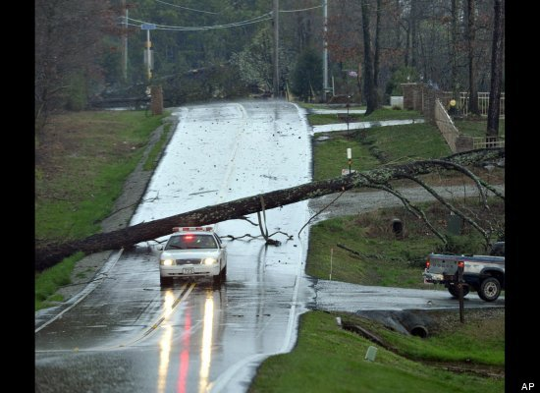
WIND DAMAGE- HARVEST, ALABAMA; MARCH 2

Slide 26
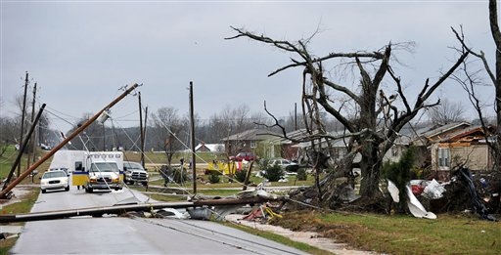
WIND DAMAGE- HARVEST, ALABAMA; MARCH 2

Slide 27
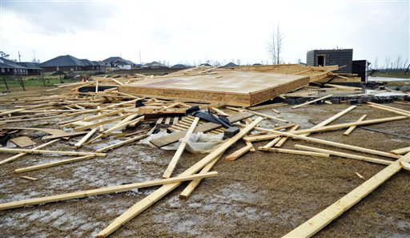
WIND DAMAGE- HARVEST, ALABAMA; MARCH 2

Slide 28
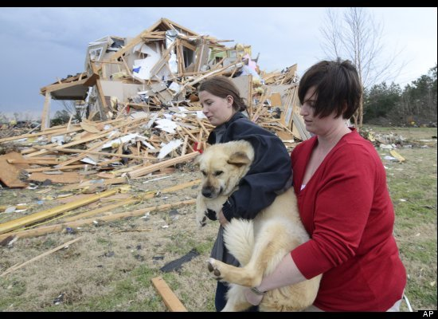
DAMAGE: OOLTEWAH, TN

Slide 29
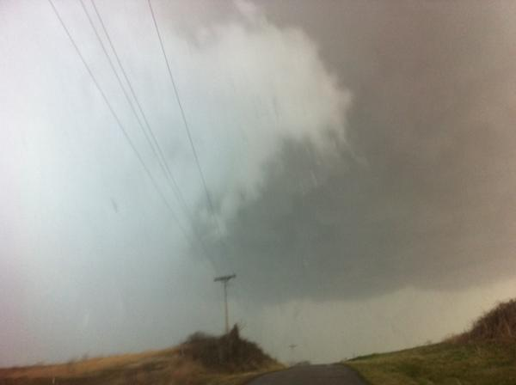
BOWLING GREEN, KENTUCKY: MARCH 2

Slide 30

TORNADO IN NEW PEKIN, INDIANA

Slide 31
During 2011, the combination of strengthening winds, daytime heating, and low-level moisture returne ahead of the cold front created an environment favorable for the development of long-lived super cell thunderstorms that produced strong tornadoes.

Slide 32
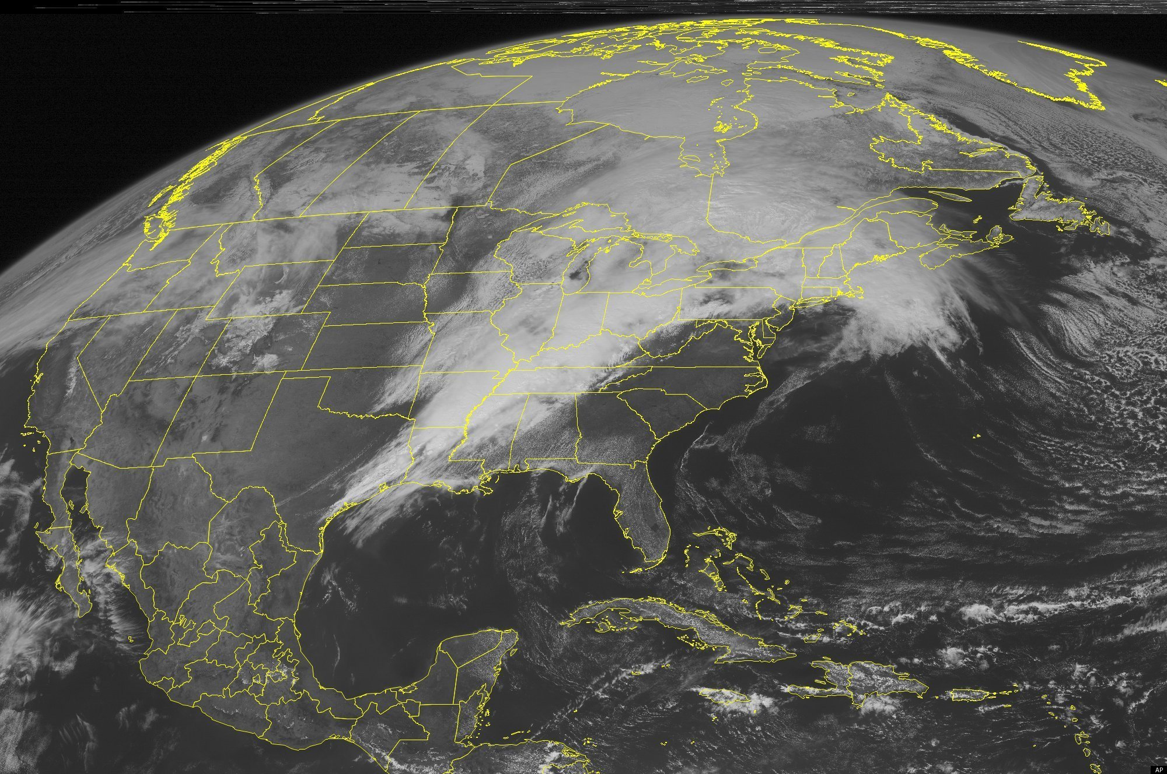
SUCH WAS THE CASE ON APRIL 14-16, 2011

Slide 33
THE APRIL 14-16 EXAMPLE:
A SEVERE WEATHER SYSTEM THAT MOVED EAST ACROSS THE USA ON APRIL 14-16 SPAWNED NEARLY 100 TORNADOES IN OK, AR, MS, AND AL, DAMAGED COMMUNITIES, AND KILLED 17 PEOPLE IN THREE DAYS.

Slide 34
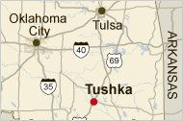
THE SEVERE WEATHER SYSTEM SPAWNED 5 TORNADOES IN OKLAHOMA: APRIL 14TH
AFTER A TORNADO LEFT A ½ MILE WIDE AND 7 MILE LONG PATH OF DESTRUCTION IN THE TOWN OF TUSHKA, OK, THE SYSTEM MOVED ON INTO ARKANSAS

Slide 35
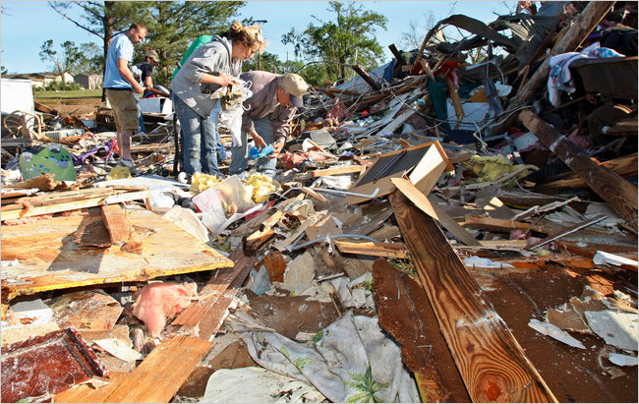
TUSHKA: DAMAGE FROM TORNADO

Slide 36
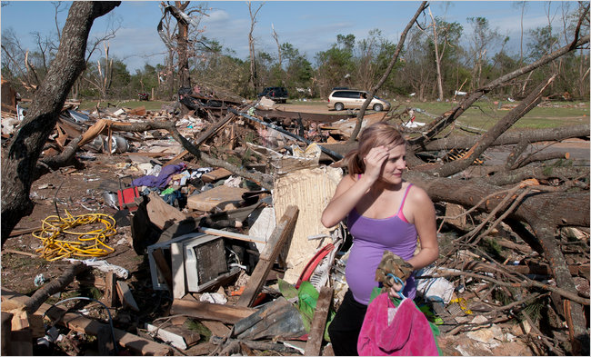
TUSHKA: MOBILE HOME DESTROYED

Slide 37
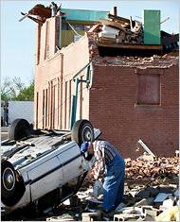
TUSHKA: HOUSE DAMAGED AND CAR OVERTURNED

Slide 38
IMPACTS IN ARKANSAS
The same weather system also spawned tornadoes with 130 kph (80 mph) winds in Arkansas, killing seven.
.

Slide 39
IMPACTS IN ALABAMA
The same weather system spawned tornadoes in six counties in Alabama Friday, causing at least eight deaths.
.

Slide 40
IMPACTS IN MISSISSIPPI
Tornadoes spawned by the same system caused major damage in the town of Clinton, near Jackson, the capitol of Mississippi..

Slide 41
OVER 100 TORNADOES DEVASTATE MIDWESTERN STATES: KANSAS, NEBRASKA, IOWA, AND, OKLAHOMA,
Saturday, April 14 - Sunday, 15, 2012

Slide 42
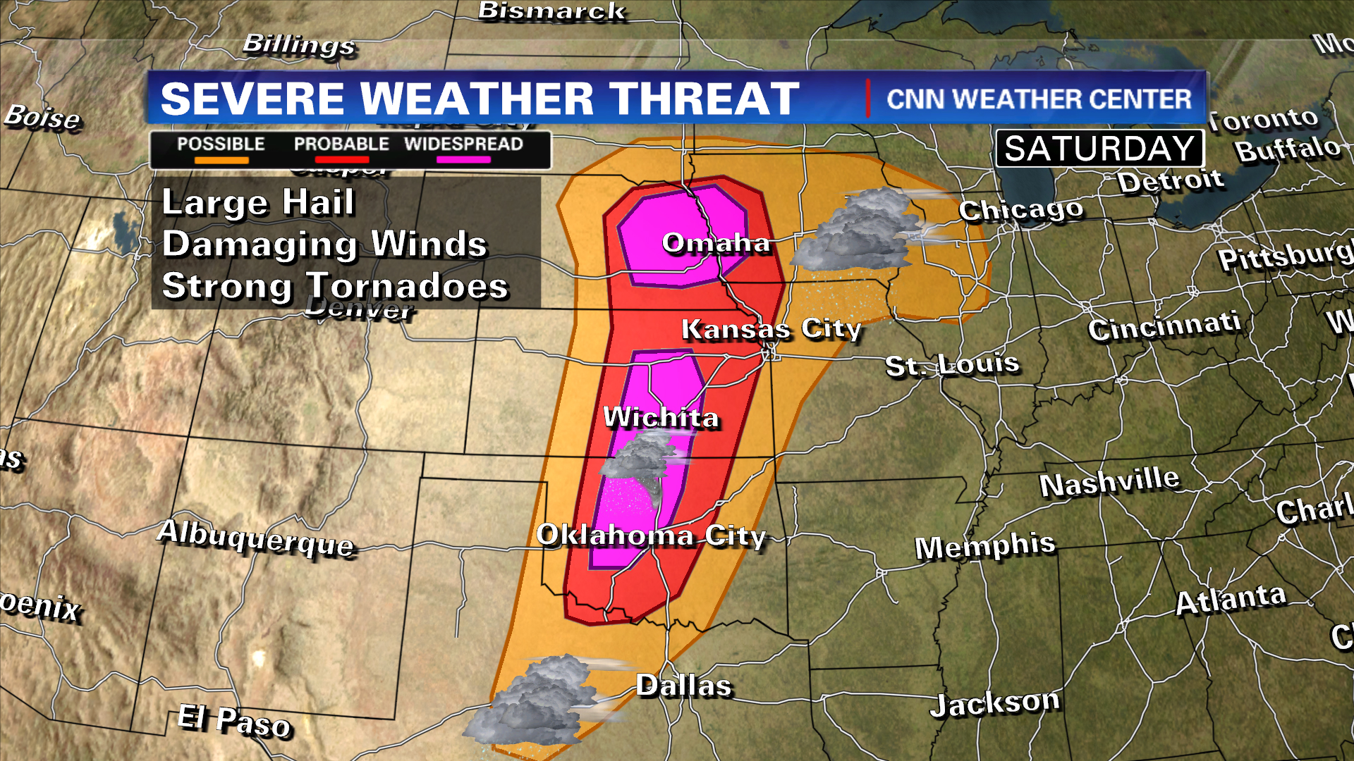
NATIONAL WEATHER SERVICE PREDICTED TORNADO OUTBREAK: APRIL 13

Slide 43
120 TORNADOES ON SATURDAY, APRIL 14TH
The Storm Center in Norman, Oklahoma logged 120 storms on Saturday, with 98 of then in Kansas
5 deaths in Woodward, OK, mainly due to siren malfunction

Slide 44
PHYSICAL IMPACTS
Lightning, hail, and heavy rain accompanied the storm system that spawned the tirnadoes

Slide 45
SOCIETAL IMPACTS
2-day losses in Kansas alone could reach $283 million
Wide-spread power outages, mobile home communities damaged, hospital in Iowa , McConnell Air Force Base, and Boeing plant damaged, 12 counties in Oklahoma declared disaster areas.

Slide 46
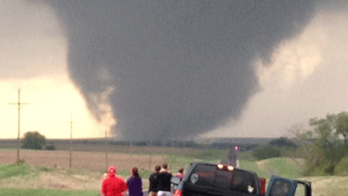
SALINA, KANSAS: APRIL 14, 2012

Slide 47
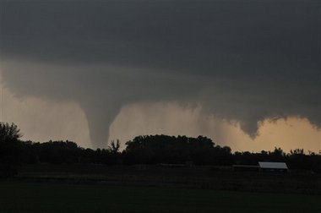
SOLOMON, KANSAS: APRIL 14, 2012

Slide 48
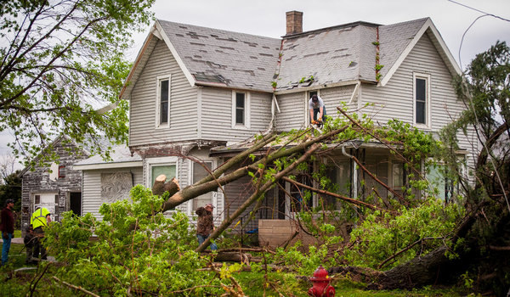
NO DEATHS, BUT 75 % OF THURMAN, IOWA DAMAGED: APRIL 14, 2012

Slide 49
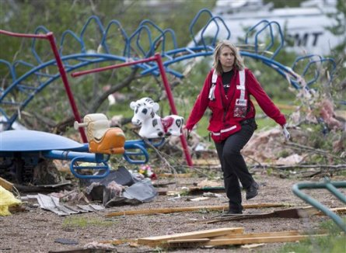
THURMAN, IOWA: AM. RED CROSS SURVEYS DAMAGE; APRIL 15, 2012

Slide 50
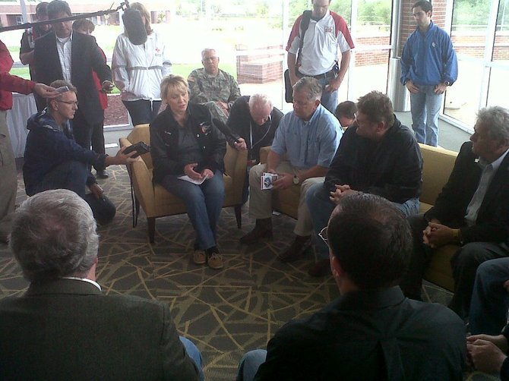
OKLAHOMA GOV. MARY FALLIN, DECLARES STATE OF DISASTER: APRIL 15, 2012

Slide 51
IMMEDIATE RESPONSE
Cots, food, water, medical supplies, and hygiene supplies were rushed to impacted areas in each state.

Slide 52
THE THREAT MOVES TOWARDS MINNESOTA
Sunday, April 15 – Monday, April 16

Slide 53
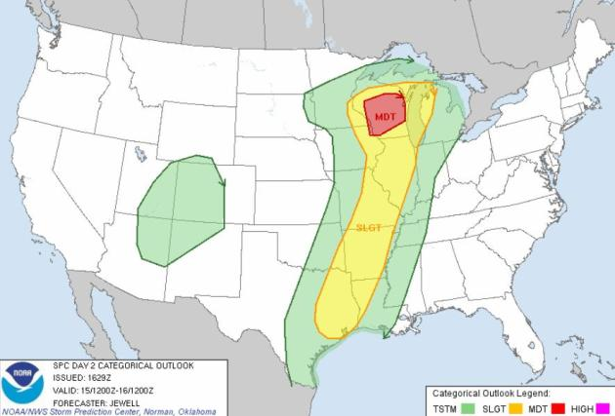
TORNADO FORECAST:
APRIL 15-16, 2012

Slide 54
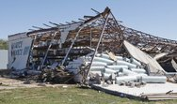
WOODWARD, OKLAHOMA: APRIL 15, 2012

Slide 55
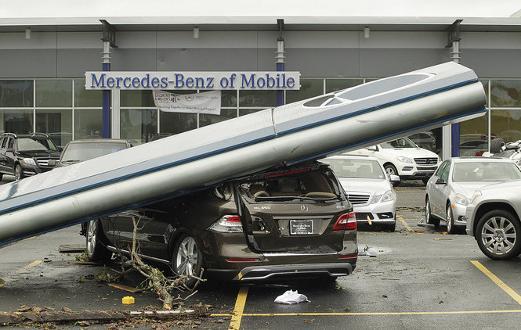
MOBILE, ALABAMA:
DECEMBER 25, 2012

