Slide 1
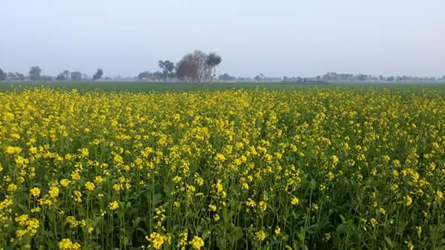
Managing a Sick Child
Abdul Rehman Pirzado

Slide 2
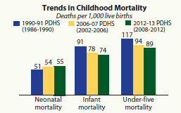

Slide 3
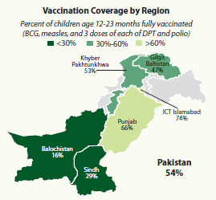

Slide 4
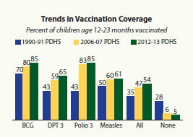

Slide 5
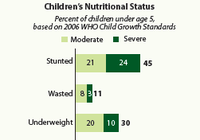

Slide 6
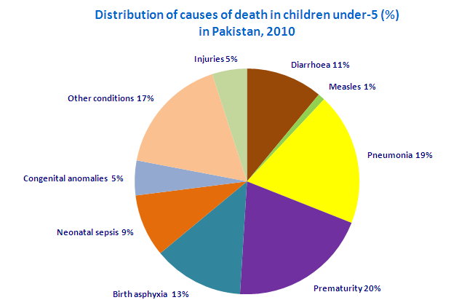

Slide 7
Human Resources and Infrastructure (2006-2013)
Physicians per 10,000 population 8.3
Nurses & midwives per 10,000 population 5.7
Community Health Workers per 10,000 population 0.7
Hospital beds per 100,00 population (2006-2012) 6.0
http://www.who.int/maternal_child_adolescent/documents/countries/indicators/dashboards/en/

Slide 8
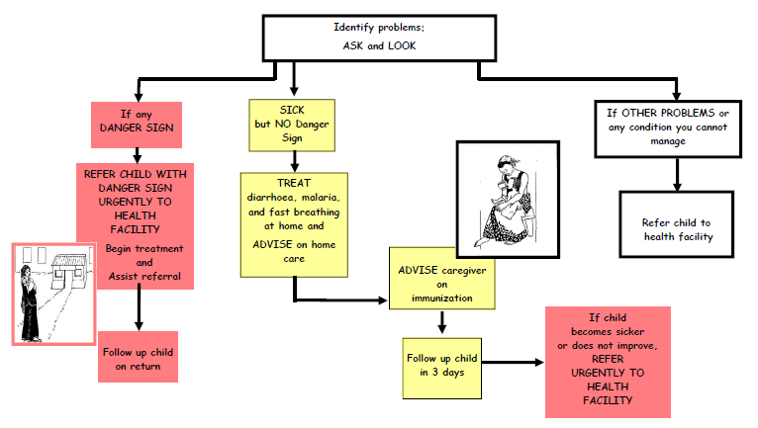

Slide 9
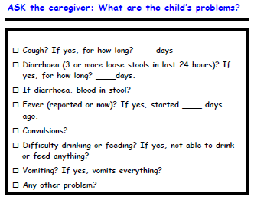

Slide 10
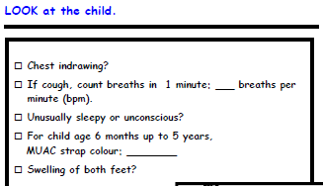

Slide 11
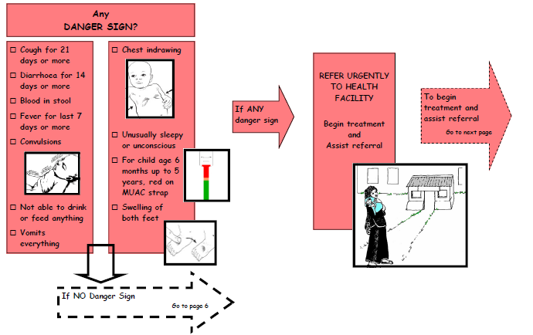

Slide 12
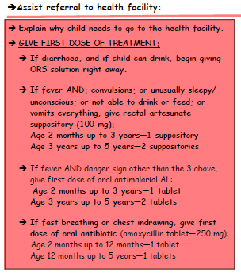
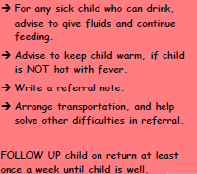

Slide 13
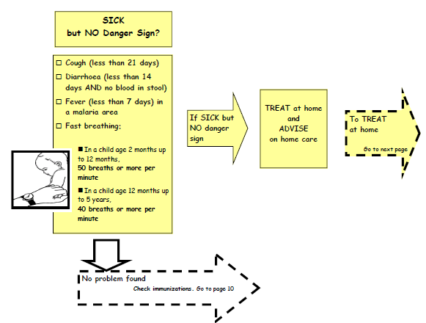

Slide 15
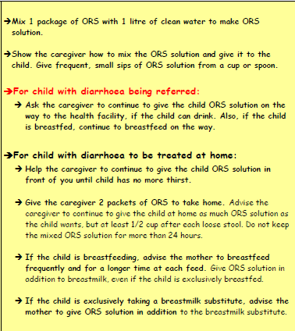

Slide 16
Age | Dose
After Birth | BCG + OPV0
At age of 6 weeks | OPV1 + Penta 1 + PCV 1
4 weeks after 1st dose | OPV2 + Penta 2+ PCV 2
4 weeks after 2nd dose | OPV3 + Penta 3+ PCV 3 + IPV
9 months | Measles 1
6 months after Measles 1 | Measles 2

Slide 17
For further readings
www.who.int/child_adolescent_health/documents/9241591951/en/
www.who.int/maternal_child_adolescent/documents/9789241506823/en/
https://www.facebook.com/عبدالرحمان-پيرزادو-Abdul-Rehman-Pirzado-601452193335897/?ref=aymt_homepage_panel

Slide 18
Total HFs | HCP Trained | HFs with IMNCI Trained HR | Year involved in IMNCI | Total (Estimated) Population of District | Total < 5 Children in District | % < 5 Children in District Covered by 2014
131 | 122 | 65 | 2008 | 910,000 | 154,700 | 50

Slide 19
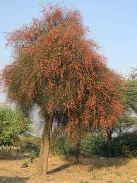
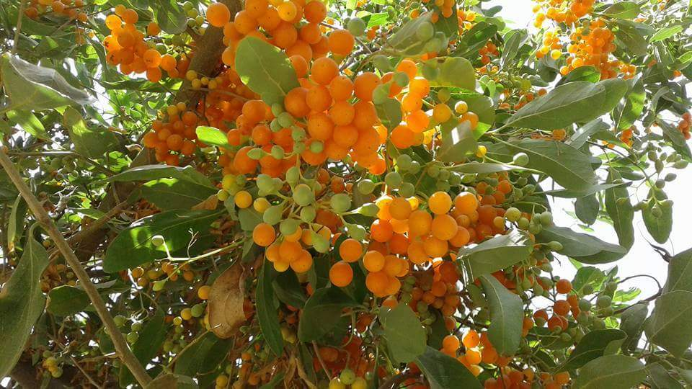
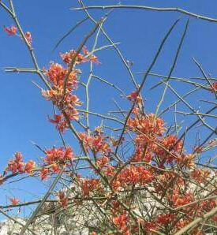
Thanks

