Slide 1
Quick Check, Rapid Assessment And Management
Module 2
Session 1

Slide 2
Objective
In this session we will:
Learn to prioritize patients presenting with an emergency or a complication through quick check and rapid assessment.

Slide 4
Emergency Conditions
Airway and breathing difficulties
Circulation and shock
Vaginal bleeding
Postpartum vaginal bleeding
Convulsions
Severe abdominal pain
Dangerous fever

Slide 5
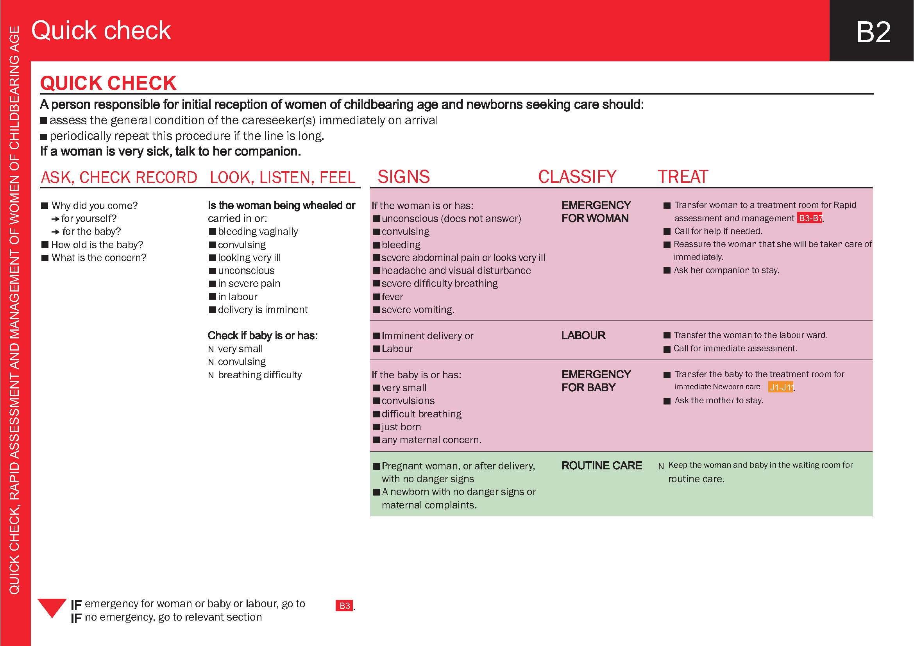

Slide 6
Case Study 1
“Shabnum has had a previous C-section. She is eight months pregnant and has severe abdominal pain and looks very unwell”
Q: How will you classify and Treat?

Slide 12
Case Study 2
“Nasreen is brought to the health facility in a wheel chair. She has a history of normal vaginal delivery at home one hours ago. On examination, she having constant trickling of blood from vagina and placenta is completely delivered”
Q.1 How do you classify her?
Q2. How do you treat her?
Q3. On what page of PCPNC Guide you will find RAM for this women?

Slide 13
Thanks

