Slide 1
Moneyball 2.0: Winning in Sports With Data
Spring 2018

Slide 2
Game Theory
Game theory studies the way in which two (or more) individuals interact in terms of choices/strategies given their preferences
Game theory has been extensively used in economics but has obvious applications in several fields including sports
John von Neumann and Oskar Morgenstern are considered the fathers of game theory

Slide 3
Normal Form of a Game
A n-player game can be described through
The set of strategies $𝒮$ available to each player $p_{i}, i∈\{1,2,…,N\}$
The utility function u_{i} for each player i, $u_{i}:S_{1}×S_{2}×…×S_{N}→ℝ$ , where $S_{j}∈𝒮$
A player’s utility does not only depends on her own strategy but also on the strategy picked by the rest of the players
Rational player: tries to choose her strategies such that her expected utility is maximized

Slide 4
Pure and Mixed Strategies
If a player picks deterministically a strategy from the set $𝒮$ then we say that she is playing a pure strategy
However, in most of the games a pure strategy is not a good idea
Thus, mixed strategy is a probability distribution over the set of the pure strategies
If player i has strategies $𝒮=\{S_{1},S_{2},…,S_{m}\}$ then a mixed strategy for this player is a function σ_{i} on $𝒮$ such that $0≤σ_{i}\left(S_{j}\right)≤1$and $\sum_{j}{σ_{i}\left(S_{j}\right)}=1$

Slide 5
Zero-Sum Games
A game where the gain of a player equals to another player’s loss is called zero-sum game
In the case of two player zero-sum game, the players have strictly opposite interests (u₁=-u₂)
Only the payoff function of one player needs to be defined
In many situations sports involve real conflicts and strictly opposite interests and hence, zero-sum games are appropriate to model the situations

Slide 6
Payoff matrix
A zero-sum two-player game can be described through the payoff matrix Π
The rows of the matrix correspond to the strategies of player R, while the columns correspond to the strategies of player C
The element Π_{ij} is the payoff value for player R when R is playing strategy i and C is playing strategy j
The payoff for player C is -Π_{ij}

Slide 7
Dominance
Given a payoff matrix Π the i^{th} row is said to dominate the k^{th} row if and only if:
In this case player R (the row player) will never choose strategy i since strategy k is dominant
$$π_{ij}≥π_{kj}, ∀j$$

Slide 8
Saddle Point
Sometimes the payoff matrix of a zero-sum two-player game makes it easy to solve the game (i.e., find the optimal/equilibrium strategy for the players)
If there is an entry Π_{ij} of the payoff matrix that
Is the minimum of the i-th row, and
Is the maximum of the j-th column
Π_{ij} is a saddle point
Π_{ij} is the value of the game

Slide 9
Saddle Point
Assume that there are 3 possible offensive plays in NFL and 3 defenses
The payoff matrix (in yards gained) of the game is the following
 | Defense 1 | Defense 2 | Defense 3
Offense 1 | 5 | 1 | 3
Offense 2 | 3 | 2 | 4
Offense 3 | -3 | 0 | 1
No one has an incentive to change strategies from offense 2 and defense 2
Equilibrium in pure strategies

Slide 10
Saddle Point
Not all games have equilibrium in pure strategies (i.e., saddle point)
In this game in every situation a player has an incentive to change her strategy
 | Run | Pass
Run | -5 | 5
Pass | 10 | 0

Slide 11
Nash Equilibrium
If we allow for mixed strategies (which is the realistic case), then Von Neumann and Morgenstern showed that a two-player, zero-sum game always has an equilibrium
Informally: a strategy profile is a Nash equilibrium if there is no player that can increase her payoff by unilaterally changing her strategy
Formally: With x_{i} being the (mixed) strategy for player i and x_{-i} the strategy of the rest of the players, x* is a Nash Equilibrium iff:
$$∀i,x_{i}∈𝒮_{i}:u_{i}\left(x_{i}^{∗},x_{−i}^{∗}\right)≥u_{i}\left(x_{i},x_{−i}^{∗}\right)$$

Slide 12
Nash Equilibrium and Game Value
If (X*,Y*) is a (mixed) equilibrium pair, then P(X*,Y*) is the value of the game v
P(X,Y) is the expected payoff when R player plays mixed strategy X and C player plays mixed strategy Y ($P\left(X,Y\right)=\sum_{i}{\sum_{j}{π_{ij}x_{i}y_{j}}}$)
$v=P\left(X^{∗},Y^{∗}\right)=\min_{Y}{P\left(X^{∗},Y\right)= \max_{X}{P(X,Y^{∗})}}$
With $u\left(x\right)=\min_{Y}{P\left(X,Y\right), w\left(Y\right)=\max_{X}{P(X,Y)}}$ then (X*,Y*) is an Equilibrium pair if and only if u(X*)=w(Y*)

Slide 13
Nash Equilibrium and Game Value
If (X*,Y*) is a (mixed) equilibrium pair →
$u\left(X^{∗}\right)≥u\left(X\right), ∀X$
w$\left(Y^{∗}\right)≤w\left(Y\right), ∀Y$
$u\left(X^{∗}\right)=\max_{X}{u\left(X\right)=\max_{X}{\min_{Y}{P(X,Y)}}}$
w$\left(Y^{∗}\right)=\min_{Y}{w\left(Y\right)=\min_{Y}{\max_{X}{P(X,Y)}}}$

Slide 14
Nash Equilibrium and Game Value
Theorem 1: The payoff for the row player when she chooses mixed strategy X is given by: $u\left(X\right)=\min_{Y}{P\left(X,Y\right)=\min_{j}{P(X,C_{j})}}$
Similarly, the payoff for the column player when she chooses mixed strategy Y is given by: $w\left(Y\right)=\max_{X}{P\left(X,Y\right)=\max_{i}{P(R_{i},Y)}}$
So essentially, if we want to find the equilibrium strategy for the row player (i.e., the payoff maximizer) we calculate $\min_{j}{P(X,C_{j})}$ and then chose X that maximizes this minimum

Slide 15
Run-VS-Pass
We saw that the previous run-pass game does not have a Nash Equilibrium in pure strategies
What about mixed strategies?
 | Run | Pass
Run | -5 | 5
Pass | 10 | 0

Slide 16
Run-VS-Pass
In a mixed strategy, the offense will chose a fraction of its plays to be passes and a fraction of its plays to be runs
How can we determine these fractions ?
Depends on the objective but let us assume that our objective is to find the Nash Equilibrium
Let’s suppose that the offense chooses run with probability q and chooses pass with probability 1-q, i.e., its mixed strategy is X=(q, 1-q)

Slide 17
Run-VS-Pass
From Theorem 1 we have to calculate the minimum of P(X, C_{i}) in order to find the payoff for strategy X
For finding the equilibrium strategy X* we need to find the maximum of that
$\max{\min{P(X,C_{i})}}$
P(X, C₁) = q(-5)+(1-q)10 = 10-15q
P(X, C₂) = 5q+(1-q)0= 5q
Equilibrium for q=0.5
u* = 2.5 (yards)
P(X,C₁)
P(X,C₂)
maxmin{P(X,C₁),P(X,C₂)}
min{P(X,C₁),P(X,C₂)}

Slide 18
Run-VS-Pass
In order to find the defense’s equilibrium strategy we follow a similar approach, but we are now looking for the $\min{\max{P(R_{i},Y)}}$ where Y is the mixed strategy of the defense, Y = (x, 1-x)
Equilibrium for the defense for x = 0.25
w* = 2.5
As expected (why?)
max{P(R₁, Y),P(R₂, Y)}
minmax{P(R₁, Y),P(R₂, Y)}

Slide 19
2x2 Matrix Games
Theorem 2: Consider a 2x2 game with no saddle point and with a payoff matrix: $\left[\begin{matrix}a & b \\ c & d\end{matrix}\right].$ Then the equilibrium strategies and the value of the game are:
$X^{∗}=(S,1−S)$
$Y^{∗}=\left(T,1−T\right)$
$U=\frac{ad−bc}{R}$
$$\begin{matrix}R=a−b−c+d \\ S=\frac{d−c}{R} \\ T=\frac{d−b}{R}\end{matrix}$$

Slide 20
Generalized Football Payoff Matrix
We can consider a generalized payoff matrix where a rushing play gains r yards on average, while a passing play gains p yards on average
A correct choice of defense has m times more effect on a passing play as compared to a running play
 | Run | Pass
Run | r-k | r+k
Pass | p+mk | p-mk

Slide 21
Generalized Football Payoff Matrix
From Theorem 2 the equilibrium strategy for the offense is given by:
$X^{∗}=(\frac{m}{m+1},\frac{1}{m+1})$
The equilibrium strategy for the defense is given by:
$Y^{∗}=(0.5+\frac{r−p}{2k\left(m+1\right)},0.5−\frac{r−p}{2k\left(m+1\right)})$
The defense chooses to defend the better play (based on the values of r and p) more than 50% of the time

Slide 22
Generalized Football Payoff Matrix
The general rule is that for m > 1 the defense has more impact on a passing play, while for m < 1 the defense has more impact on a rushing play
The offense will choose more often the play for which the defense has less control
m>1 → offense runs more
m<1 → offense passes more
The choice does not depend on the base effectiveness levels of running and passing (i.e., r and p)

Slide 23
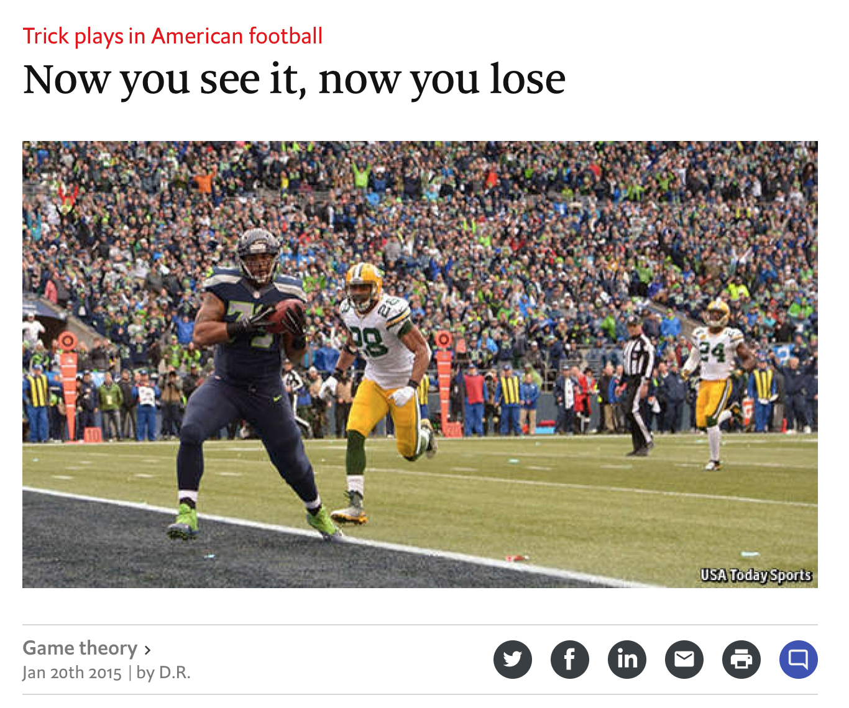
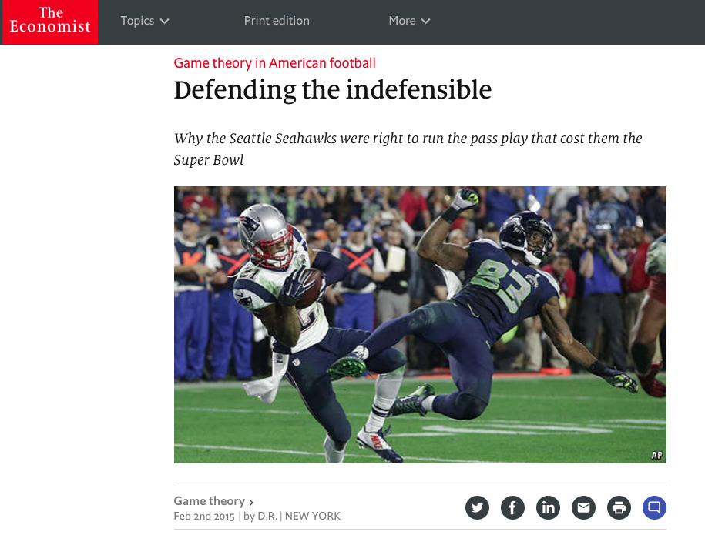
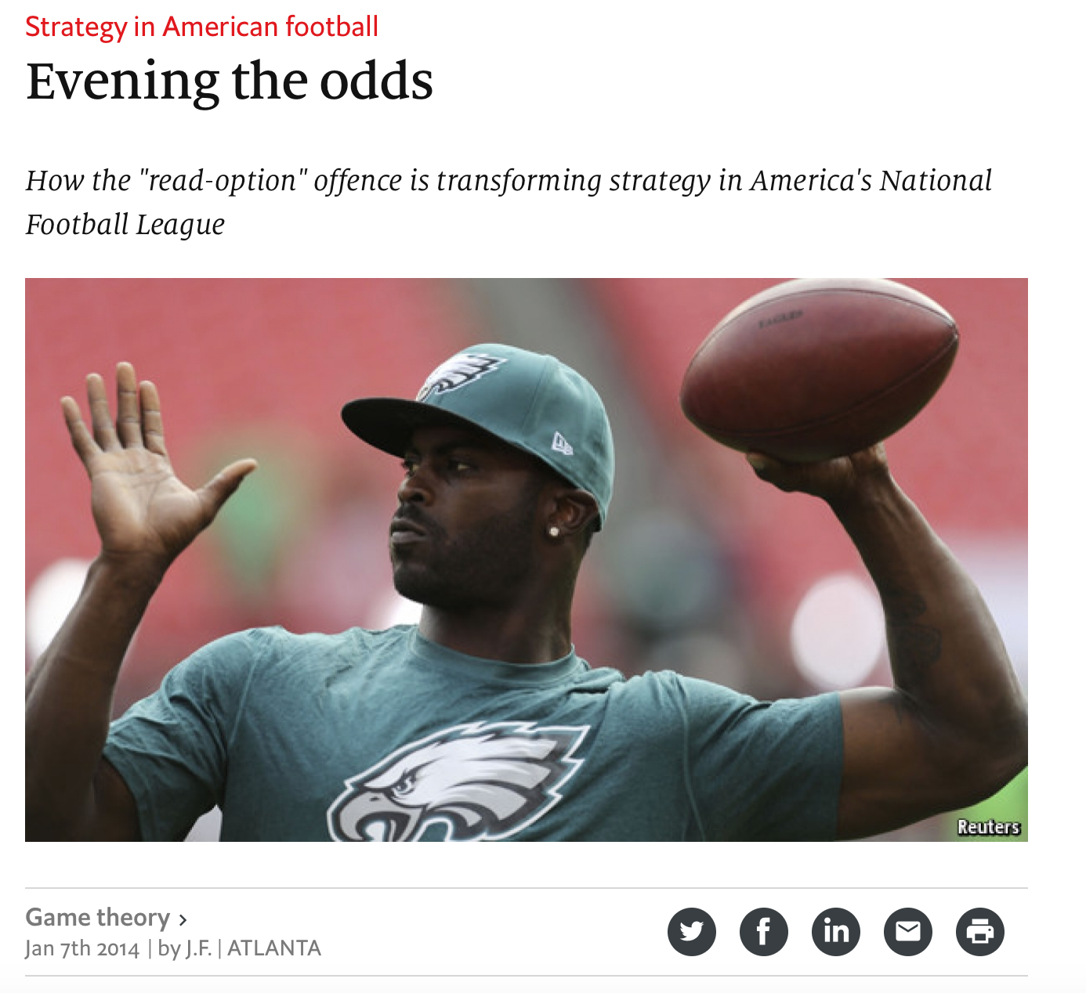
Game Theory and Real Football

Slide 24
Game Theory and Real Football
The examples given are certainly simple and have little relationship to actual football
However, game theory can be useful in the NFL when the following information from play-by-play data are available:
Play called by offense
Defensive formation/strategy
Down, line of scrimmage, yards to go and yards (expected/value points) gained on play

Slide 25
Game Theory and Real Football
To reduce the dimensionality of the problem we can combine the down and yards to go in groups. E.g.,
First and 10 (maybe separate for first and more than 10)
Second/Third and short (less than 3 yards to go)
Second/Third and medium (between 3 and 7 yards to go)
Second/Third and long (more than 7 yards to go)
Assume that we have 15 plays that an offense can call on 1st and 10, and 10 plays that the defense can call on 1st and 10

Slide 26
Game Theory and Real Football
Given the data we can determine the payoff matrix for this situation
i.e., there will be on payoff matrix for each situation
With 15 options at the offense and 10 at the defense we will have a matrix with 150 entries
These data could be available pretty soon and game theory could provide some useful insights

Slide 27
Game Theory and Basketball
In the past we talked for end-of-game strategy in basketball
We can perform the same analysis using game theory
Consider the case where the team is down 2 points
Defense has two options: Defend tightly the 2-point shot, defend tightly the 3-point shot
Offense has two options as well: Take the 2-point shot, take the 3-point shot

Slide 28
Game Theory and Basketball
We need to know the FG% for different options (open and contested shot)
Contesting a shot reduces the FG% significantly (Weill (2011))
 | Defense the 2 | Defend the 3
Shoot 2 | Contested 2 0.4*0.5 = 0.2 | Open 2 0.6*0.5 = 0.3
Shoot 3 | Open 3 0.45*1 = 0.45 | Contested 3 0.25*1 = 0.25
Weill, S. (2011). The Importance of Being Open: What optical tracking data says about NBA field goal shooting. Boston: MIT Sloan Sports Analytics Conference.

Slide 29
Game Theory and Basketball
Using Theorem 2 we can find that
The offense should attempt the three-point shot 66% of the time
The defense should contest the three-point shot 85% of the time
This is in agreement with our earlier findings in the same situation

Slide 30
Soccer Penalty Kicks
Penalty kicks are a two-person, zero-sum game
Two players are involved and the utility for the one player is equal to the cost for the other
There are three (pure) strategies for each player (kicker and goalie)
Shoot/Move to the right
Shoot/Move to the left
Shoot/Stay to the middle

Slide 31
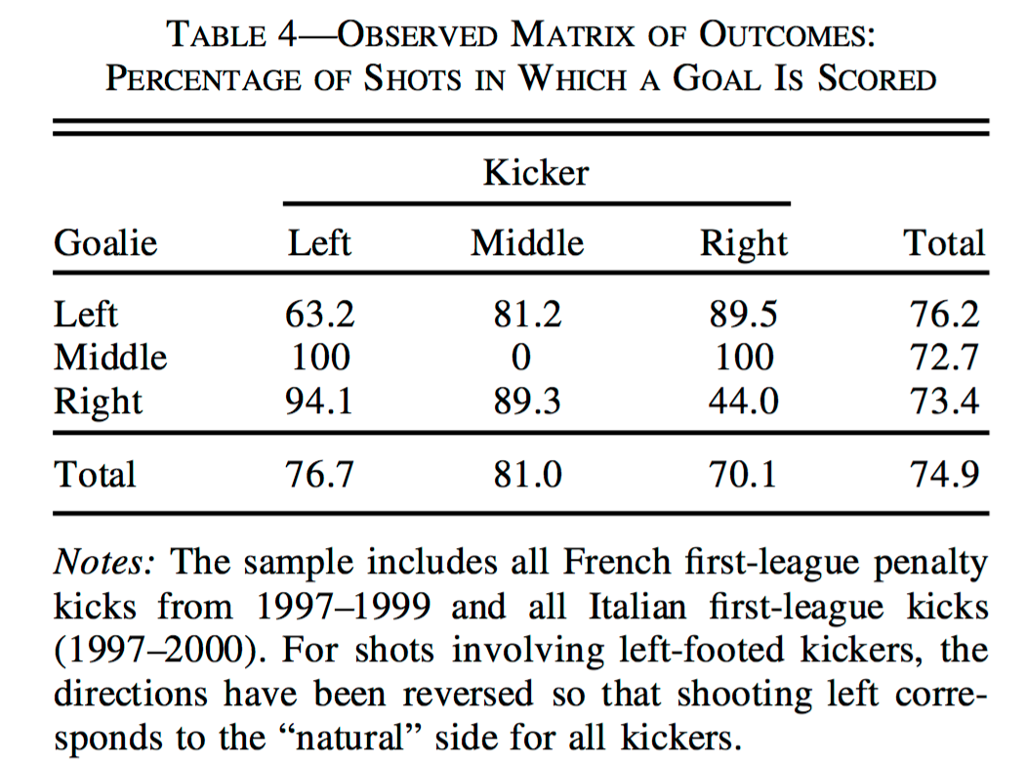
Soccer Penalty Kicks
How should kicker and goalie choose their strategy?
Chiappori, Levitt and Groseclose have built the game matrix using data from the Italian and French leagues
You will have to solve this game for homework

